Slide 1
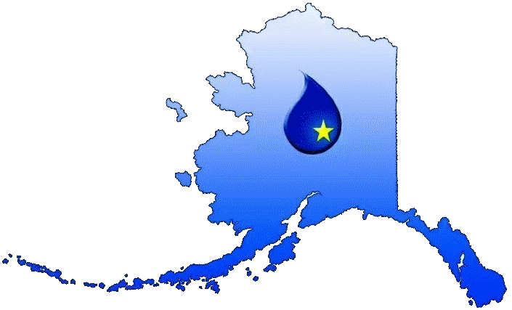
Alaska Rural Water Association
Prioritizing Water/Sanitation Capacity Needs Workshop
January 24, 2020

Slide 2
Who is ARWA?
A membership-based nonprofit established in 2001 operating under federal grants
USDA:
Two Water Circuit Riders
One Wastewater Circuit Rider
One Source Water Protection Specialist
EPA:
Formal classroom training
Affiliate of the National Rural
Water Association
31,000+ nationwide utility members
www.arwa.org

Slide 3
Communities Served
All communities under 15,000 in population are eligible for ARWA membership = All of Alaska except municipalities/cities of:
Anchorage, Fairbanks, and Juneau
Will provide technical assistance to non-members as well
But must be eligible for USDA loan funding to qualify
www.arwa.org

Slide 4
Organization
ARWA is governed by a member-elected Board of Directors:
President: Jana Littlewood, Bluff View Acres HOA
Vice-President: John Becker, City of Wasilla
Secretary: John Atchak, City of Chevak
Treasurer: David Kranich, Nikishka Bay Utilities
Director: Darryl Thompson, City of Togiak
Director: Dennis Moeglein, Ashton Park
Director: Vacant due to recent retirement
www.arwa.org

Slide 5
Staff
Robyn Dombroski, Executive Director
Kelly Comerford, Office Manager/Training Coordinator
Laren Kowallis, Circuit Rider
Sarah Ramey, Circuit Rider
Mark Wuitschick, Wastewater Technical Assistance and Training Specialist
Kevin Schoneman, Source Water Protection Specialist
www.arwa.org

Slide 6
Services Provided
Onsite training and technical assistance
Formal classroom training
Sanitary surveys
Backflow assembly testing
Consumer Confidence Reports
Leak detection
Level 1 and 2 Assessments
Source water protection plans
Sludge level evaluations
DMR reporting
Annual Training Conference
And much more!
www.arwa.org

Slide 7
Past Formal Training
Level I & 2 Operator Exam Training
OSHA - HAZWOPER, Confined Space Entry, Construction Safety, First Aid/CPR
Electrical Control Panel Troubleshooting
Consumer Confidence Report Training
Leak Detection, Mainline Flushing
Wastewater Lagoon Troubleshooting
Line Locating
Water Sampling
Water Chemistry
Alternative Disinfection UV/Ozone
Pumps and Motor Maintenance and Repair
Valve Exercising
Operator Math
And more!
www.arwa.org

Slide 8
Member Benefits
One of the most important but least visible benefits:
Membership dues support ARWA’s ability to represent the legislative interests of small water and wastewater utilities in Washington D.C., along with all the other state rural water associations (representing 31,000+ systems)
Example: Legislative efforts resulted in legislation (H.R. 1340 & S. 1578) that repealed the mailing requirement of the CCR if the system publishes the report on the Internet and provides a mailed report on request. In January 2013 the EPA released rule guidance that allows for electronic distribution of CCRs as a direct result of our collective nationwide effort.
www.arwa.org

Slide 9
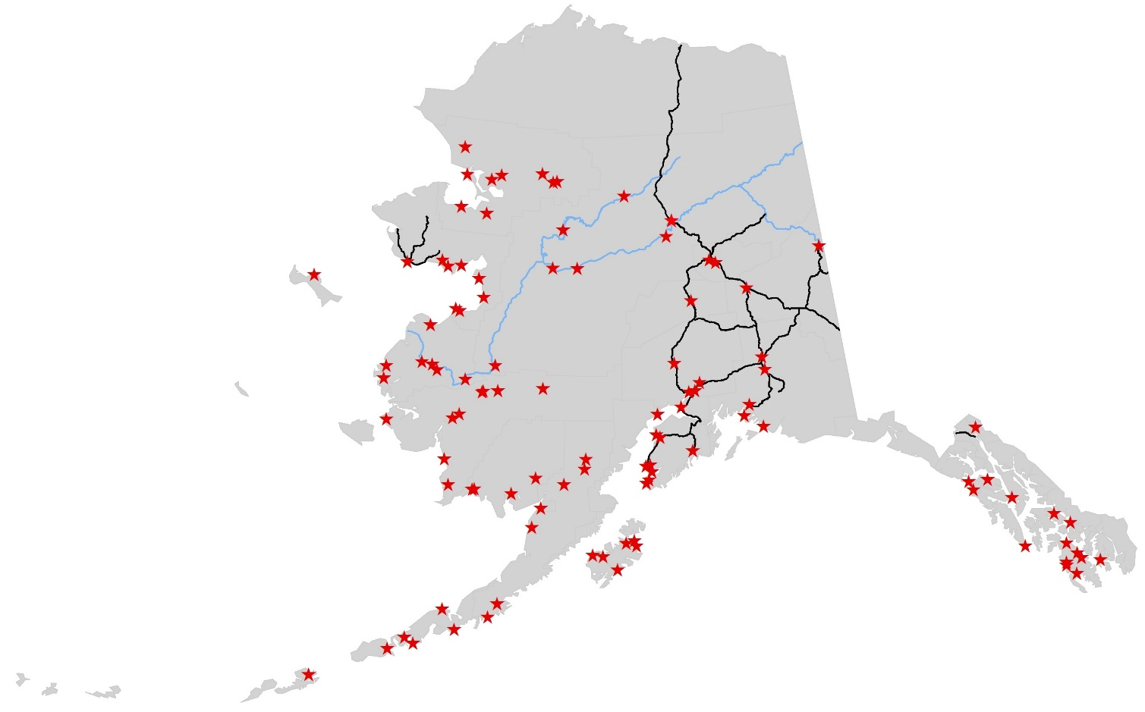
2019 Member Locations
www.arwa.org

Slide 10
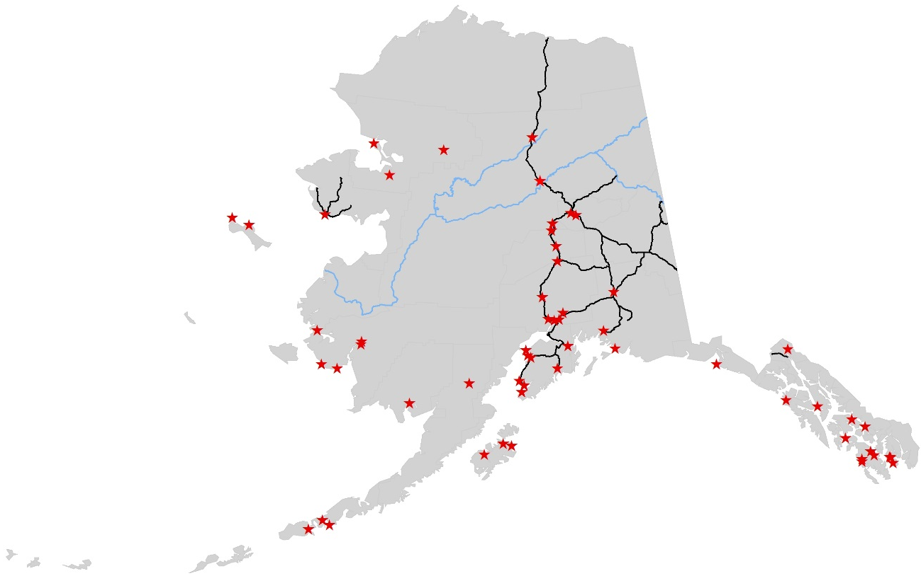
2019 Onsite Assistance
www.arwa.org

Slide 11
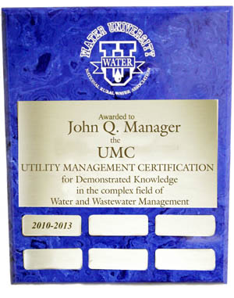
Water University
ARWA actively encourages utility operators to complete the Utility Management Certification (UMC) exam through the National Rural Water Association to join the growing national registry.
The purpose is to provide recognition and certification for experience and educational achievements in the field of water and wastewater management.
wateruniversity.org
www.arwa.org

Slide 12
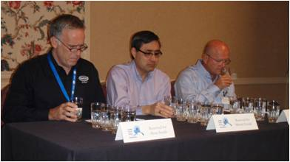
Water Taste Test Contest
Held at ARWA’s Annual Training Conference
Past Winners:
2019: City of Whittier
2018: City of Whittier
2017: Toksook Bay
2016: City of Homer
2015: City of Whittier
3rd place nationally
2014: City of Whittier
2013: McKinley View Estates
2012: City of Wasilla
2011: City of Wasilla
2010: Nikolaevsk
2009: Pioneer Wells
2008: Nome Joint Utility
2007: City of Whittier
2006: City of Whittier
2005: City of Valdez
2004: Lower Kuskokwim School District, Kipnuk
1st place nationally
www.arwa.org

Slide 13
Water Poster Contest
Program started at the 2011 Annual Training Conference to support Source Water Protection outreach directed to tomorrow’s leaders
Has been very well received
300+ submissions each year from all around the state
Announcements sent to all school districts throughout the state annually
Three divisions: K-2, 3-5, and 6-8
Winners receive $100 and school supplies for their class
ARWA is always looking for additional support for the prizes!
www.arwa.org

Slide 14
Newest National Initiative
Apprenticeship Program!
Nationally, the water sector is expected to lose between 30-50% of the workforce to retirement over the next decade
In a proactive approach, NRWA has developed the apprenticeship program
Certified through USDOL in July 2017
Beginning to be implemented in other states
AK has some unique challenges we are trying to work through to get it (hopefully) started
Stay tuned!
www.arwa.org

Slide 15
Partners
Some of the organizations we interact and partner with on a regular basis:
www.arwa.org

Slide 16
Questions?
Alaska Rural Water Association
1075 Check Street, Suite 106
Wasilla, AK 99654-8067
907-357-ARWA (2792)
www.arwa.org

