Slide 1

Remote Maintenance Worker (RMW) Program Overview
Tammy Helms
RMW Program Manager
Division of Water
Department of Environmental Conservation
Notes:
Lived in LB for 15 years
Primary WPO for approx. 14 years from 1990-2005.
LB assigned RMWs- Kent Knapp & Steve Evavold
Received WD OIT & WT1 in 1994 –WT1 cert still active and have enough primary op time to qualify for WD1 & WT2
Operator pay
City Clerk for 12 years
After leaving LB worked for the RUBA program for 14 years

Slide 2

$
Over one billion dollars in State and Federal funds have been spent to construct or upgrade water and wastewater infrastructure in rural Alaska
Notes:
Fun Fact! 1 billion $$
Intro to next slide…The funding agencies began to notice that the infrastructure was quickly failing or not being maintained. In response…

Slide 3
Creation on RMW program
The Remote Maintenance Worker (RMW) Program was created to protect the water and wastewater infrastructure investment in rural communities.
The program is funded by the State, EPA and USDA-RD

Slide 4
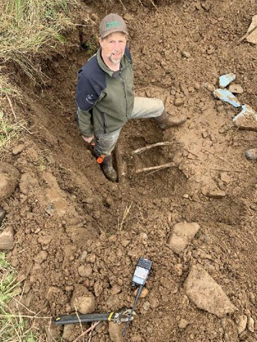
RMW Goal
Develop the local capacity of rural Alaskan communities and individuals to provide and sustain public health protection while safeguarding state, federal, and community capital investments.

Slide 5
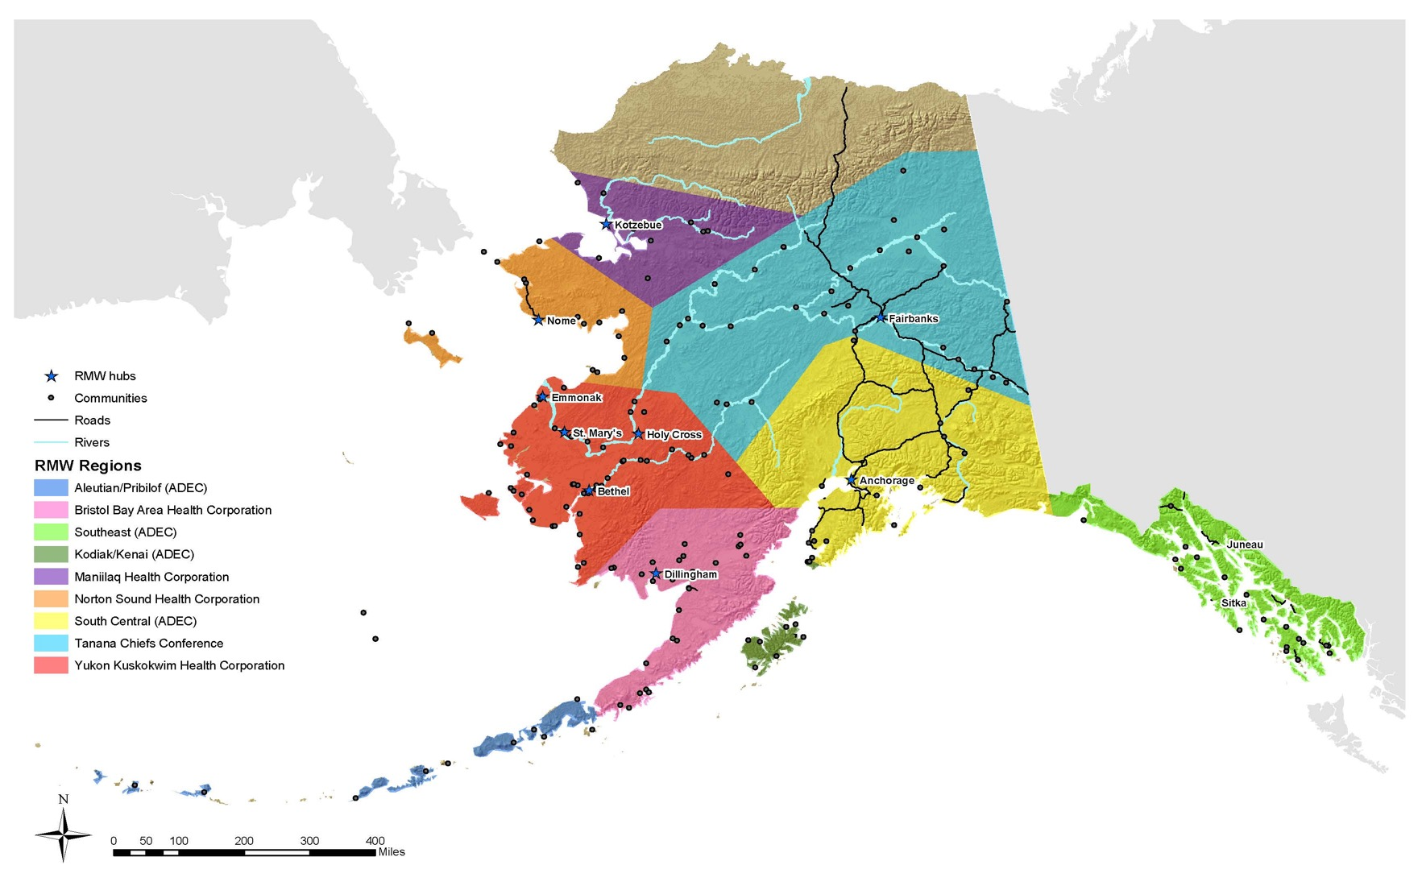
Staff based regionally
approximately 12 active
communities each
Notes:
In addition to the 164 actively assigned communities, there are 32 advisory communities.

Slide 6
RMW Program Supports
3 full time RMW field positions and a RMW program coordinator employed by DEC.
11 full time, and one half time RMW positions employed through grants to five separate non-profit entities.
Bristol Bay Area Health Corp.
Maniilaq Association
Norton Sound Health Corp.
Tanana Chiefs Conference
Yukon Kuskokwim Heath Corp.
DEC
Notes:
Currently, 11 of the 14.5 field RMW positions are filled. Recruitment for the vacant positions are on going.

Slide 7
Emergency repair equipment for loan
Preventative Maintenance Plans
Assistance attaining certification
Services
Training on backwashing, maintenance, and monthly monitoring
Troubleshooting
On-site training and assistance
Emergency assistance to prevent system failures
Identification of critical parts
Regional training courses

Slide 8
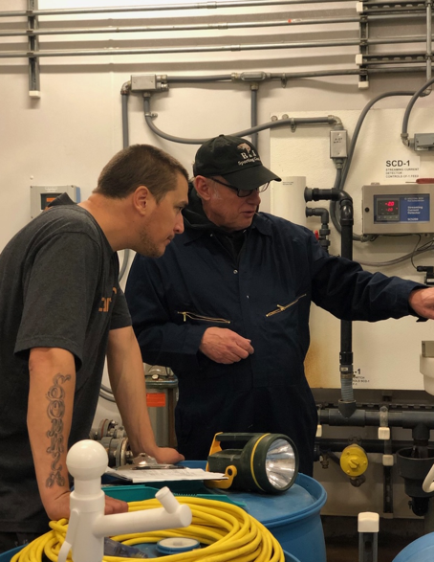
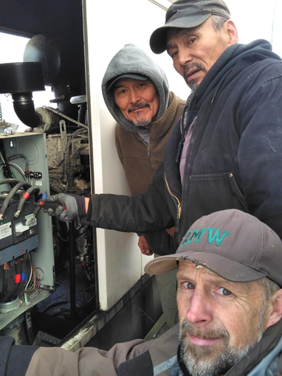
SFy19
186 communities received on-site training and technical assistance and operations and maintenance (O&M) support
291 routine trips
52 emergency trips
2,465 hours of on the job training
11 training courses
4,394 phone calls from communities

Slide 9
Success
A large factor for the program’s success comes from the RMWs relationship with the communities and the knowledge of the RMWs due to their longevity with the program.
Bruce Werba, YKHC, 24 years
Allan Paukan, YKHC, 22 years
Steve Evavold, DEC, 21 years
Billy Westlock, YKHC, 17 years
Bob White, YKHC, 12 years
Notes:
96 years

Slide 10
Contact information
Tammy Helms
Program Manager
Technical Assistance and Finance
Division of Water
ADEC
269-7613
tammy.helms@alaska.gov
    RMW website: http://dec.alaska.gov/water/rmw/index.htm

