Slide 1
RCAC envisions vibrant, healthy and enduring rural communities throughout the west.
Kristin K’eit
Regional Field Manager – AK, OR, WA
Anchorage, AK

Slide 2
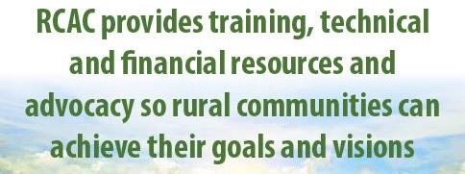
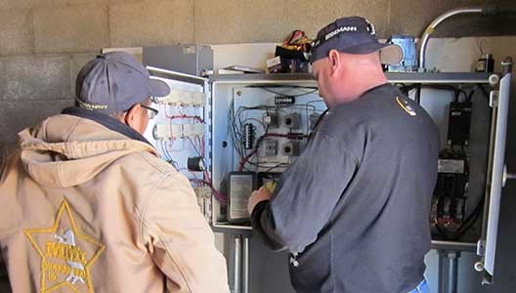
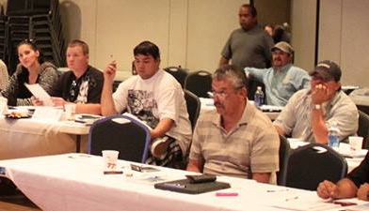
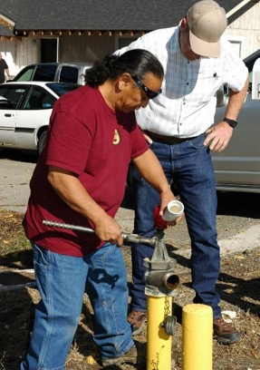
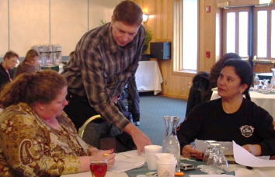
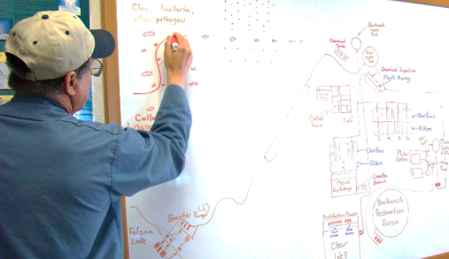

Slide 3
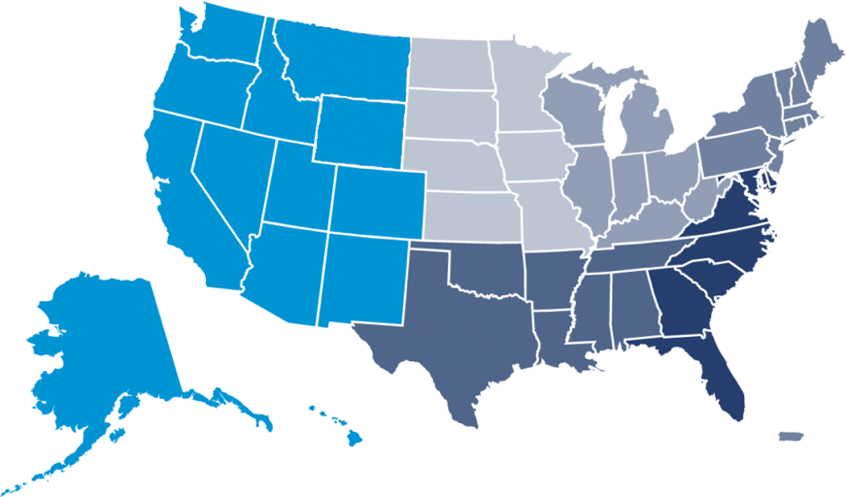
RCAC
Non-Profit Corporation operating in the western 13 states
Corporate office in
West Sacramento
155+ employees, about 70% in field offices
Alaska Board Member Megan Alvanna Stimpfle, Principal Strategist, Arctic Geopolitical Consulting
Alaska
Arizona
California
Colorado
Hawaii and other
Pacific Islands
Idaho
Montana
Nevada
New Mexico
Oregon
Utah
Washington
Wyoming

Slide 4


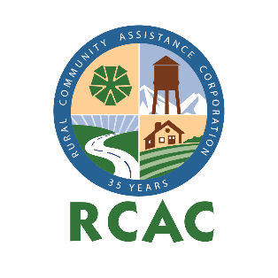
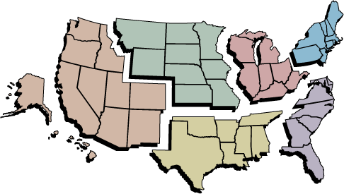

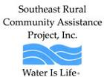
Rural Community Assistance Partnership (RCAP)

Slide 5
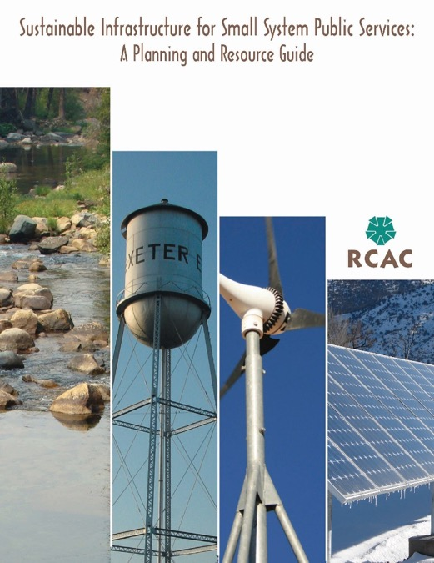
RCAC Services Overall
Training in-person, online webinars, recorded webinars
Technical Assistance (TMF)
Publications for training, educational and informational materials, newsletters

Slide 6
RCAC Departments
Community and Environmental Services (CES)
  Community and Economic Development
  Drinking Water and Wastewater Infrastructure and TMF TA and Training
  Systems Regionalization
  Rate Studies and Household Income Surveys
Affordable Housing
Loan Fund

Slide 7
RCAC Community & Economic Development Programs
Comprehensive services for communities from creating their vision, identifying champions and partners, setting goals, and implementing their action plan.
Building Rural Economies (BRE)
WealthWorks West hub
Leadership Development
Economic Development

Slide 8
RCAC Environmental Programs
EPA Region 10 Environmental Finance Center (EFC)
Regionalization Program
Income Surveys – Median Household Income (MHI) and Percent Low and Moderate Income (LMI)
Financial Capacity Analysis (Rate Studies)
Asset Inventory and Asset Management Planning

Slide 9
RCAC Housing Programs
Housing Development and TMF TA
USDA RD Mutual Self-Help Housing program
USDA RD 502 Single Family Housing Loan packaging

Slide 10
RCAC Loan Fund
Community Facilities
Small Business
Water and Wastewater Infrastructure
  Primarily Gap Funding & Small Loans
  Will Loan Against Future Revenues
  Quick Turnaround

Slide 11
RCAC’s Funding Sources for Environmental Services in Alaska
US Health & Human Services
  Free on-site and distance Technical Assistance and Training (TAT) to drinking water and wastewater systems in low income communities.
Technitrain
  Free on-site and distance TAT to drinking water, wastewater and solid waste systems, including grant and loan applications, as approved by USDA RD in AK.
  Free GIS mapping of a system’s drinking water and wastewater assets.

Slide 12
RCAC’s Funding Sources for Environmental Services in Alaska
EPA1
  Free on-site and distance compliance assistance for Technical capacity to drinking water systems
  Includes for profit systems.
EPA3
  Free on-site and distance compliance assistance for Technical, Managerial and Financial capacity to wastewater systems.

Slide 13
Kristin K’eit
kkeit@rcac.org 907-764-8798
www.rcac.org

