Slide 2
TUS: Tribal Utility Support
An Overview
Presenter: Brian Menghini, PE
Engineering Project Manager IV
TUS, ANTHC
January 24, 2020

Slide 3
TUS Within ANTHC
ANTHC
DEHE – Division of Environmental Health and Engineering
DRUMS – Department of Rural Utility Management Services
TUS – Tribal Utility Support
ARUC – Alaska Rural Utility Collaborative

Slide 4
Organizational Chart
DEHE
DRUMS
Project Management
Engineering/ Design
Construction
Quality
Department of Rural Utility Management Services
Health and Safety
TUS
ARUC Operations
ARUC Business
Energy
National Tribal Water Center
TUS: Tribal Utility Support
ARUC: Alaska Rural Utility Cooperative

Slide 5
TUS Roles
Water treatment, water distribution, wastewater collection/disposal
Operator training
New construction
New operators
Small projects
Repairs
Upgrades
Retrofits
Remote monitoring installation
Troubleshooting problems / Community Support

Slide 6
Who is TUS?
Engineers
Operations Specialists
Electrician
Purchaser

Slide 7
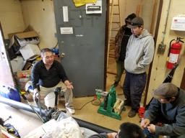
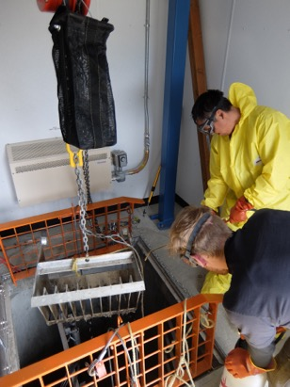
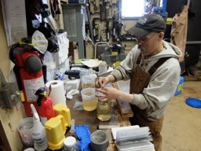
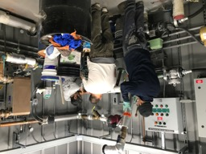
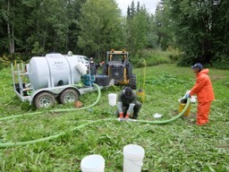
TUS Snapshot

Slide 8
Operator Training
New Construction
Provide O&M materials
Wall charts
Maintenance checklists
Log sheets
Facility labeling
Onsite training (Multiple trips)
Provide MTO for critical spare parts and needed supplies
Callback Support

Slide 9
TUS Small Projects
Too small for DEHE construction group to complete cost efficiently
Projects flow down to TUS from DEHE PM group
Minor equipment upgrades
Process controls upgrades
Energy efficiency upgrades, building weatherization
Electrical upgrades

Slide 10
TUS Technical Capabilities
Water Treatment Plant
Plumbing
Pumps
Instruments
Minor electrical
Lift Station
Pump upgrades
Controls
Heating, lighting
No structural repairs
No Water/Sewer Mains
Minimal civil work

Slide 11
TUS Community Support and
Emergency Response
Direct calls from operator
Request from RMW group
Request from PM
Funding
Very limited TUS program funding
RMW group first line of defense
Emergency funds

Slide 12
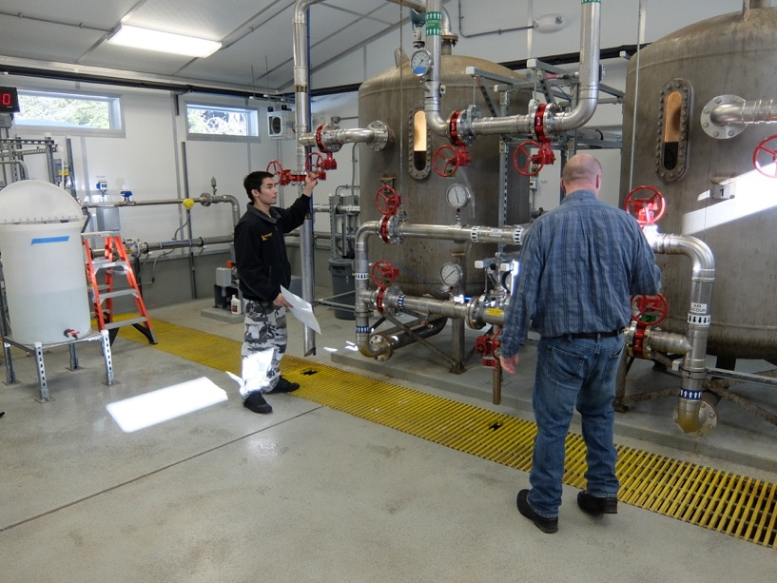
Training

Slide 13
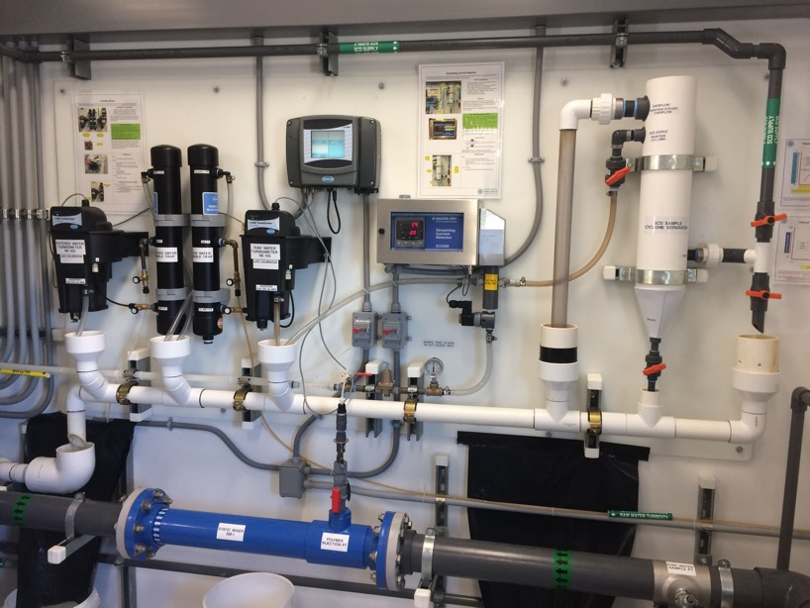
Training

Slide 14
Training

Slide 15
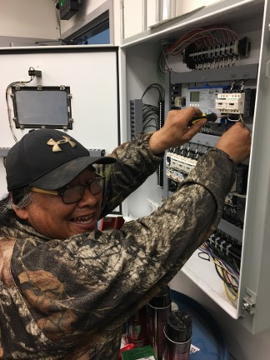
Critical Element
The operator is essential
Notes:
Alex Tom – St. Michael Operator

