Slide 1
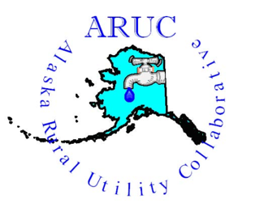
Alaska Rural Utility Collaborative
Francine Moreno
Sr. Program Manager

Slide 2
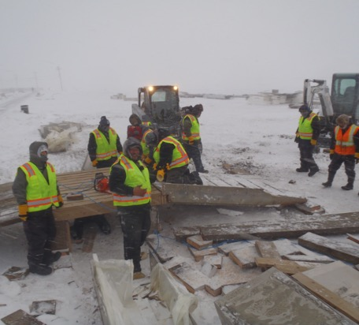
ARUC Background and Purpose
Piloted in Bethel as “RUC” – 6 communities
  Economies of scale
Partnership – 26 vs. 1
Management, operations & maintenance of
water and wastewater systems –
sustainability
Billing and collections of utility service &
management of monies
Network and advocate with project managers and funding agencies for community projects

Slide 3
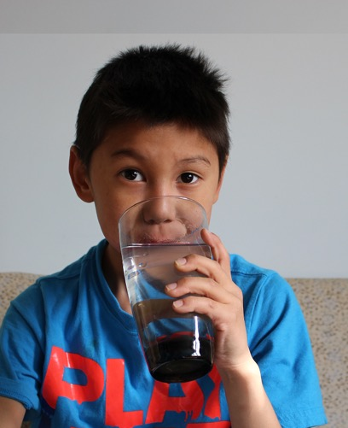
Why?
Extend system’s useful life
Build capacity within rural
communities
Protect the health of those we
serve

Slide 4
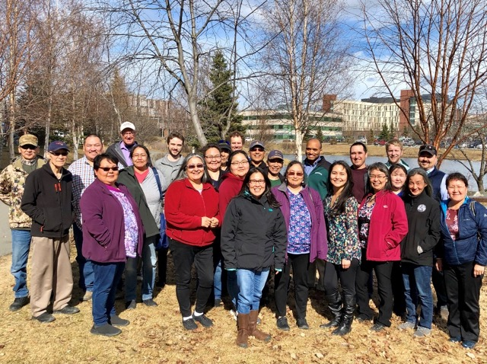
Capacity Building
  Operator training and certification
    Operator exchange program
  Financial decisions by local
  leadership
    Large purchases, community
    funded projects, unique
    collection efforts
  Advisory committee member
  from each community
    ARUC program direction and
    rates
  Each community continues to
  own their system infrastructure
  and employ operators

Slide 5
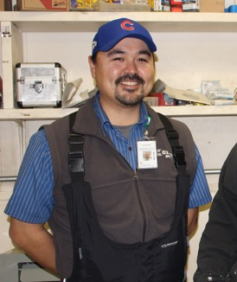
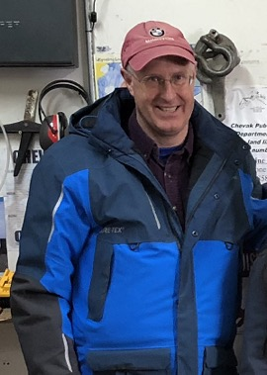
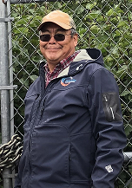
ARUC Structure
17 ARUC staff
  Free to communities – funded by grants,
  projects, ANTHC $
Regional managers
  Bethel
  Kotzebue
  Anchorage

Slide 6
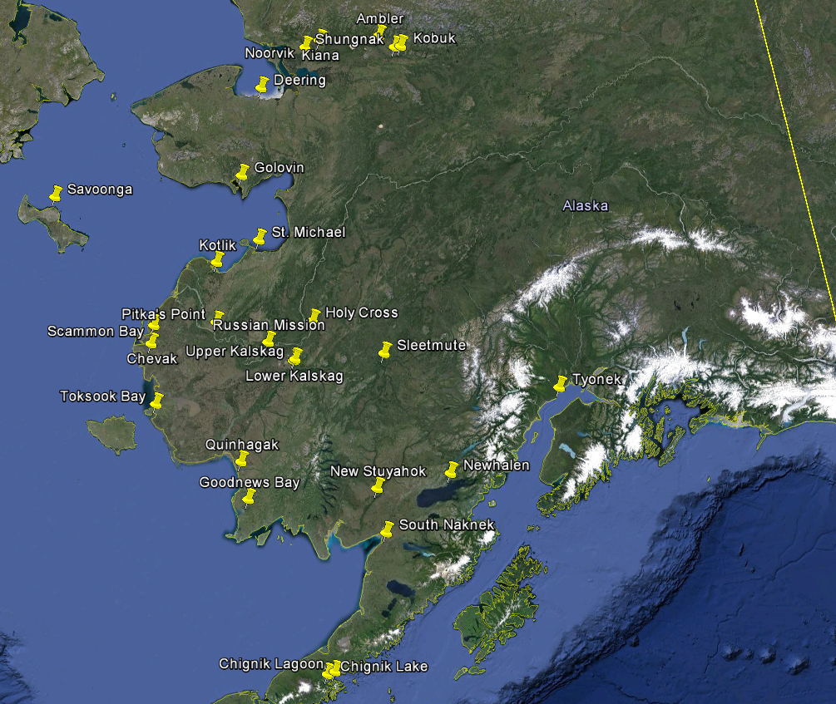
Communities in the ARUC
Ambler
Chevak
Chignik Lake
Deering
Golovin
Goodnews Bay
Holy Cross
Kiana
Kobuk
Kotlik
Lower Kalskag
Newhalen
New Stuyahok
Noorvik
Pitka's Point
Quinhagak
Russian Mission
Savoonga
Scammon Bay
Shungnak
Sleetmute
South Naknek
St. Michael
Toksook Bay
Tyonek
Upper Kalskag

Slide 7
ARUC Water/Wastewater Rates

Slide 8
Reserves

Slide 9
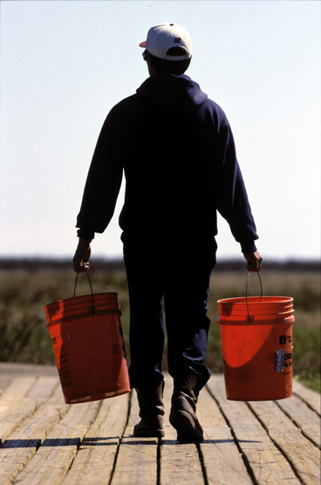
ARUC’s Purpose
Empower communities in rural Alaska to sustainably provide safe water and sanitation services
Ensure our communities never go back to
honey buckets
https://www.youtube.com/watch?v=eHlcEm8uHVM

Slide 10




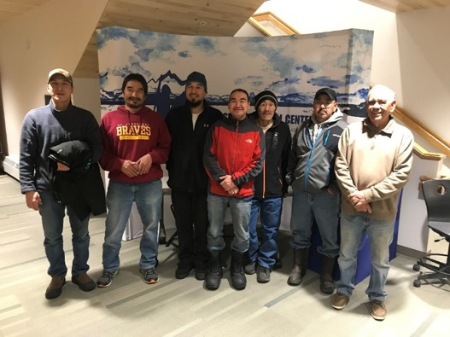
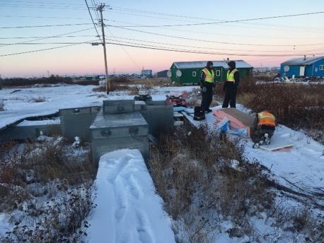


Community Utility Assistance Program (CUAP)
Reduce average residential water/sewer rates by two-thirds
Reduce the cost and number of emergencies through proper Preventative Maintenance performed by operators
Provide regional training and support for operators and administrators
Increase Construction grant possibilities for communities through increasing Best Practice scores

Slide 11
CUAP Results
Preventative Maintenance Plans from 27% to 80%
Revenue collections up from 88% to 102%
Best Practice scores up from 74 to 83 (highest in the state)
Rural operator certification pass rate up from 7-8% to ~35%
Community | Pre CUAP Rate | Percent Reduced | CUAP Rate | Individual Household Yearly Savings
•Ambler | $210 per month | 66% | $71.40 per month | $1,663
•Buckland | $175 per month | 66% | $59.50 per month | $1,386
•Deering (Sewer Only) | $105 per month | 66% | $35.70 per month | $832
•Deering (Water Only) | $.25 per gallon | 66% | $.085 per gallon | $16.50 per delivery
•Kiana | $140 per month | 66% | $47.60 per month | $1,109
•Kivalina | $.05 per gallon | Rates were already subsidized by the City of Kivalina | $.05 per gallon | $29,120 Saved by City
•Kobuk | $200 per month | 66% | $68.00 per month | $1,584
•Noatak | $138 per month | Have Not Joined Program | $46.92 Per Month | $1,093
•Noorvik | $157.50 per month | 66% | $53.55 per month | $1,247
•Shungnak | $180 per month | 66% | $61.20 per month | $1426
•Selawik | $250 per month | 66% | $85.00 per month | $1980
 | 6/2018 Pre-CUAP | Sep-19
Ambler | 96% | 105%
Buckland | Unknown | 96%
Deering | 111% | 101%
Kiana | 102% | 100%
Kivalina | N/A | 97%
Kobuk | 85% | 134%
Noatak | Unknown | Unknown
Noorvik | 95% | 106%
Shungnak* | 83% | 73%
Selawik | 41% | 106%
AVERAGE | 88% | 102%

Slide 12

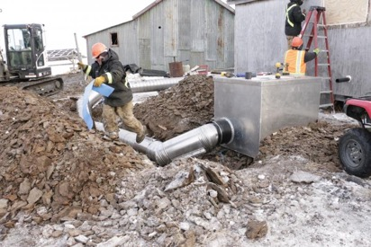
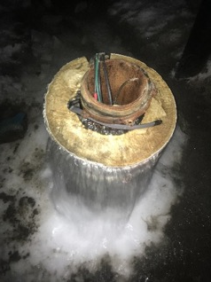
What can other regions do?
3 out of 4 CUAP goals if no $
  Reduce the cost and number of emergencies through proper Preventative Maintenance performed by operators, improved O&M
  Increase revenues to have $ available to pay expenses, perform O&M and send operators to certification training
  Increase construction grant possibilities for communities through increasing Best Practice scores

Slide 13
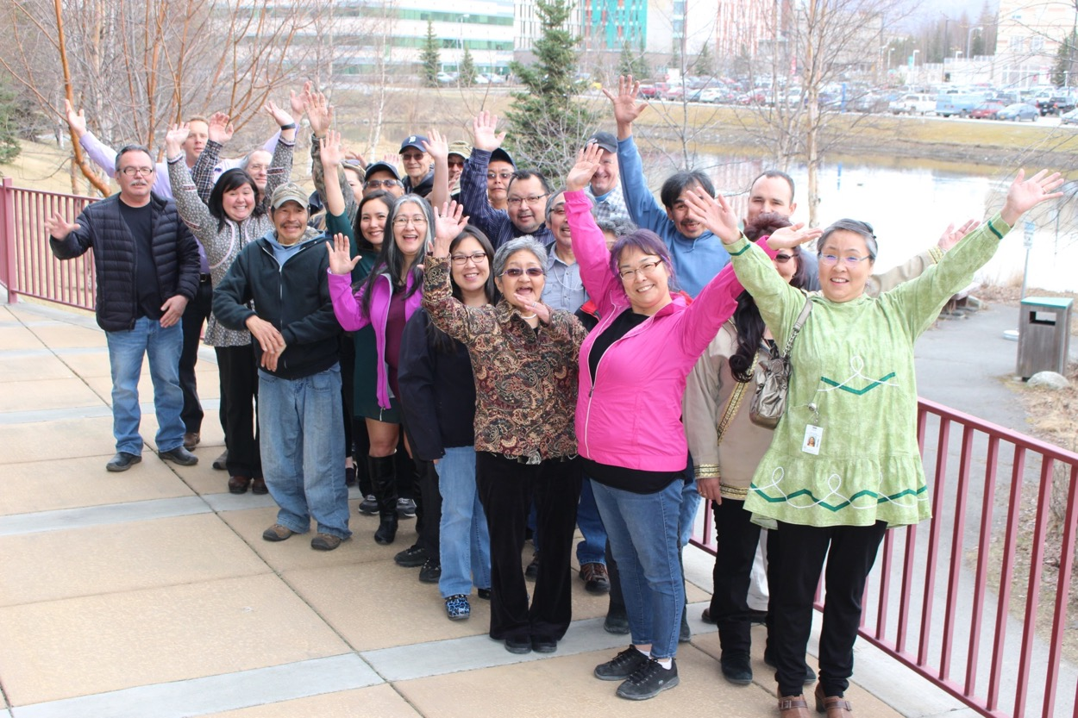
Questions?

Slide 14


Slide 15


