Slide 1
Asset Management
For Water and Wastewater Infrastructure
Presented by:
Shilo Williams

Slide 2
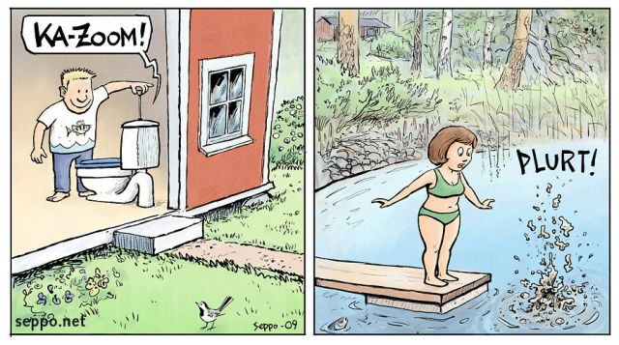
Definition of Asset Management
A process for maintaining a desired level of service for what you want your assets to provide at the lowest life-cycle cost.
Lowest life-cycle cost refers to the best appropriate cost for rehabbing, repairing, or replacing an asset

Slide 3
Asset Management
A high-performing asset management program incorporates asset inventories, O&M tasks, and long-range financial planning to build system capacity, and it puts systems on the road to sustainability.
Basically- it’s a way to effectively and affordably manage your infrastructure.

Slide 4
Benefits of Asset Management
Prolonged asset life and aiding in rehabilitation and replacement decisions through efficient and focused O&M
Meet customer demands
Set rates based on sound operational and financial planning
Budgeting focused on activities critical to sustained performance

Slide 5
Benefits of Asset Management
Meet service expectations and regulatory requirements
Improve responses to emergencies
Improve the safety and security of assets
Reduce overall costs for both operations and capital expenditures

Slide 6
What Are Assets?
Tangibles that are used in the operation of a drinking water or wastewater utility
Buildings
Tools
Equipment
Pipes
Machinery
Operator

Slide 7
Why Care About Managing Your Assets?
Managing assets will help your utility be more efficient and financially self sufficient
ULIMATE GOAL: Protection of public health and efficient, sustainable utilities

Slide 8
recognition
AM has gained recognition all across the world, and across all infrastructure heavy sectors due to its effectiveness in maximizing the value of capital as well as O&M expenditures.

Slide 9
The 5 Core Questions of Asset Management
1. Current State of Assets
2. Level of Service
3. Critical Assets
4. Minimum Life Cycle Costs
5. Long-term Funding Plan

Slide 10
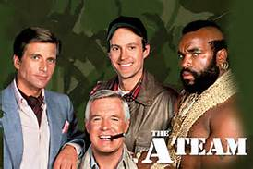
Effective Asset Management Implementation
Assemble a TEAM!
Asset Management is not a one-person job.
Tap into all of your resources.
Who should be on your team?

Slide 11
SE Communities
Craig
Klawock
Kassaan
Saxman
Metlakatla
Angoon
Wrangell
Hoonah
Skagway
Haines
Klukwan
Yakutat

Slide 12
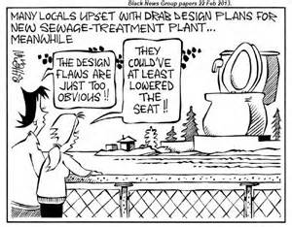
Find an asset management template or program that will work for you
Many to choose from
Depends on what “bells and whistles” you want/need
Cost is usually a factor

Slide 13
Check up program for small systems (CUPSS)
EPA-Based
Free!
Easy to use
Does not require internet connection
On-line and self-paced training
Can prepare a full asset management plan in 10 steps

Slide 14
What can cupss do?
Track Your:
Inventory
Tasks- O&M
Finances
This process will help develop a personalized asset management plan.

Slide 15
Considerations when starting asset management
Will not happen overnight
Start-up will likely require $$
Gain community support- Let them know what you are up to
Living document. Requires continual input.

Slide 16
The end result!
Implementing AM can help identify the full costs of operating your utility
Address high-priority asset needs that are critical to your utility’s performance
Better decision making
Better pricing and asset valuation
Improve your TMF capacity

Slide 17
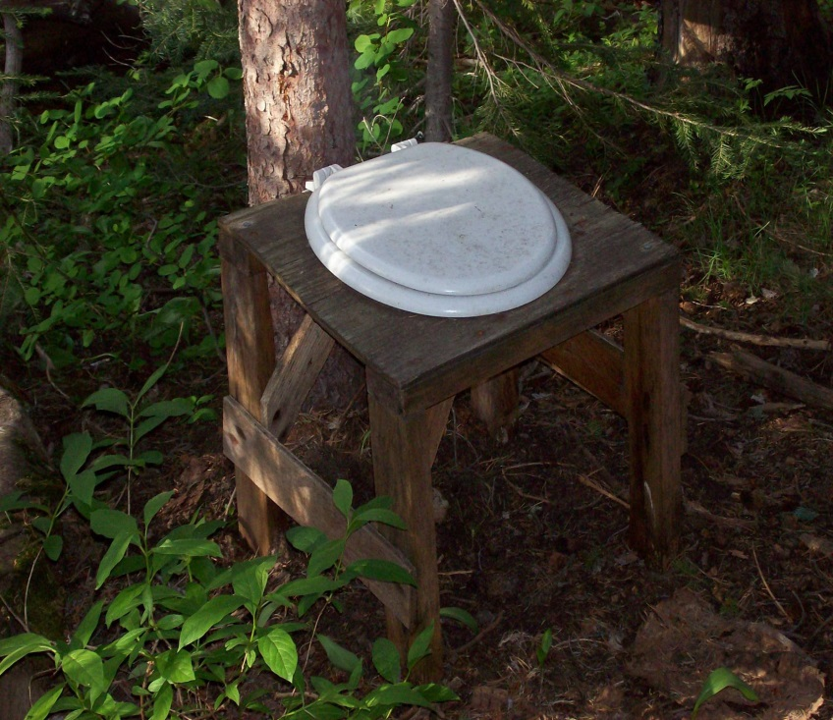
QUESTIONS?
Shilo Williams
100 Lincoln St
Sitka, AK 99835
907-747-4071
shilo.Williams@cityofsitka.org

