Slide 1
“Small” Community Sampling: Tracking SARS-CoV-2 in Municipal Wastewater in Juneau, Alaska
Lori Sowa, PE
CBJ Utilities Engineer

Slide 2
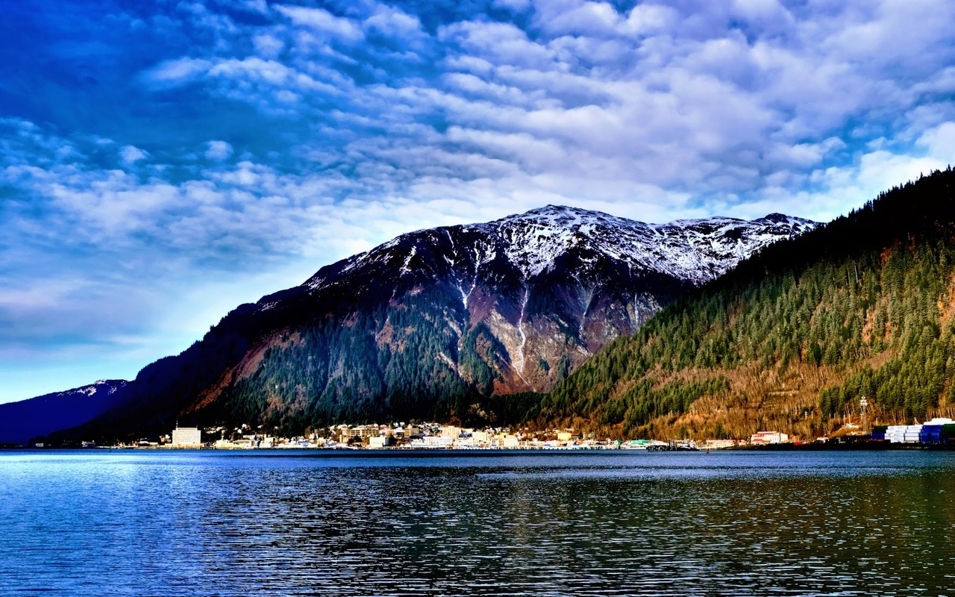
“Small” Community Sampling:
Tracking SARS-CoV-2 in Wastewater in Juneau, Alaska
Lori Sowa, PE

Slide 3
How did we get started?
Phone call from ADEC asking about sampling equipment, interest
Followed news reports, articles on WW testing
Watched CDC webinar (July 2019), started doing some independent research (The Water Research Foundation, UAA contacts)
Started discussions with City Manager, Emergency Ops folks
Interest from the public
Decision point:
Are we going to get useful information out of this effort?
CBJ Assembly allocates $75k in funding through CARES Act for testing

Slide 4
Program Development
Site specific sampling? Goal: Presence of virus in wastewater identify outbreaks in high risk settings
Identified sites of interest (Pioneer home, LCCC, schools)
Looked for sampling locations – access, staffing
Grab samples?
Whole community surveillance? Goal: Collect trend information to help inform community risk level and public health recommendations
Influent composite samplers at 2/3 plants, need to install one more
Coordinate sample collection with staff availability
Where can we get the samples analyzed? How soon can we get results?
Commercial lab identified, week turnaround for results, need to ship early in week
How will we use this data and share it with the public?
Another metric in the Risk Mitigation Matrix

Slide 5
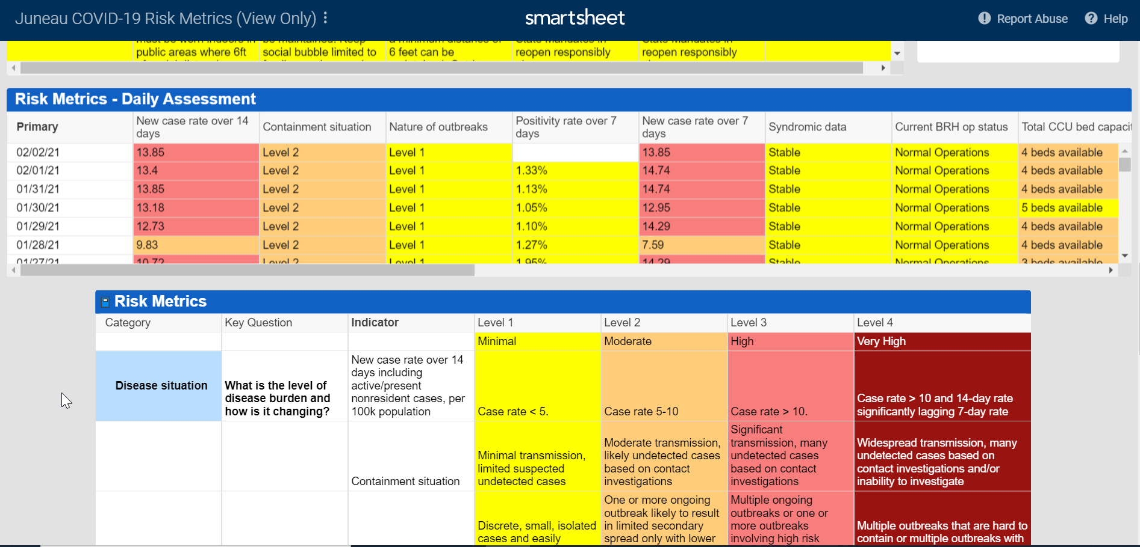
Notes:
Goal was to compliment other metrics, another tool

Slide 6
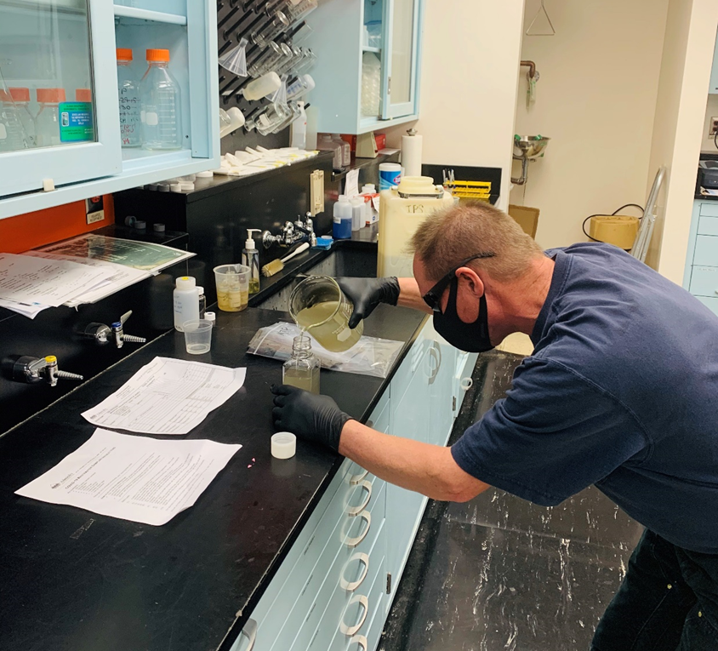
CBJ Sewage Surveillance Program
Samples collected from each of the three WWTPs 2x per week, sent to lab for analysis.
Why sewage surveillance?
Can be an indicator of relative prevalence of the virus in the community, and help with public health decision making.
Can detect virus present in the community independent of testing behavior, including asymptomatic cases.
Challenge: many variables!

Slide 7
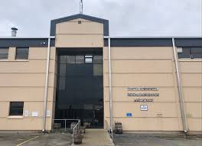
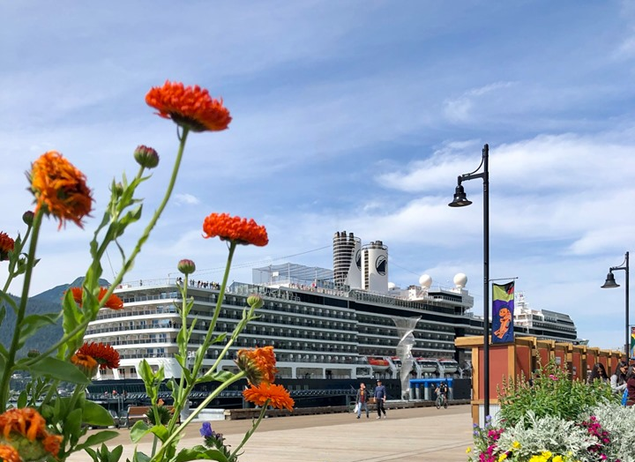
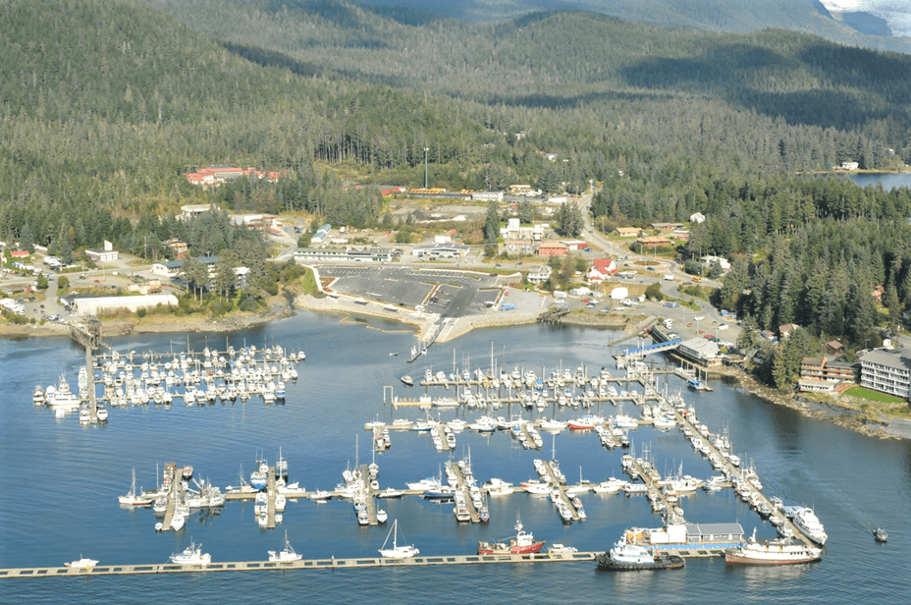
~80% of homes/businesses connected to municipal sewer system
Mendenhall Treatment Plant (MTP)
Avg Flow 2 MGD
Landfill Leachate
Brewery Waste
Fish processing
Juneau Douglas Treatment Plant (JDTP)
Avg Flow 1 MGD
Cruise ship WW
Downtown
Auke Bay Treatment Plant (ABTP)
Avg Flow 0.05 MGD
University of AK Southeast

Slide 8
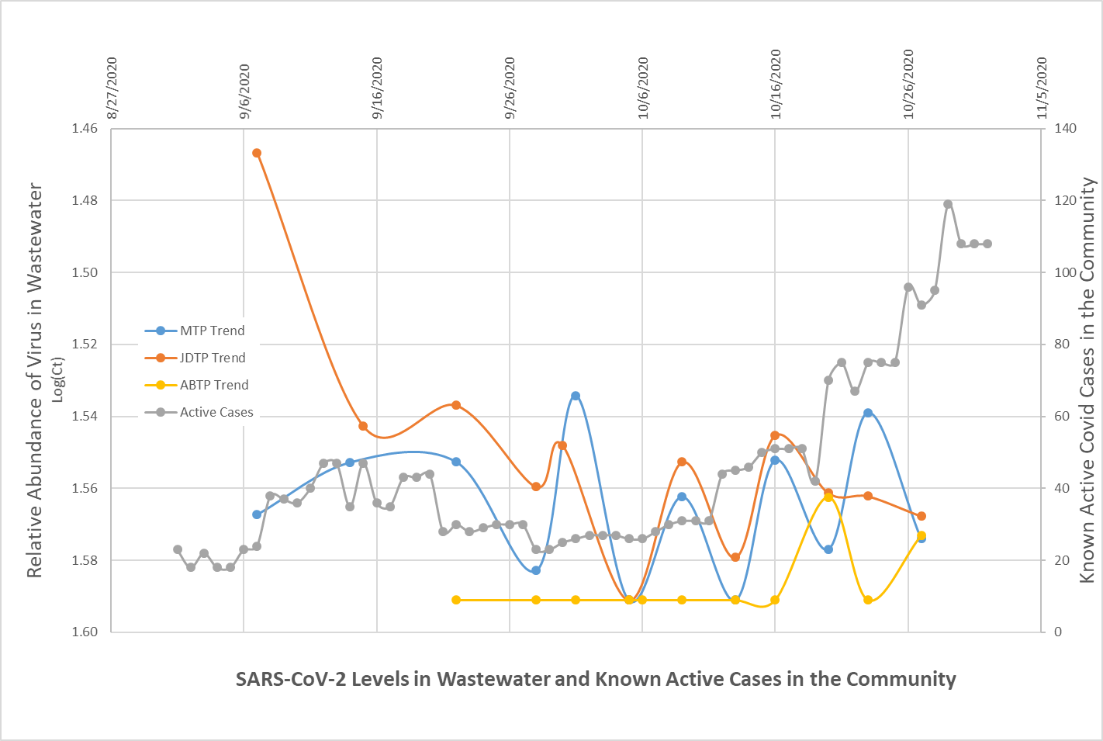
Notes:
First graph that I circulated. Active case data based upon local EOC data from Juneau PH. This data is for the full community and is not broken down by location into “sewersheds”. We discussed trying to work with public health to get more data on the location of the cases, but PH was already overloaded and there were some privacy concerns. Anecdotally, we know that one of our first clusters was related to a wedding and bars located downtown, notice the large hit we got at our JD plant. Second, we weren’t seeing any detections at AB until mid-October, a few weeks later there was a cluster at UAS. With only getting Ct values, really couldn’t do much quantitatively to try to flow weight the data. Also wasn’t getting any QC with the results, which made me nervous spending public funds. So started looking for a lab that could provide results in GC/100 mL

Slide 9
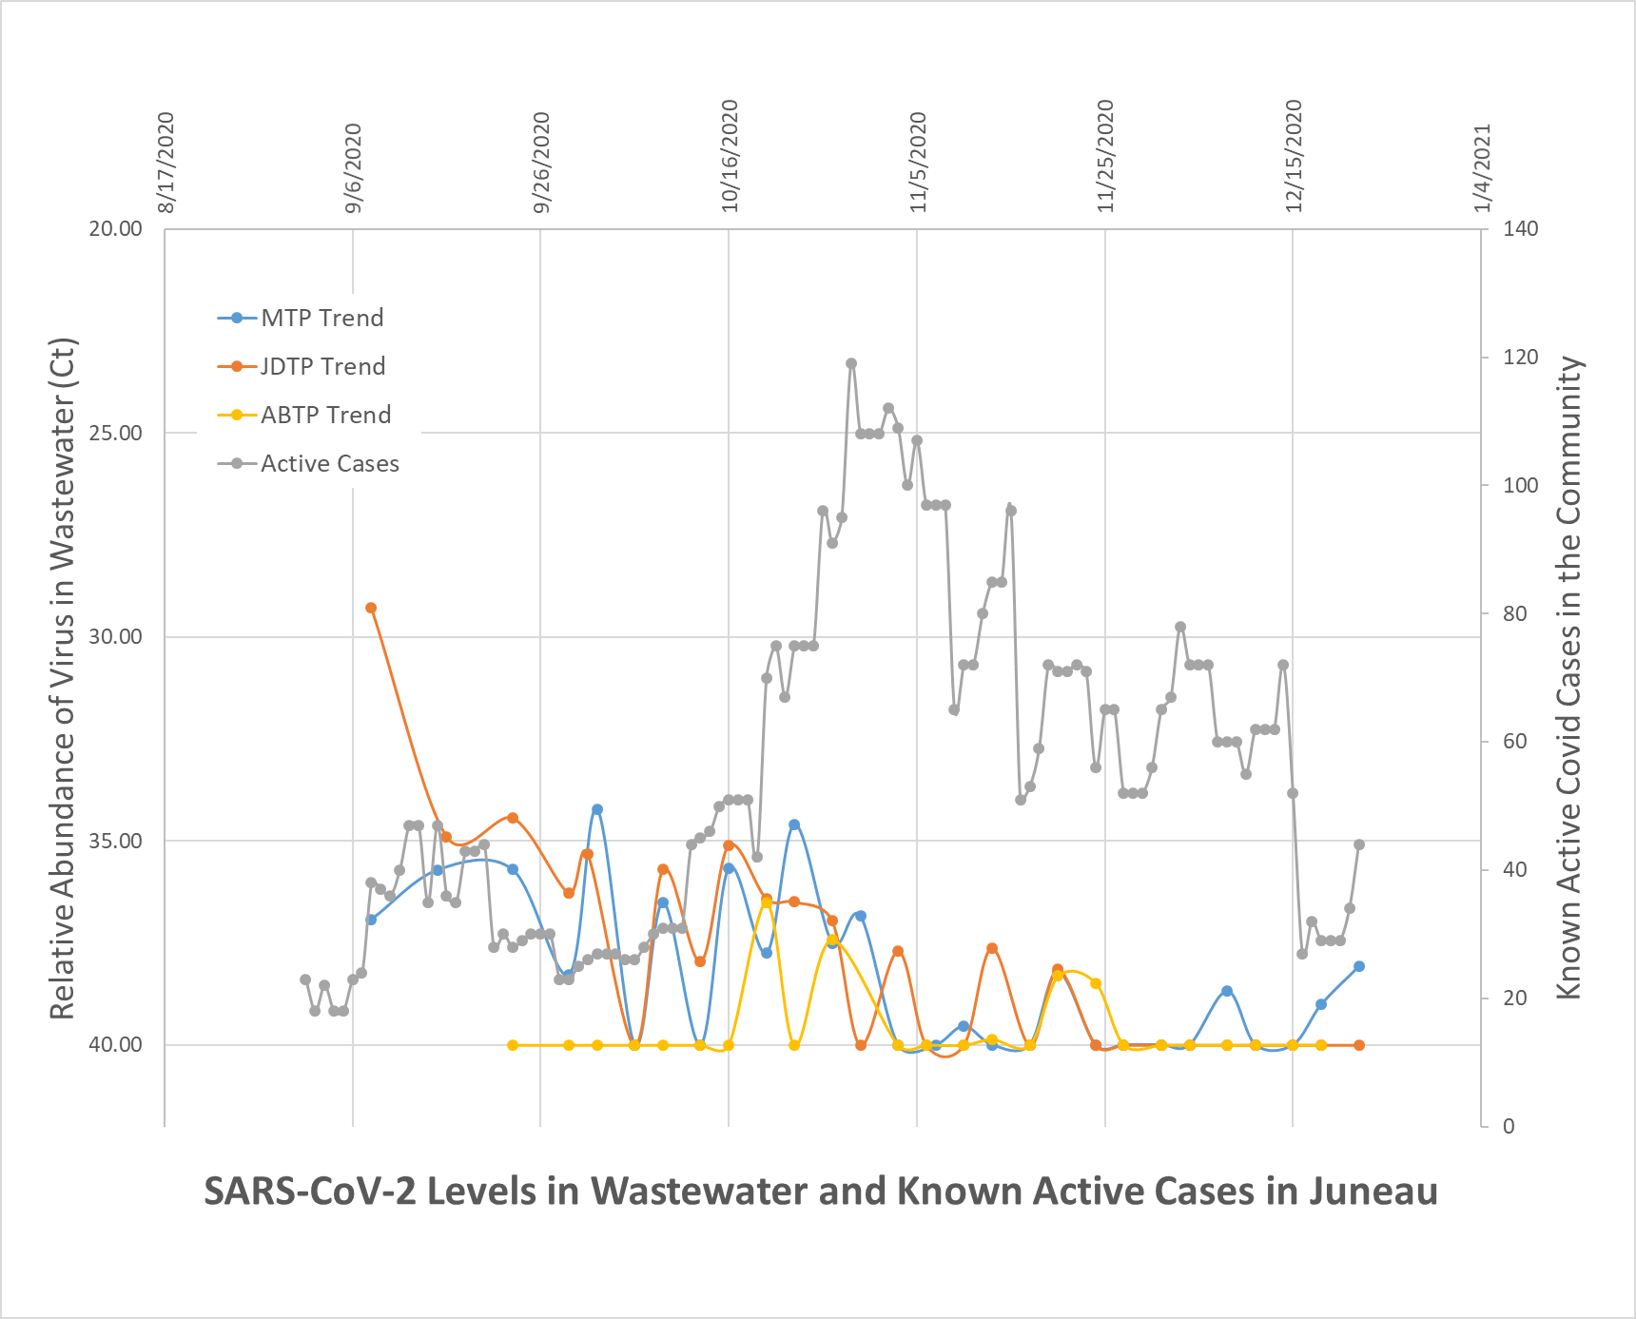
Switch to new lab
Notes:
Continued collected data, in early November we made the decision to switch labs. This was risky, but the next lab could give results in both Ct value and GC/100mL, and included QC in their reports. Started getting a lot of non-detects or comparably low detections – was it the different method? Were case numbers dropping?

Slide 10
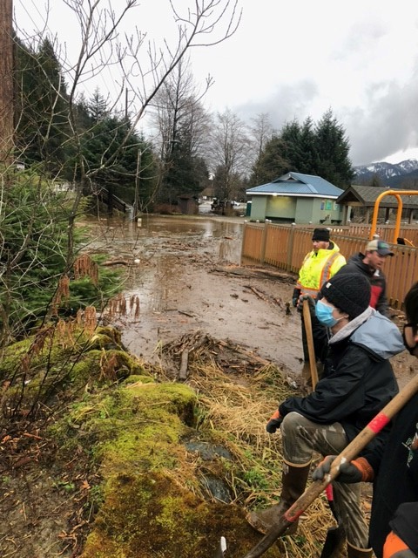
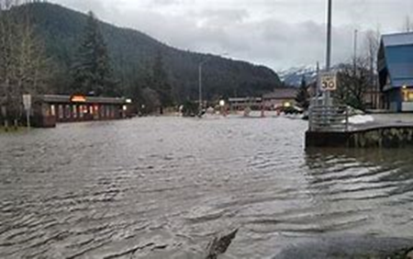
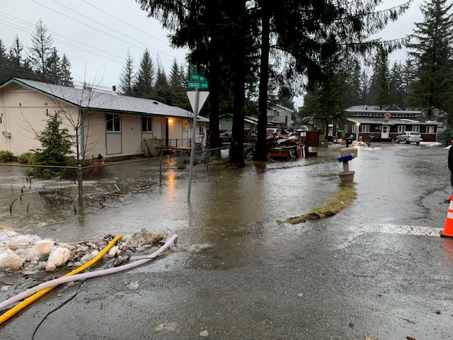
Notes:
Significant wet weather – always soggy in SE in the Fall, but this year brought 5” of rain in a day, lots of flooding, landslides, significant damage across SE. Particularly affecting our friends in Haines. This led to record flows at our TPs. Ideally, stormwater would not make its way into our sewer system but it always does to some extent. Double or triple the average flows at our plants. Dilution.

Slide 11
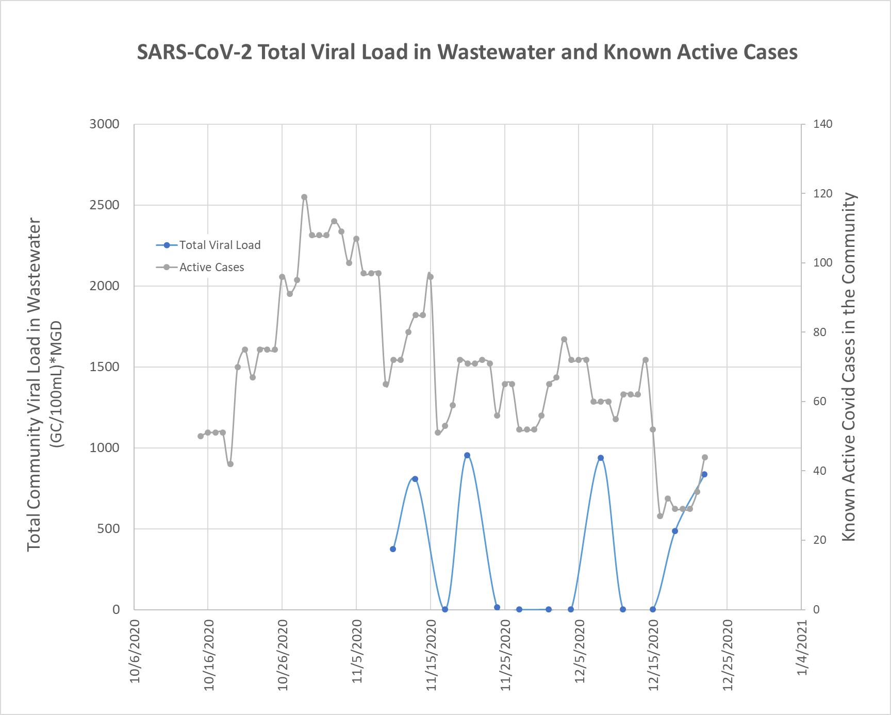
Total Community Viral Load =
C_{M}*Q_{M} + C_{JD}*Q_{JD} + C_{AB}*Q_{AB}
Notes:
With the data generates from the new lab, I did get a few detections and was able to start building this community viral load metric that was flow based, but clearly we have a pretty limited data set at this point.

Slide 12
Comparison of results from split samples analyzed by both labs
 |  | Lab 1 | Lab 2
Date | Location | Ct | Ct
12/18/2020 | MTP | 33.89 | 39.01
12/22/2020 | MTP | 35.36 | 38.08
12/18/2020 | JDTP | ND | ND
12/22/2020 | JDTP | ND | ND
12/18/2020 | ABTP | ND | ND
12/22/2020 | ABTP | ND | ND
Notes:
We did send one week’s worth of samples to both labs for comparison, see what kind of agreement we would get between the two. We did see agreement in terms of presence or absence of the virus between labs, but the Ct values were different and didn’t agree in terms of how they compared to each other.

Slide 13
Challenges
Significant wet weather events led to highly variable flows
Using BOD as an indicator of strength doesn’t work due to industrial inputs
Relatively low incidence of disease in the community (this is a GOOD thing!)
Presenting data to the public in a meaningful way
Navigating the different analytical methods, no standard method
Lag between sample collection and results

Slide 14
Current status
Decision made to “pause” testing due to funding needs and lack of actionable data
Clinical testing availability is good, turnaround time improving
May consider starting testing again prior to tourism, monitor for re-emergence in the community
We are all glad that we did this work, but the results weren’t as actionable as hoped
Notes:
Appreciate Dan Gerrity’s discussion about scale of work and how actionable the information is

Slide 15
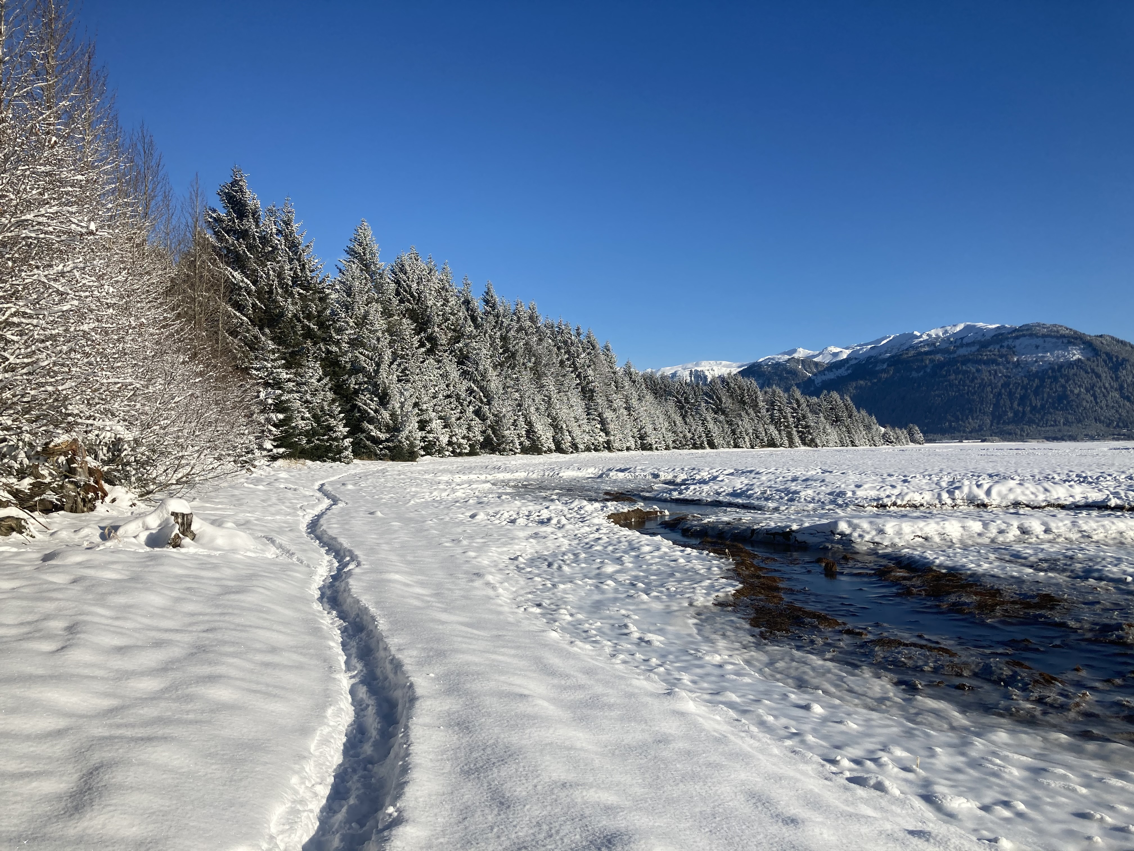
Thank you!
Aaron Dotson, UAA
Eric Bortz, UAA
John Albert, WRF
Nathan LaCross, UtahDH
Jeff Ostermiller, UtahNR
Erica Gaddis, UtahWQ

