Slide 1

Climate Change Impacts In Alaska
Mike Black
Center For Climate and Health (CCH)
Department of Environmental Health and Engineering (DEHE)
Notes:
1
Snowmelt - positive feed back loop
Coast blast - damage in Nome:
Meltdown - infrastructure damage, surface water loss:
Lightning – forest fires
Warm weather – shell fish poisoning

Slide 2
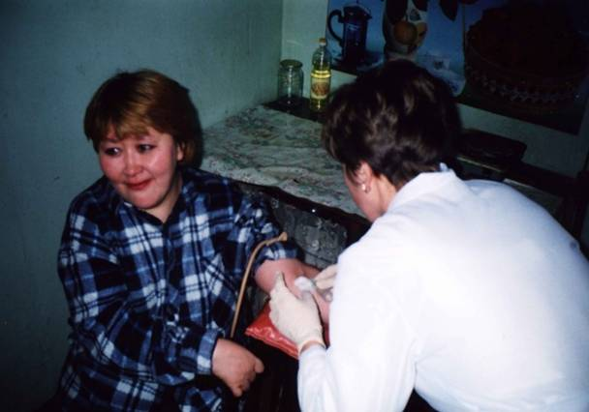
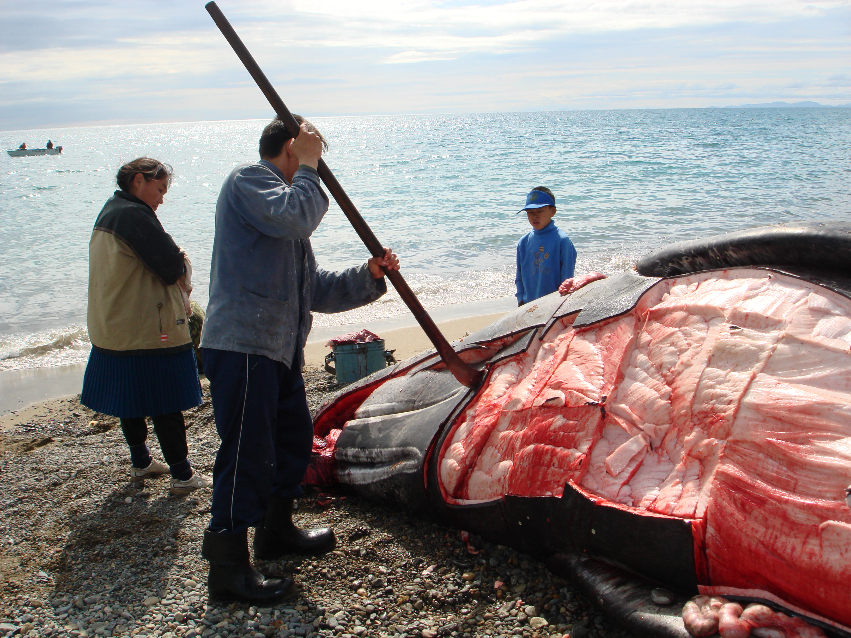
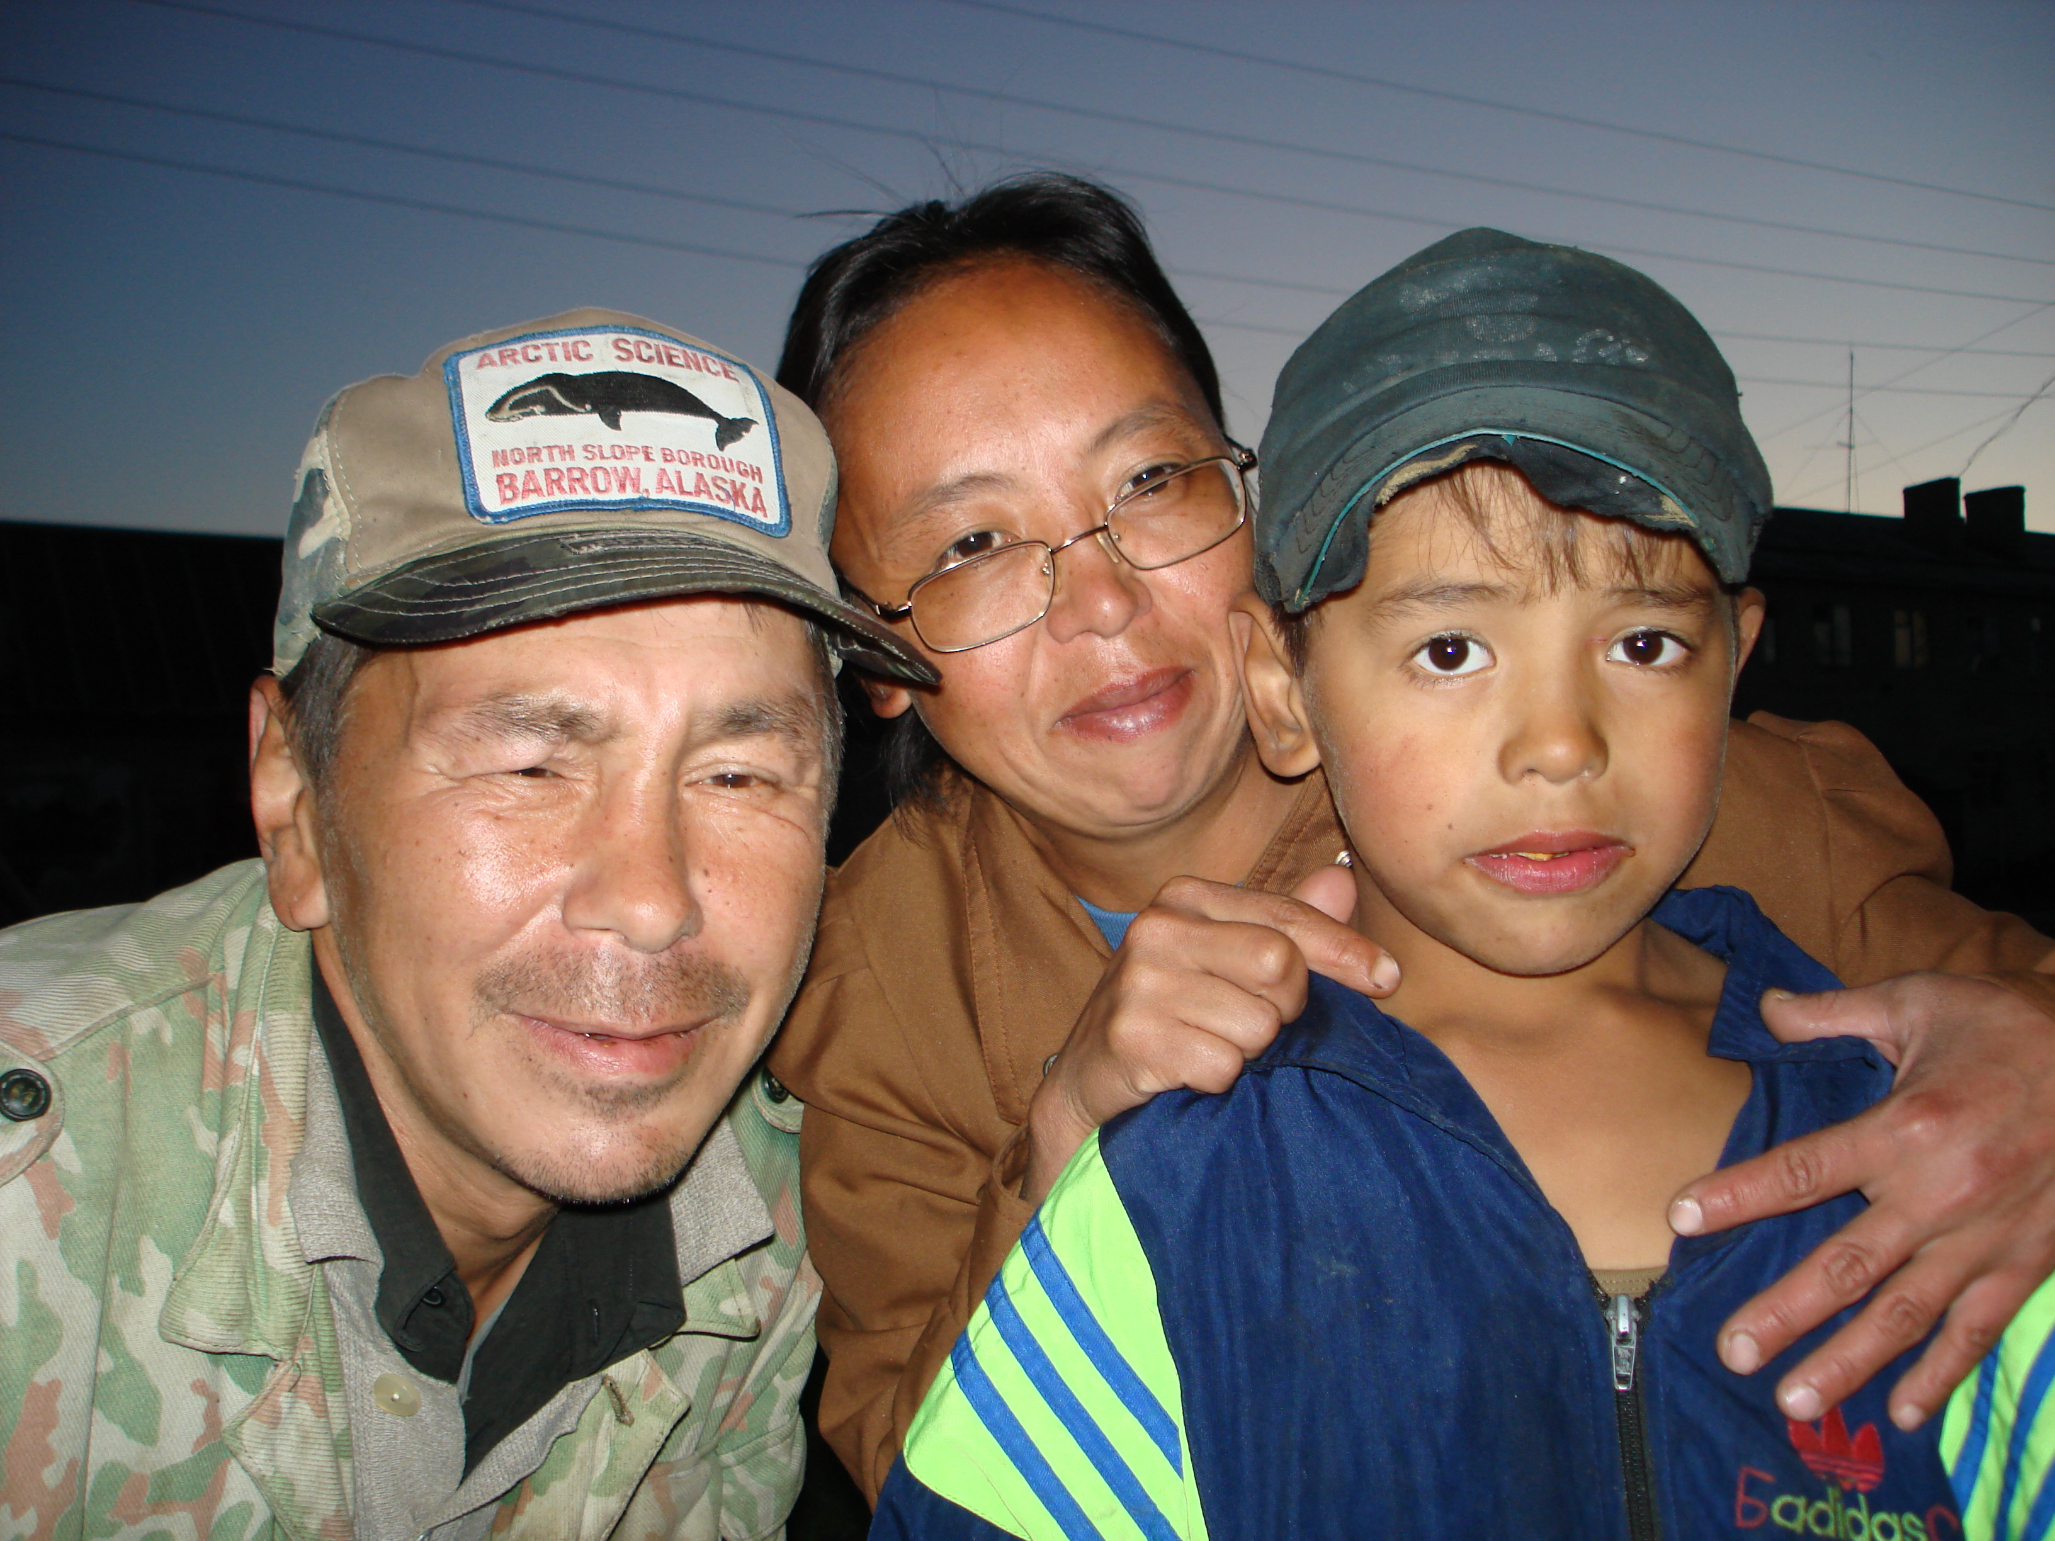
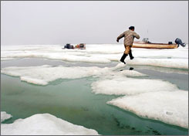
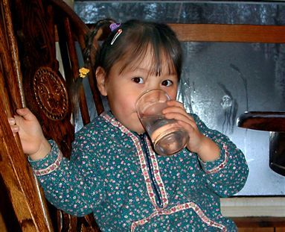
the mission
Identify health effects associated with climate change and develop strategies that will help protect community health.
Photo courtesy V. Chaschin
Photo courtesy A. Parkinson

Slide 3
the project
Objective:
develop a process for working with communities to determine health effects of climate change at the local level to provide assist local and regional leadership in adaptation planning.
develop Alaska Atlas for Engineering Parameters projected over design life of facility (~30 years)
Funding: U.S. Indian Health Service
Partners: Maniilaq Association, Northwest Arctic Borough, Tribal Governments,
City Governments, Universities, State and Federal Agencies

Slide 4
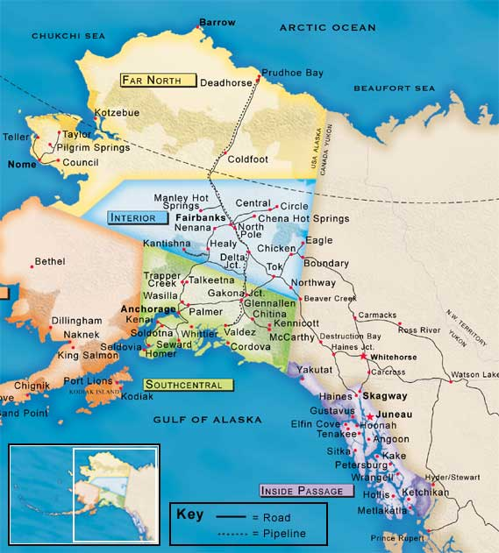
Current Study Area
(Northwest Arctic Borough)
ANTHC Target Area
(Entire State of Alaska)

Slide 5
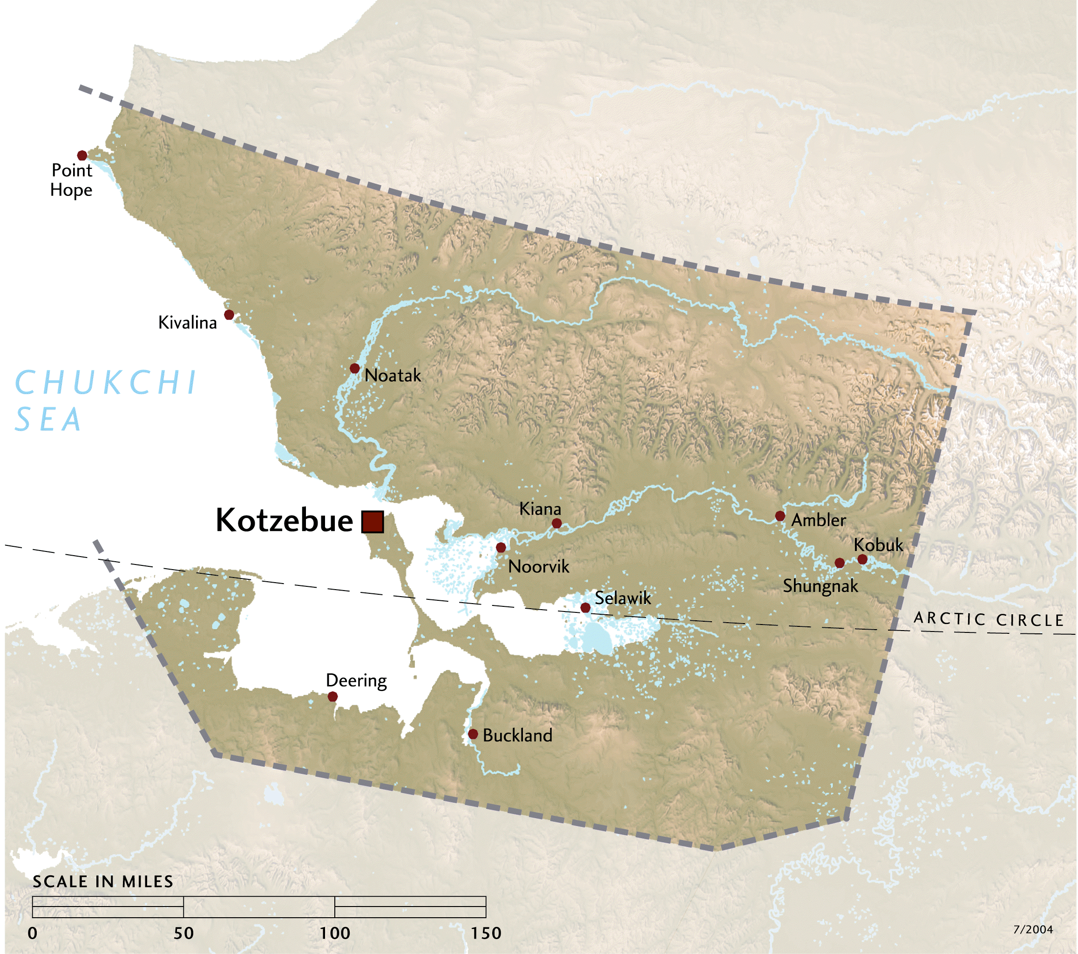
the region

Slide 6


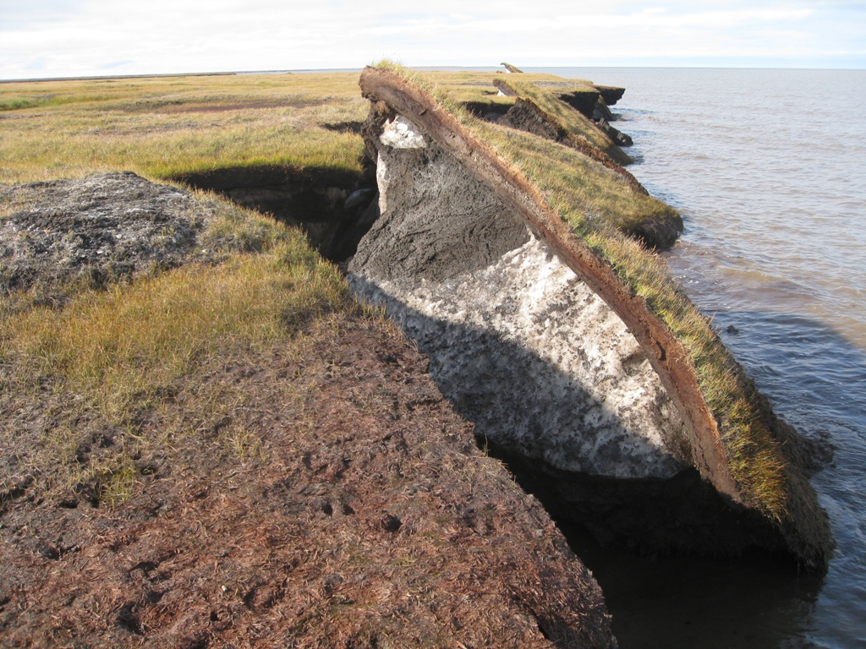
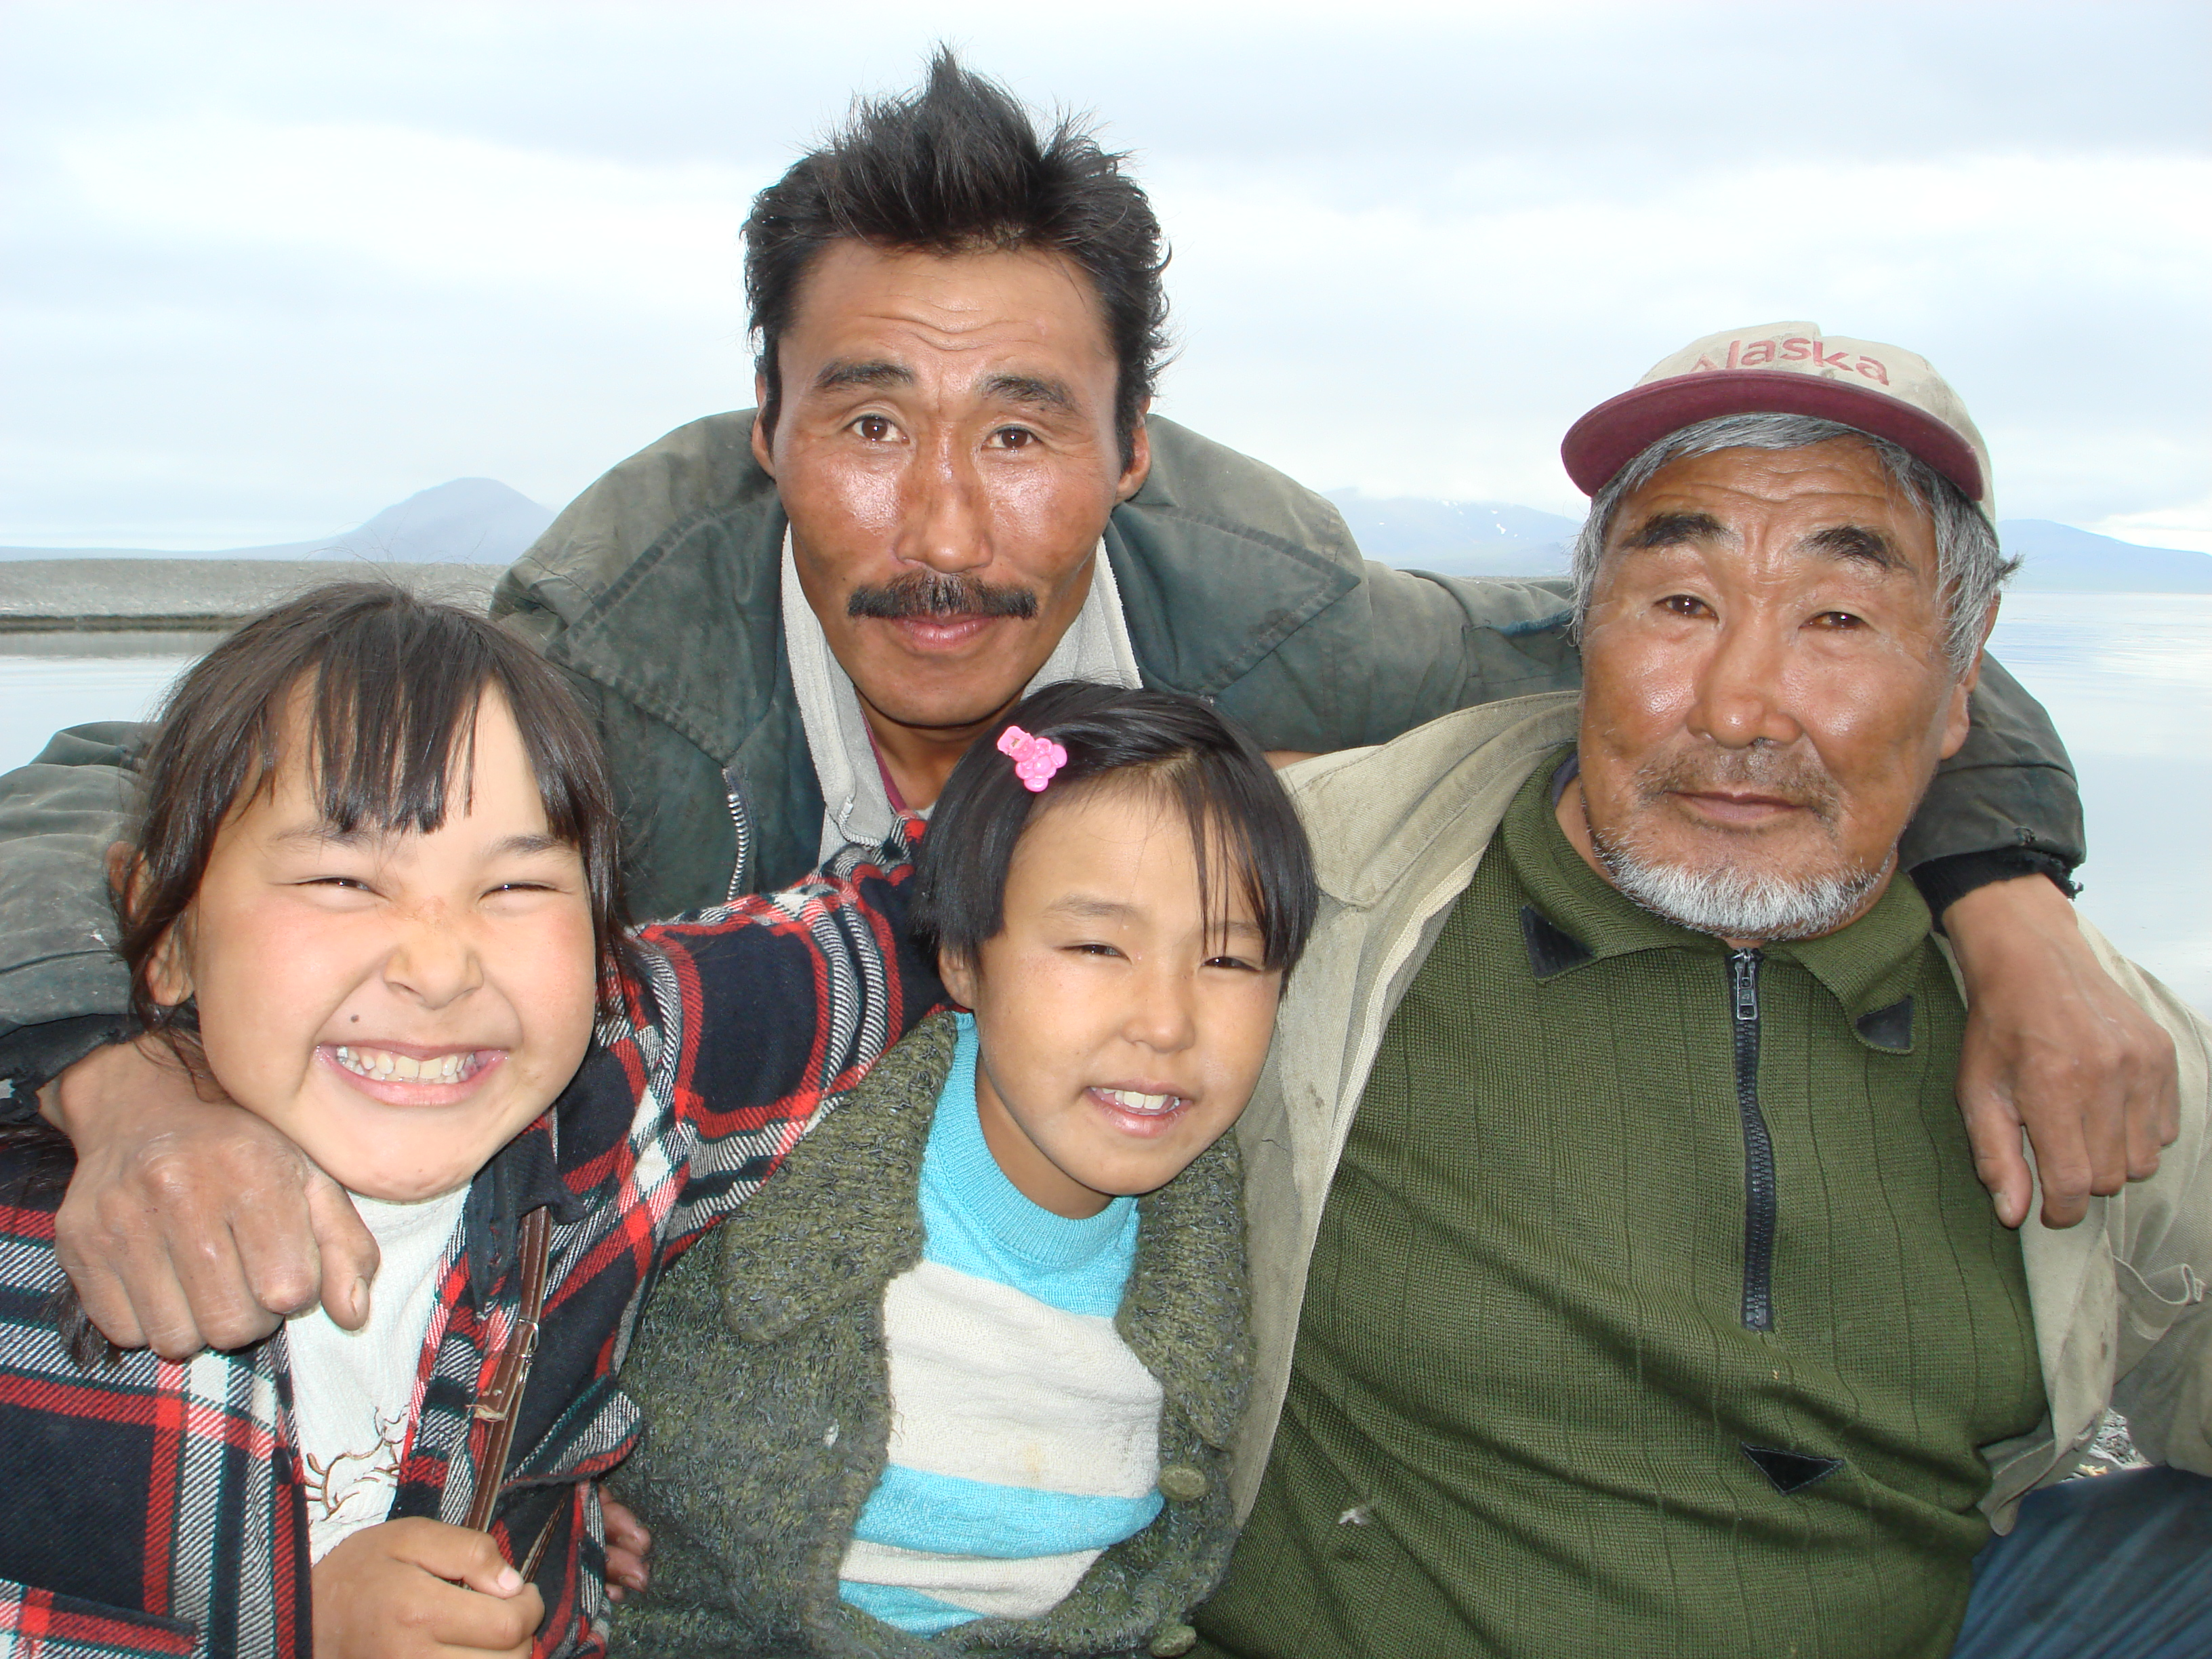
the purpose
- Raise awareness about climate – health and water connections.
- Record local observations about climate change.
- Identify health risks and benefits.
- Explore health protective adaptation strategies.
- Recommendations for design and construction of Sanitation
Insrastructure.
Photo courtesy Ben Jones

Slide 7
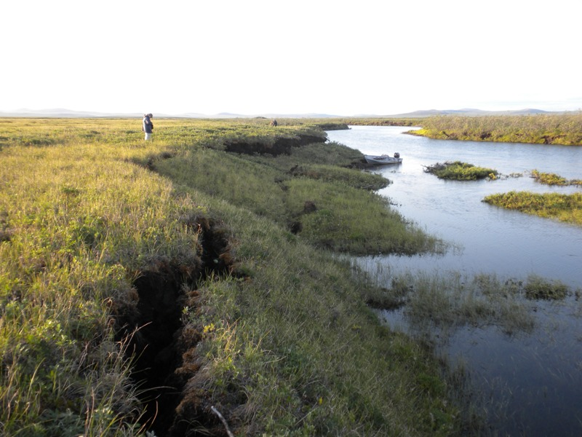
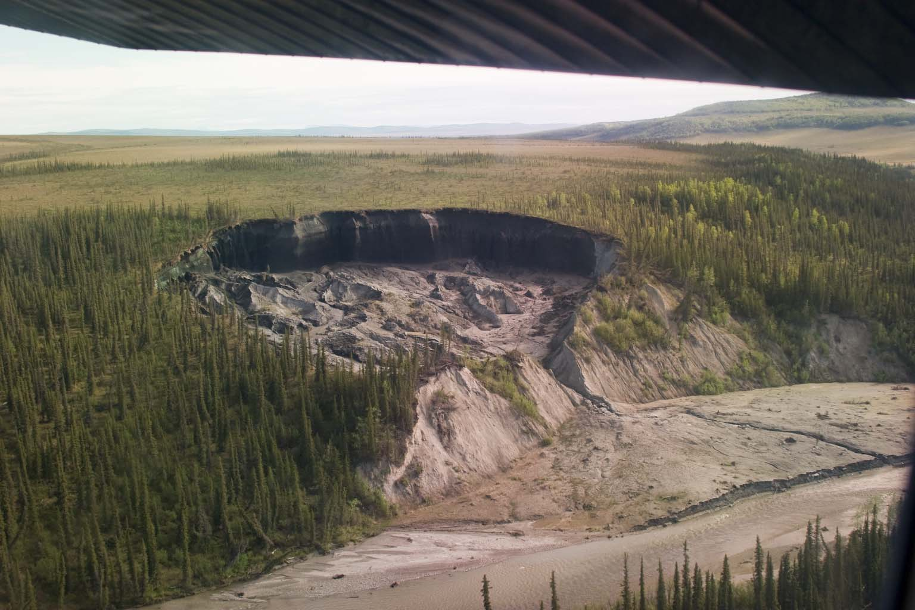
the problem
- Climate impacts not well understood.
- Health effects are not well understood.
- Climate information is largely focused at regional level.
- Communities need local information for planning.
- Complexity requires an inter-disciplinary approach.
Photo courtesy Yuri Gorokhovich

Slide 8
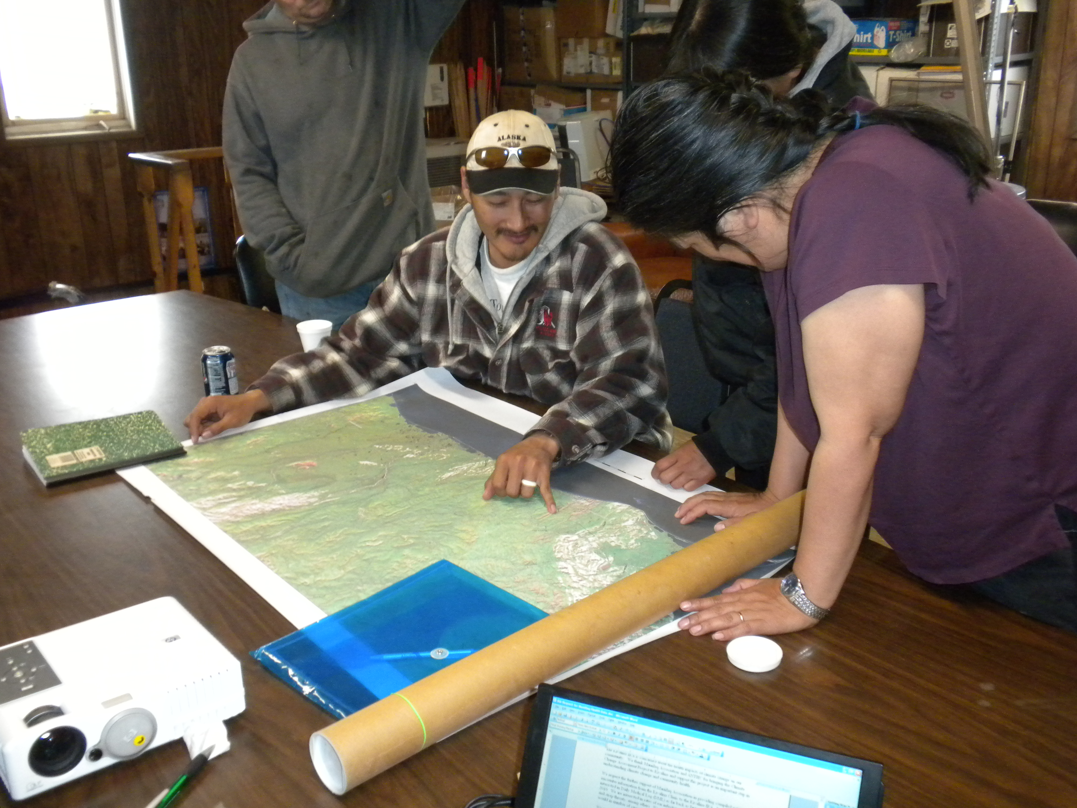
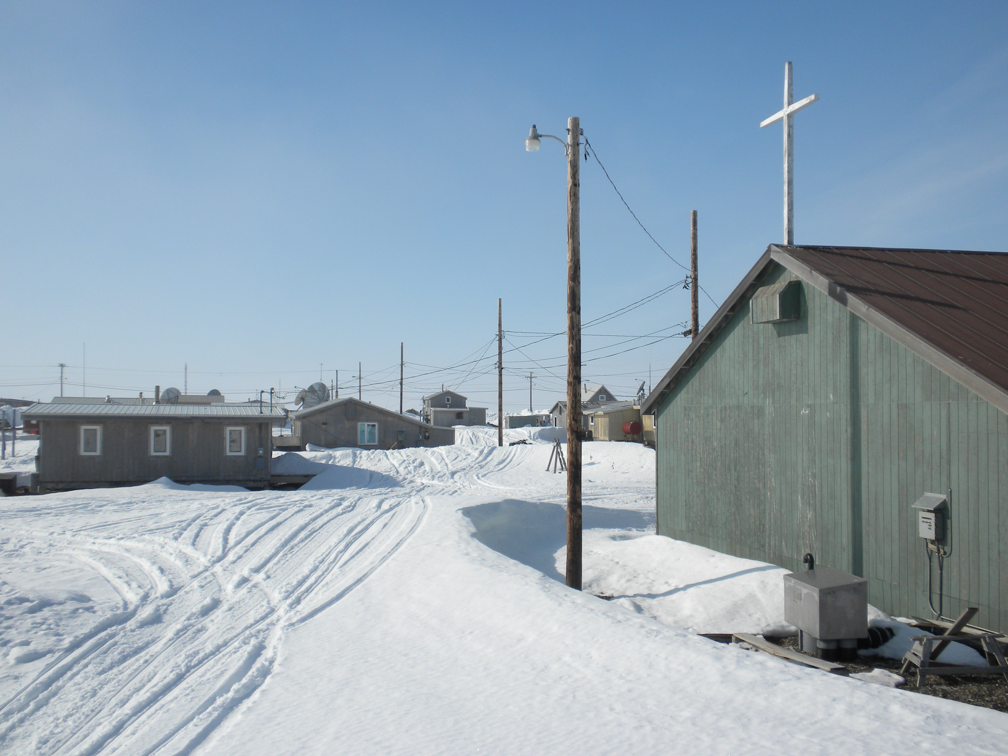
the process
- Scoping: describe general regional climate / health condition
- Surveying: local visit, interviews (>25), and data collection
- Analysis: review climate and health trends
- Planning: provide information for informed decision making
Photo Yuri Gorokhovich

Slide 9
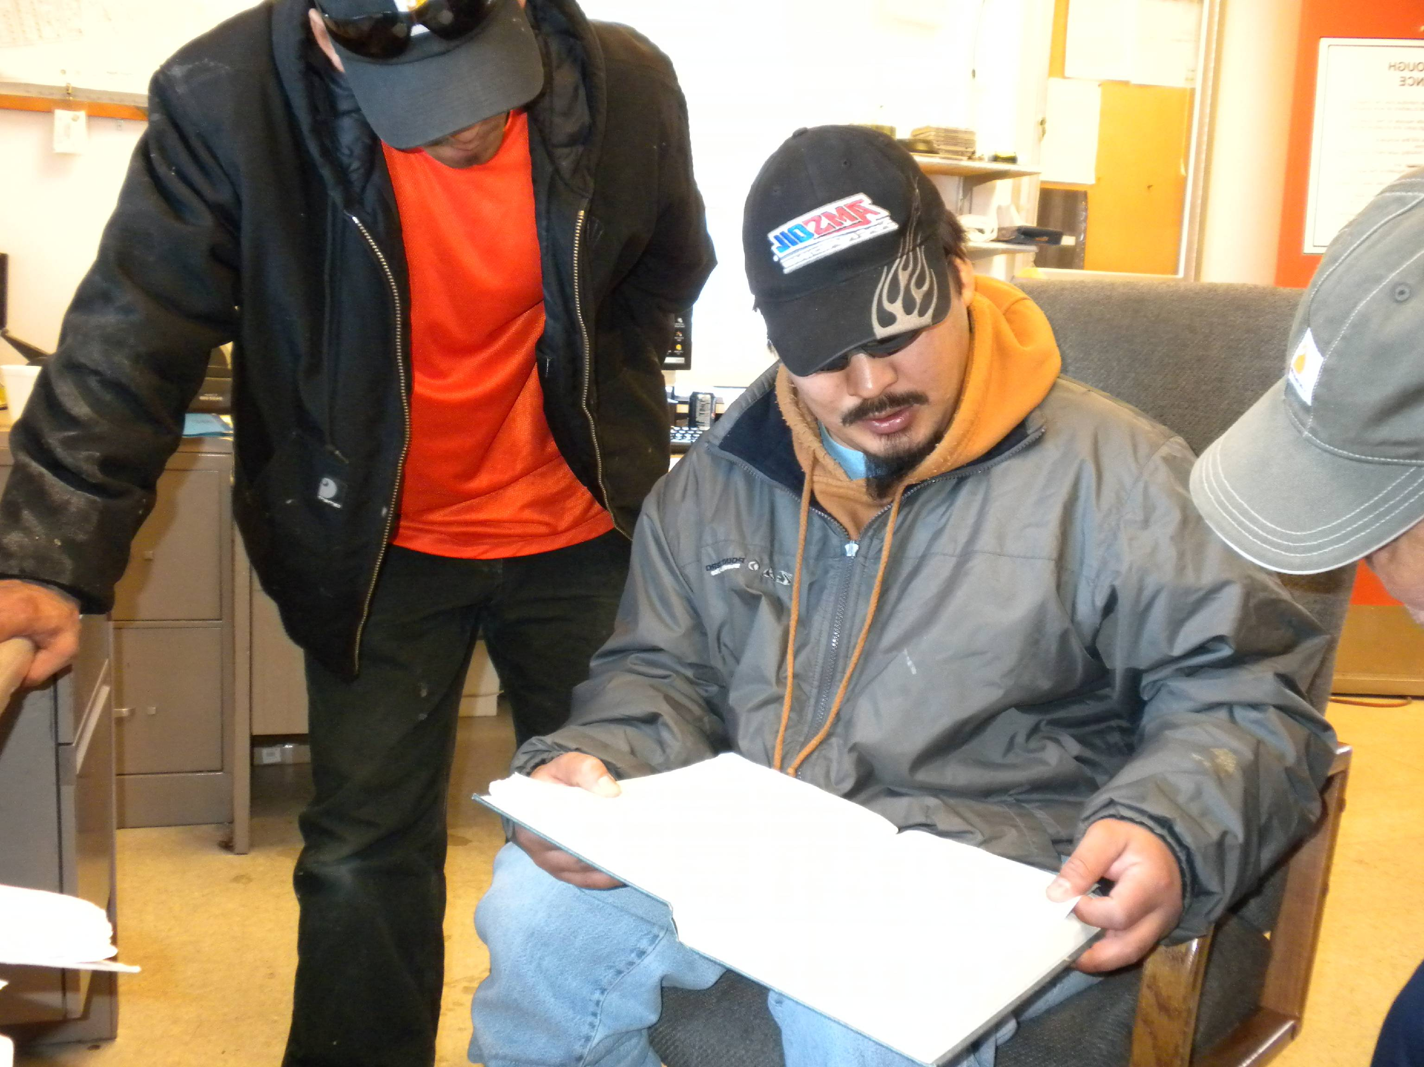
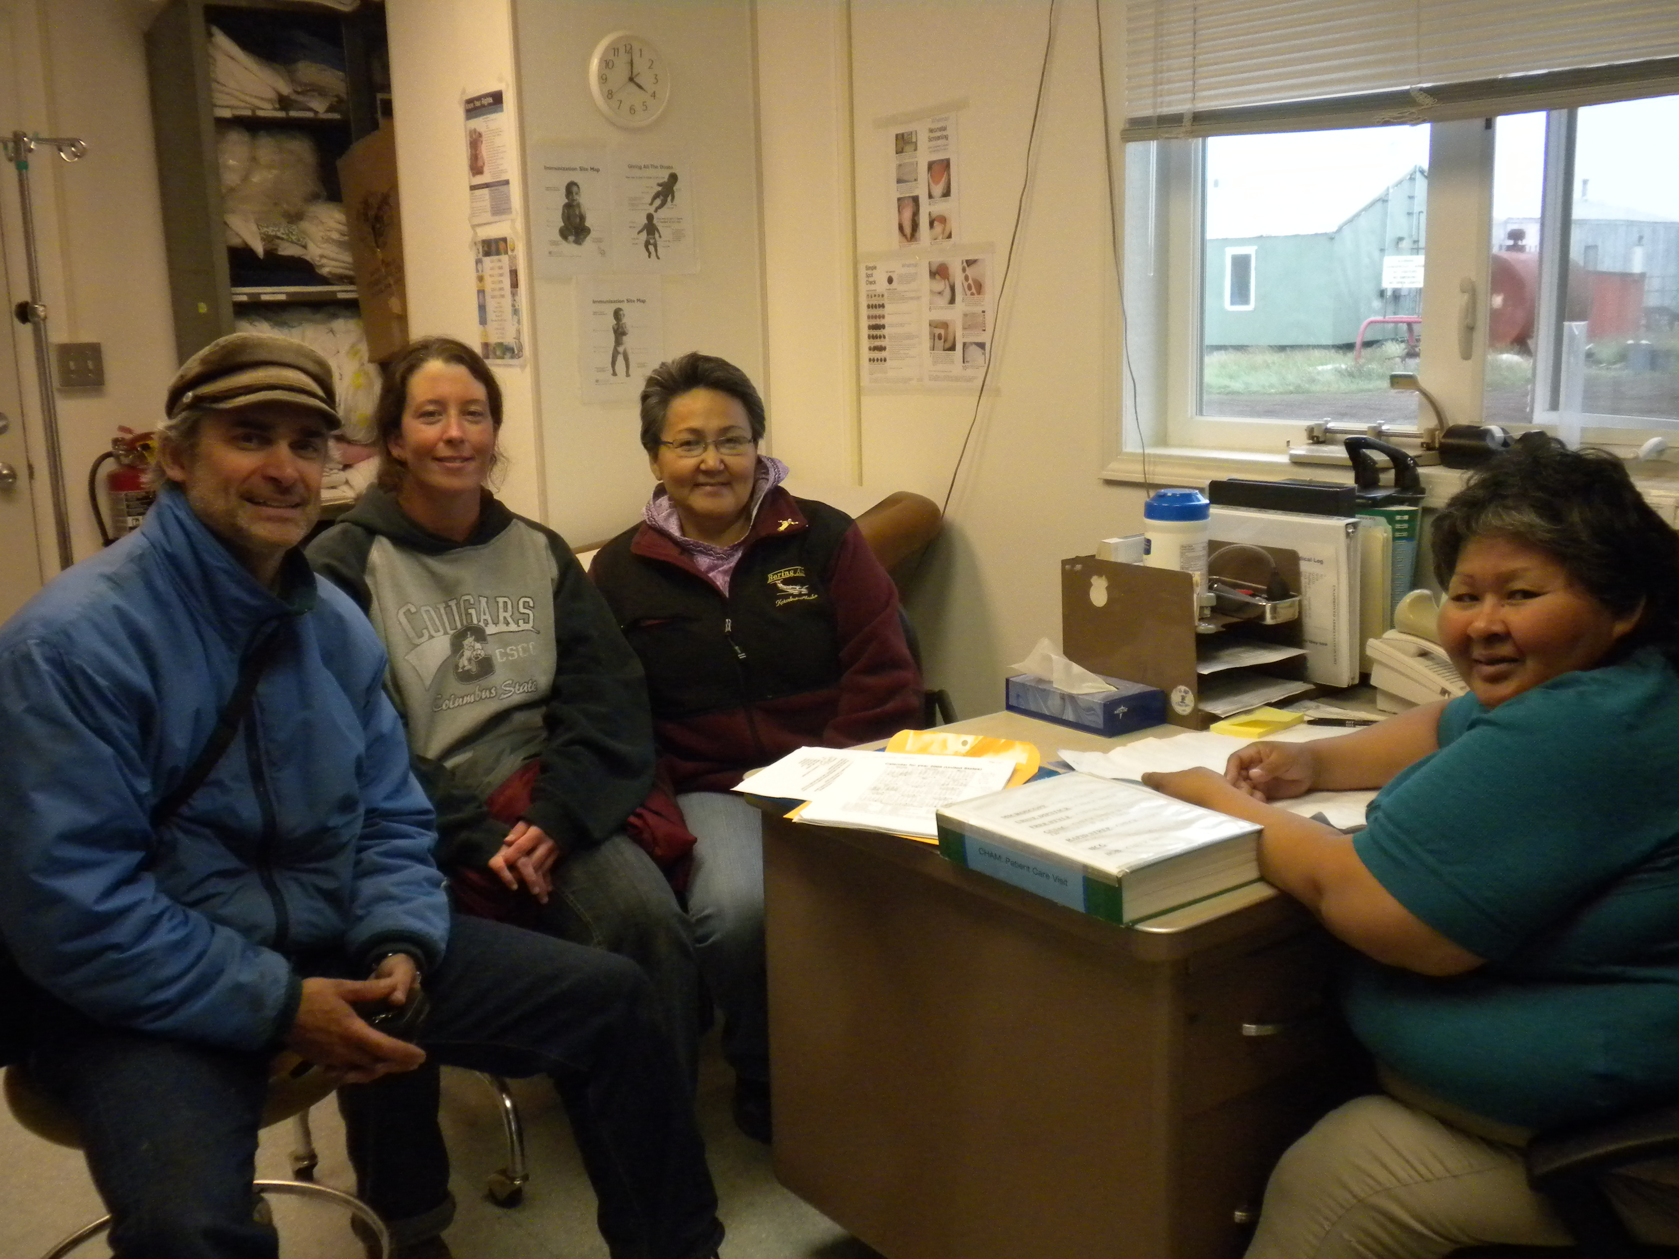
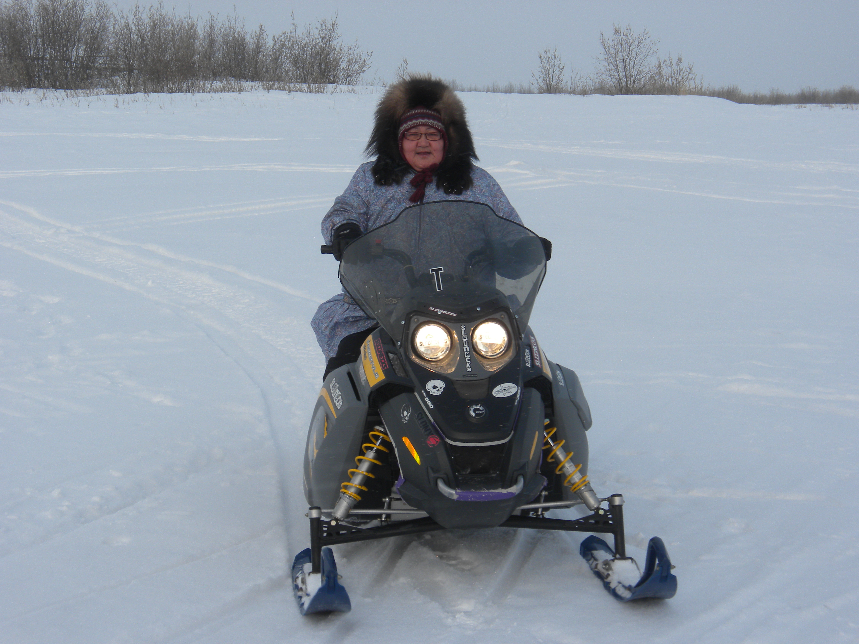
the people
Health: clinic, behavioral health,
Water and Sanitation: operators, RMWs, Env. Health managers
Education: teachers, students, counselors
Environment: natural resource and environmental managers
Governance: city and tribal councils, staff and leadership
Public Safety: police, fire, search and rescue
Traditional Knowledge: subsistence experts, elders

Slide 10
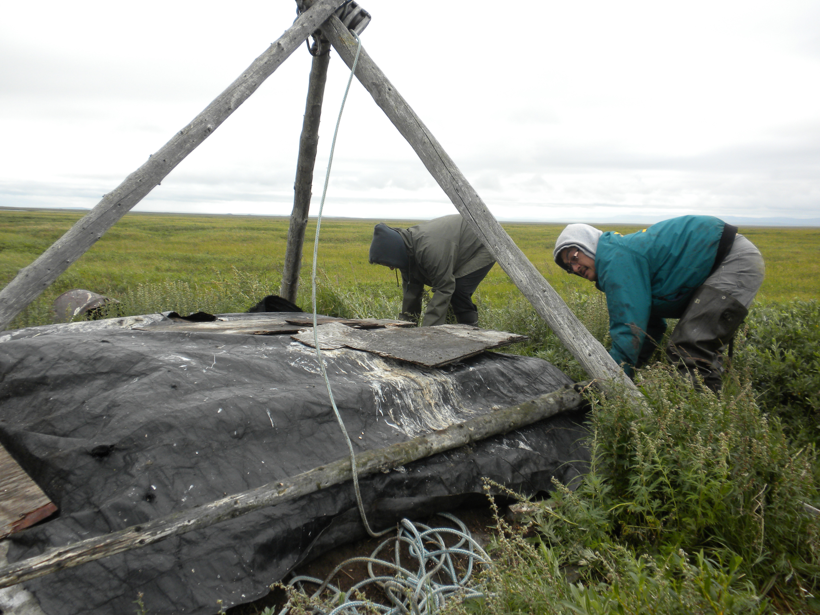
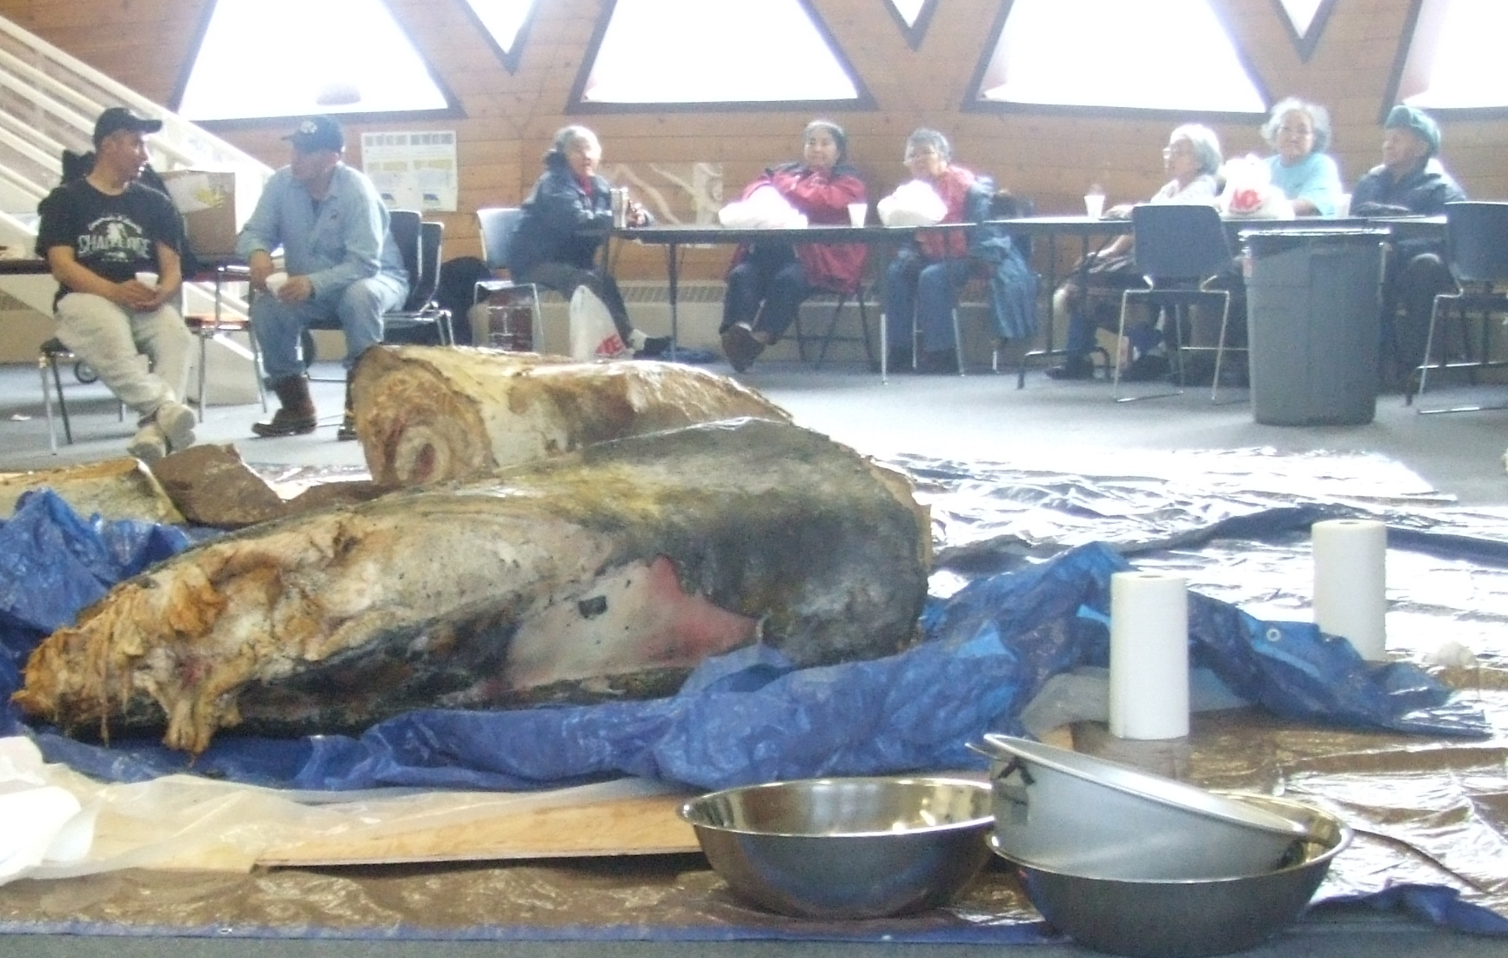
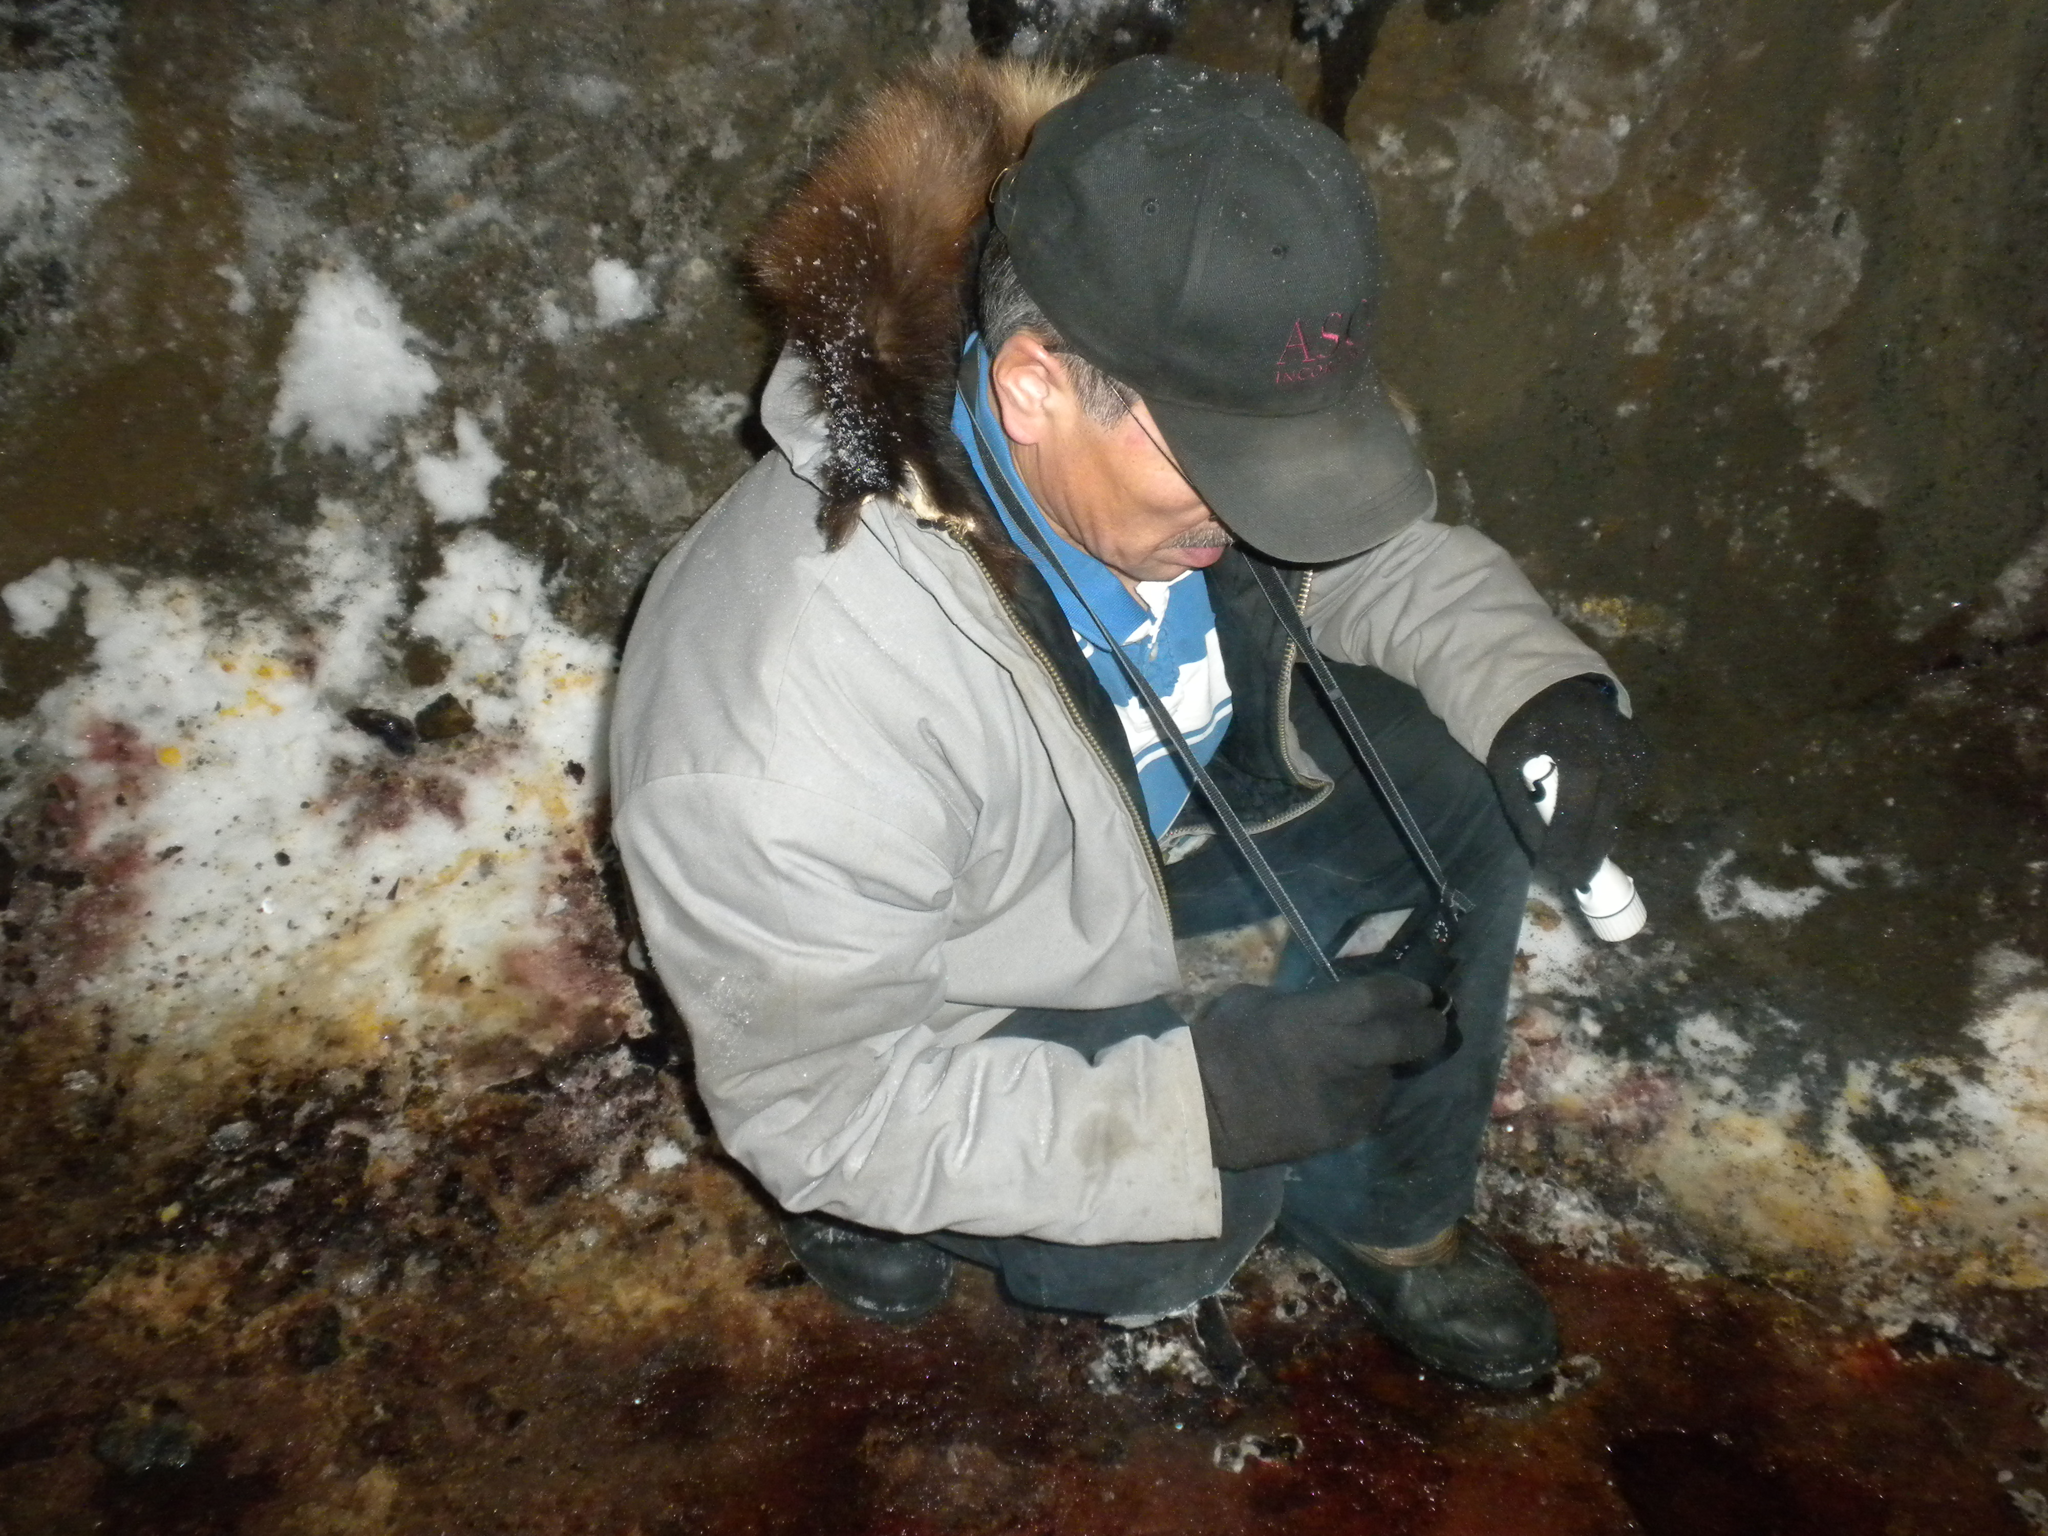
“We used to have frozen meat and blubber in summertime, but they’re not frozen no more.”
Joe Towksjhea - Elder
Impact: thawing cellars
Effect: food insecurity
Adaptation: permafrost surveillance, adaptive design

Slide 11
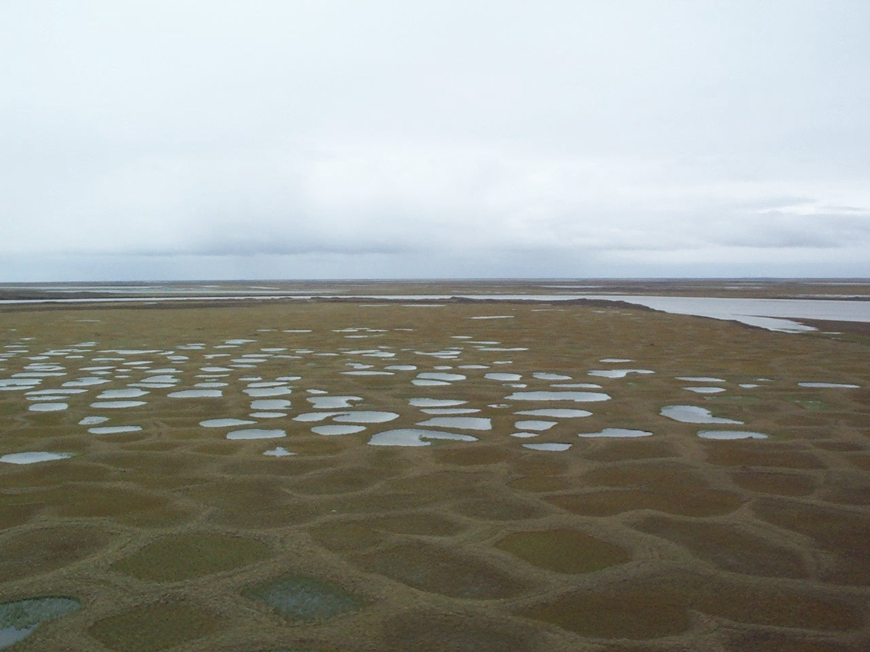
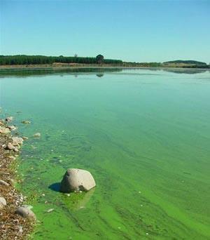
“In summer the lake water is getting really warm, we are seeing a lot of larvae in the water“
Andrew Frankson – Water Operator
Impact: changing lakes
Effect: water insecurity
Photo Courtesy Vladimir Romanovsky
Adaptation: surveillance & filtration
Photo Courtesy Alex Whiting

Slide 12
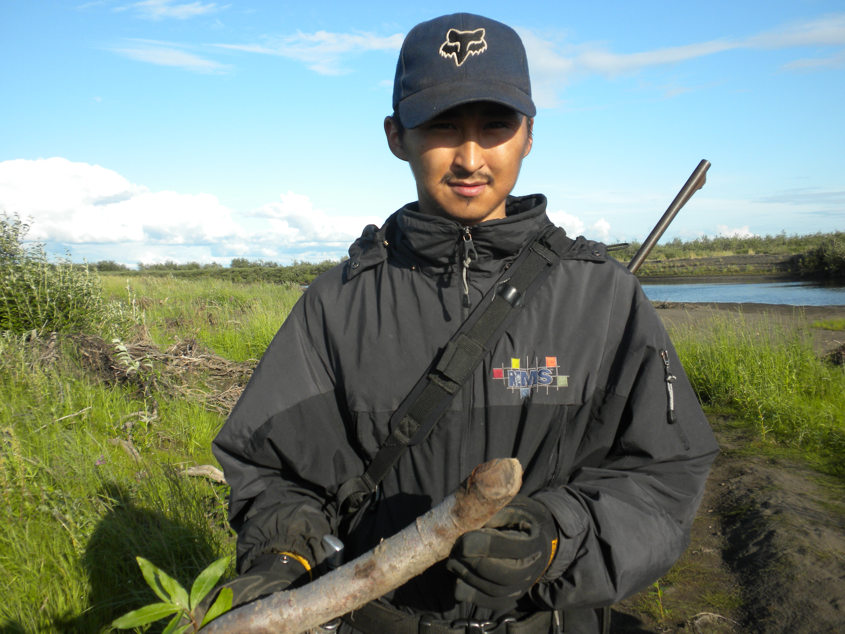
“There have been beavers in the river the last few years.”
Rodger Hawley
Impact: Invasive species
Effect: Zoonotic Disease
Adaptation: Surveillance & Prevention

Slide 13
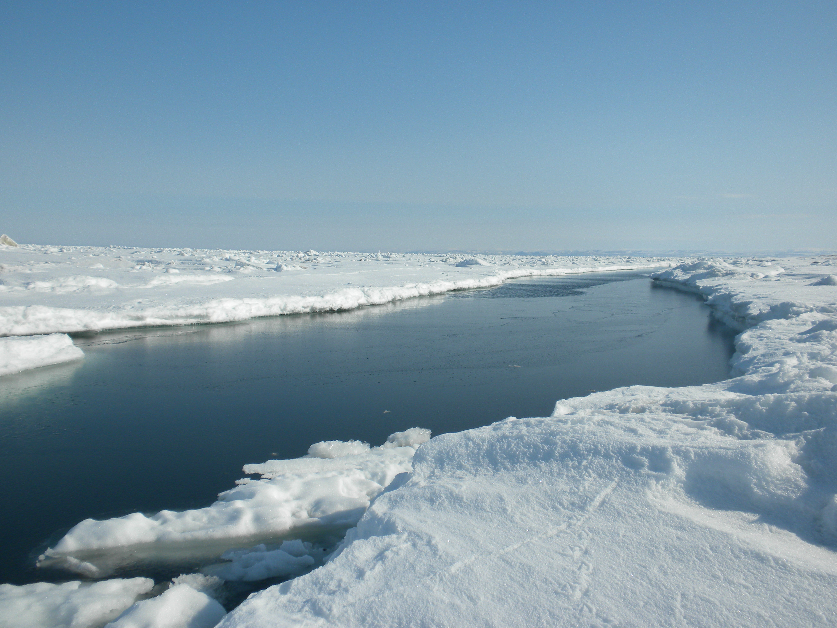
“The ice is no good for haul out and butchering of bowhead. Too thin.”
Ray Koonuk Sr. – Whaling Captain
Impact: unsafe ice
Effect: injury, nutritional?
Adaptation: ice surveillance & improved emergency response
Photo Courtesy Charles Wohlforth

Slide 14
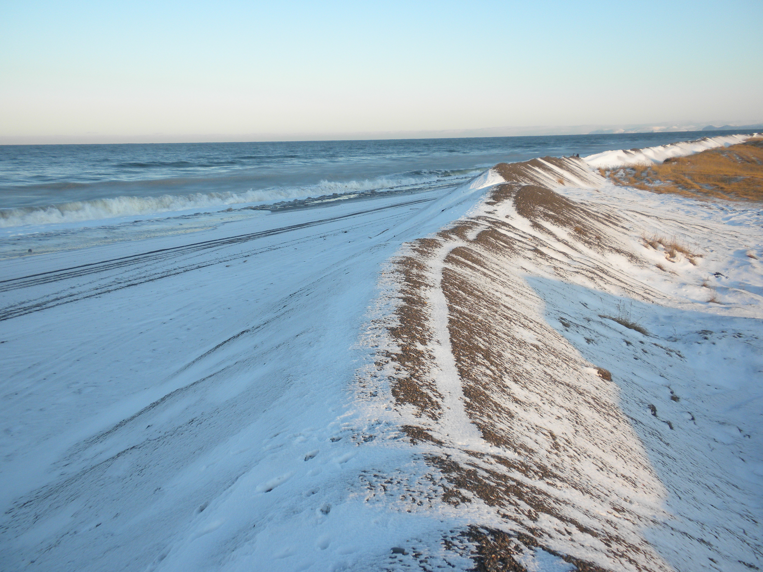
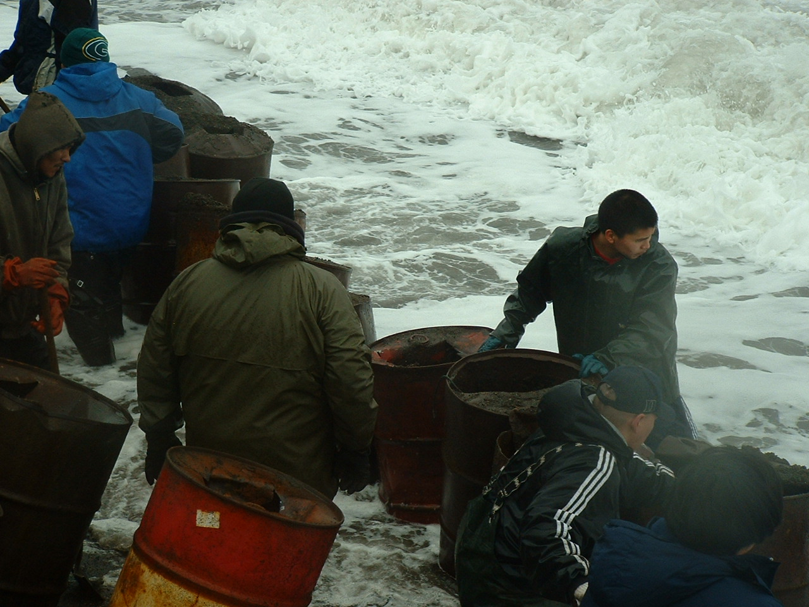
“The ocean is coming and eroding the beach, real fast. Some of the food cellars are gone.”
Joe Towksjhea. – Elder
Impact: storms / erosion / flooding
Effect: injury, stress, infrastructure
Adaptation: emergency preparedness
Photo courtesy Millie Hawley

Slide 15
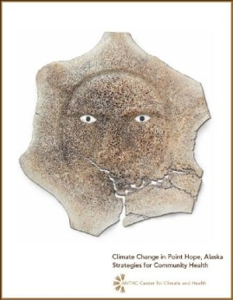
the deliverables
Final Report – includes findings, observations, results, recommendations, and adaptation strategies
Typical Outline of Report:
Summary, Introduction, Community Profile, Temperature and Precipitation, Sea Level, Erosion, Permafrost, Snow and Ice, Water and Sanitation, Food Safety and Security, Conclusions, and Adaptation Strategies
Presentations: to communities, regional corporations, funding agencies, Climate Summits
Web based Alaska Atlas –
Engineering Design parameters

Slide 16
Government Policies for Imperiled Communities Affect Public Health
excerpt from IMMEDIATE ACTION WORKGROUP RECOMMENDATIONS TO THE GOVERNOR’S SUBCABINET IN CLIMATE CHANGE MARCH 2010
“o Community in Peril: Newtok finds itself in a Catch-22, or a no-win, situation.
Plans to relocate, combined with the imminent threat of flooding and erosion, has rendered Newtok ineligible for capital funding for improvements to existing infrastructure (e.g., water and sewer, bulk fuel tanks, power plant, and clinic) to meet needs at the current village until the relocation is complete or substantially complete.
Notes:
16
Human health can be negatively impacted by climate change through:
- 1 The introduction of disease causing organisms to new areas
- 2 Discharge of contaminants to drinking water sources
- 3 Destruction of infrastructure
Some recent disease outbreaks include:

Slide 17
The ability to divert designated resources to the new village site is hampered by policies that create barriers to investment in non-existent communities.
Any upgraded facilities or new facilities must be protected against imminent environmental threats, such as flooding and erosion, consistent with Administrative Order No. 175.”
Notes:
17
Human health can be negatively impacted by climate change through:
- 1 The introduction of disease causing organisms to new areas
- 2 Discharge of contaminants to drinking water sources
- 3 Destruction of infrastructure
Some recent disease outbreaks include:

Slide 18
General Recommendations
The development of an engineering feasibility study that will address the need for improved sanitation conditions in the community with follow on funding to construct the required improvements.
The development of an engineering feasibility study to address water treatment alternatives with follow on funding to construct the required improvements.
The need for improved monitoring of environmental conditions in impacted communities to enhance the ability to understand what is happening in the changing Arctic and improve our ability to adapt to these changes.
The development of a study to address public safety concerns in the event of storm surge flooding due to increasingly severe weather patterns in combination with the increased ice free season.
Notes:
18
Human health can be negatively impacted by climate change through:
- 1 The introduction of disease causing organisms to new areas
- 2 Discharge of contaminants to drinking water sources
- 3 Destruction of infrastructure
Some recent disease outbreaks include:

Slide 19
Questions?
ANTHC (Website: http://www.anthc.org/)
DEHE (Website: http://www.anthc.org/cs/dehe/)
CCH (Website: http://www.anthc.org/chs/ces/climate/)

