Slide 1
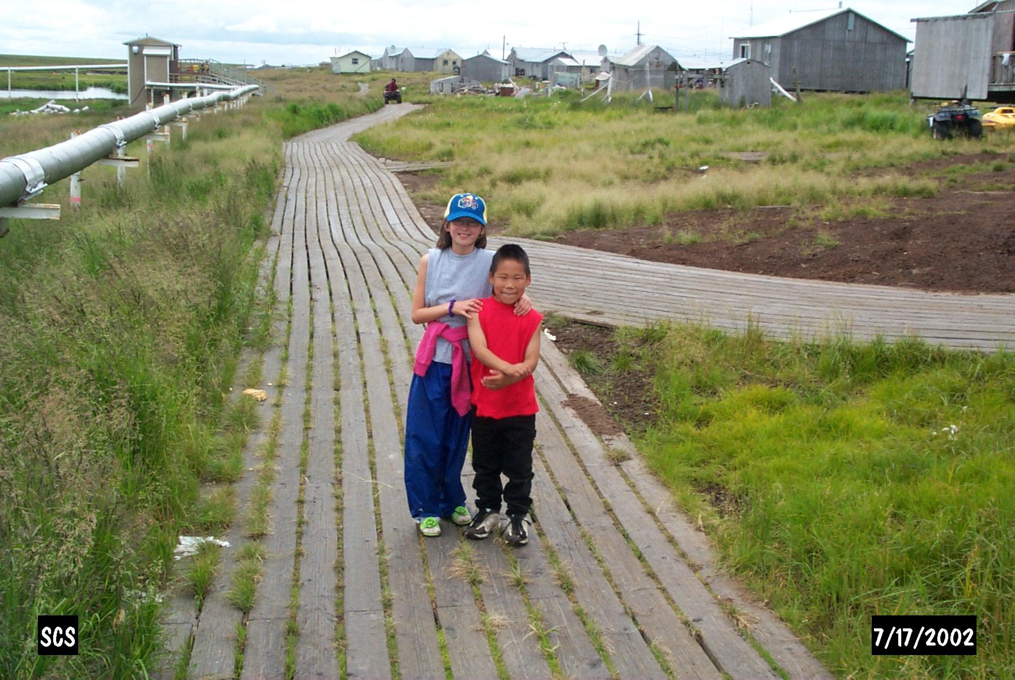
WATER AND SANITATION INOVATIONS FOR THE ARCTIC
Denman Ondelacy, PE
Director, Office of Environmental Health & Engineering
Alaska Area Native Health Service – Indian Health Service
January 2011

Slide 3
ALASKA SANITATION FACILITIES FUNDING REPORTED TO IHS

Slide 6
AVERAGE ALASKA SANITATION PROJECT DURATIONS REPORTED TO IHS

Slide 7
ALASKA SANITATION FACILITIES FUNDING VERSUS NEED

