Slide 1
Sanitation Engineering in the North
Past Solutions and Considerations
John A. Warren, P.E.
Co-sponsored workshop by:
US Arctic Research Commission and Centers for Disease Control and Prevention

Slide 2
Sanitation Engineering in the North
Presentation Overview
Water Source
Groundwater
Surface Water
Groundwater Under the Direct Influence of Surface Water (GUDISW)
Water Treatment
Organics
Inorganics
Microorganisms
Water Distribution
Piped Systems
Haul Systems

Slide 3
Sanitation Engineering in the North
Presentation Overview
Wastewater Collection
Gravity Systems
Vacuum Systems
Low Pressure Systems
Haul Systems
Wastewater Treatment
Lagoons
Septic Tanks
Advanced Treatment
Wastewater Disposal
Liquids
Solids

Slide 4
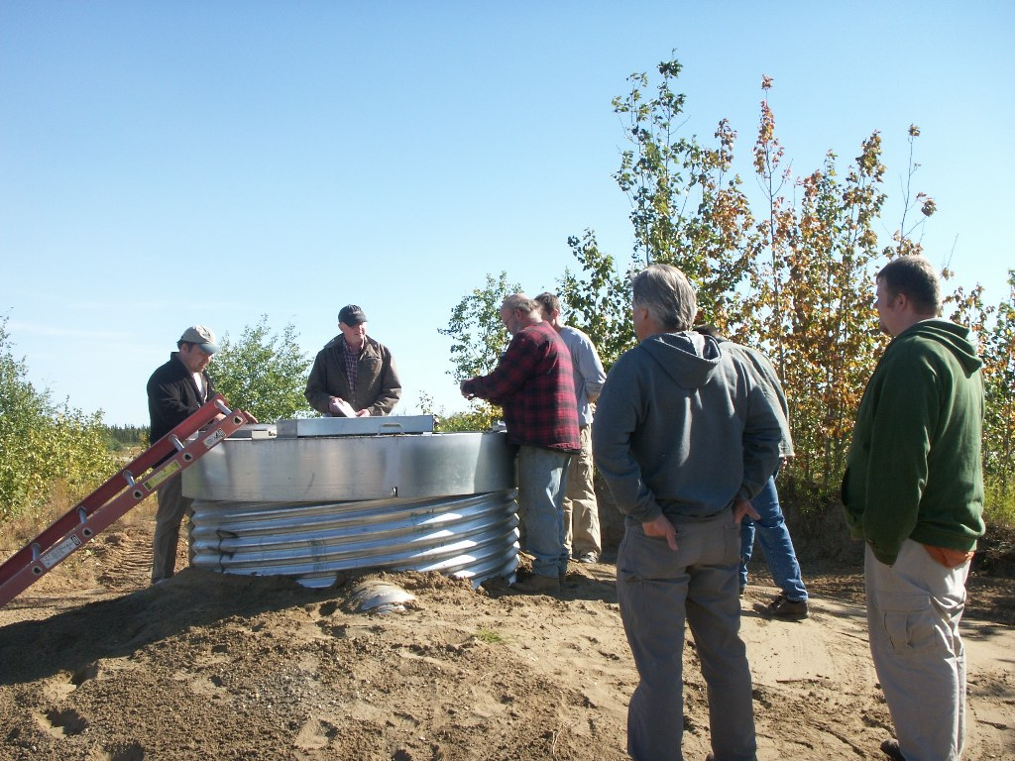
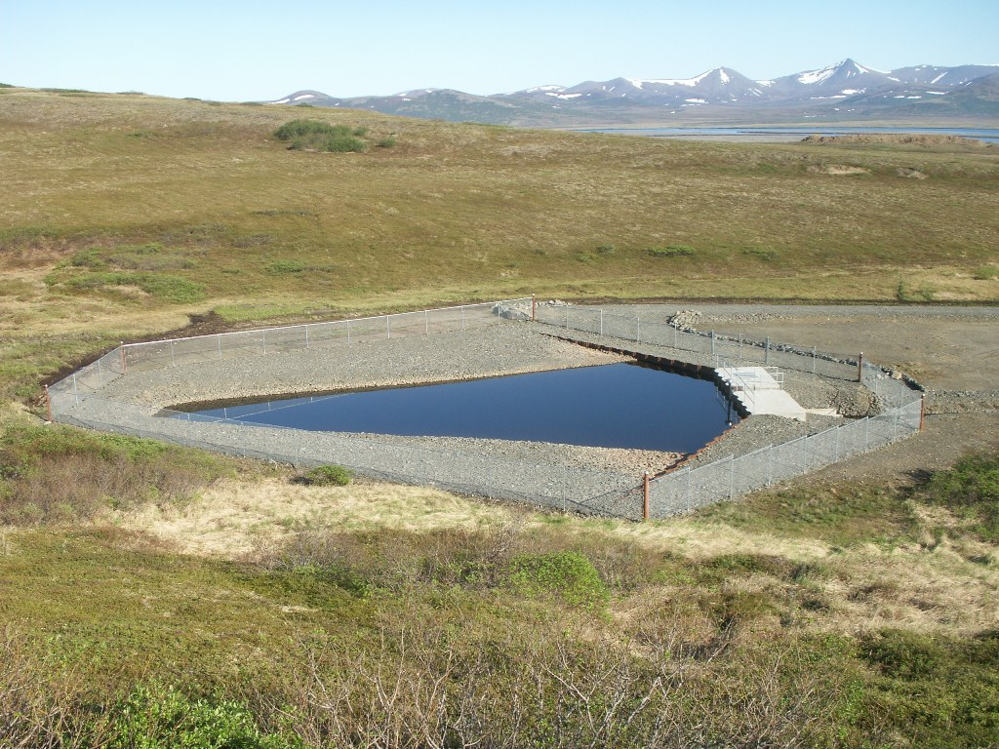
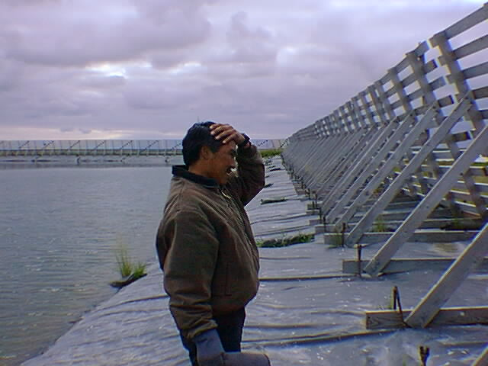
Water Source
Groundwater
Wells
GUDISW
Wells
Infiltration Galleries
Surface Water
Impoundments
Diversion Structures

Slide 5
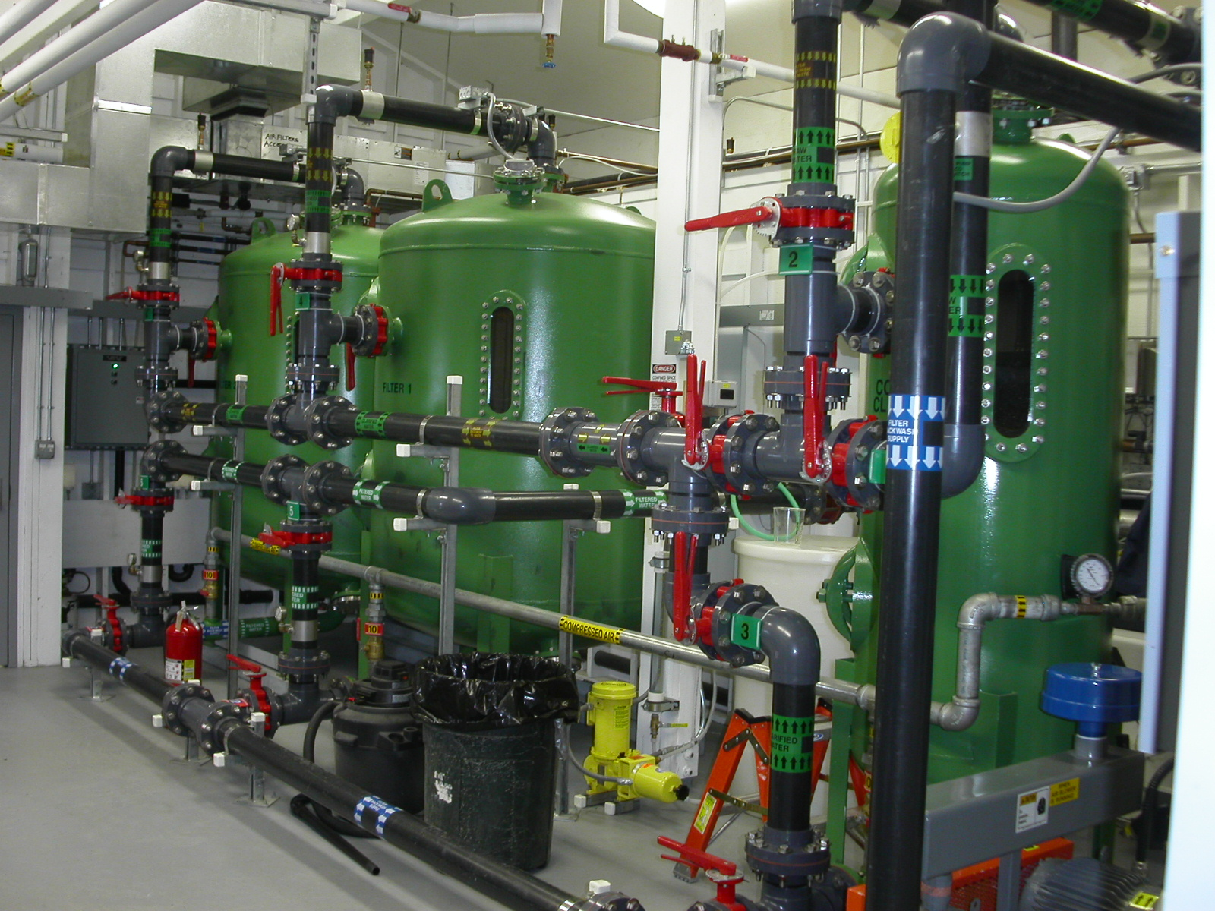
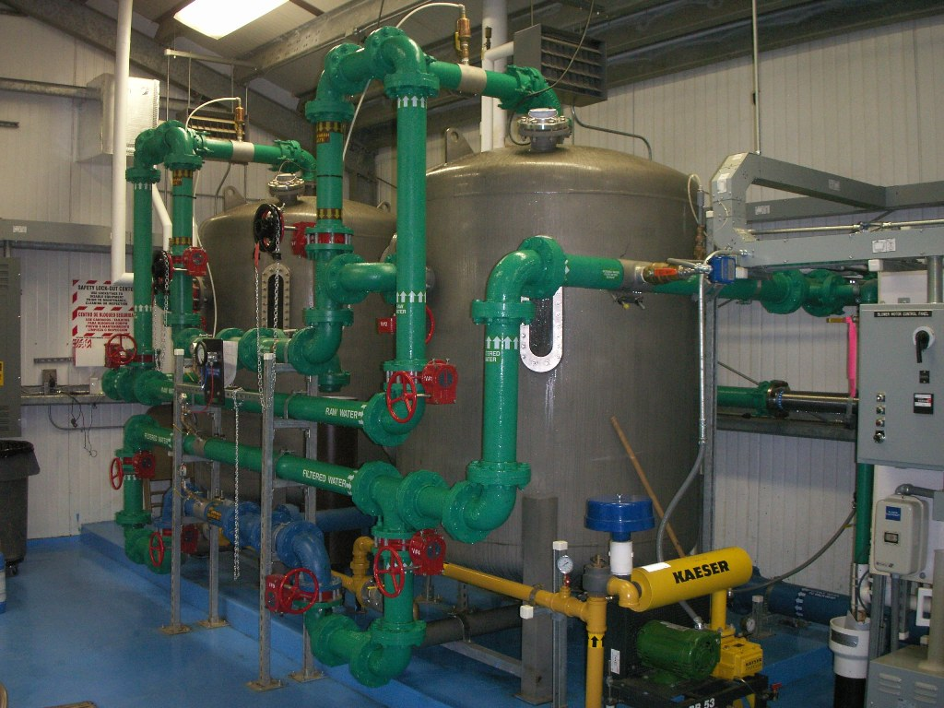
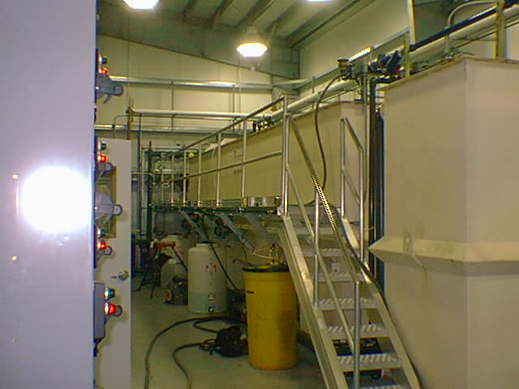
Water Treatment
Groundwater
Inorganics & Complexed Organics
GUDISW
Inorganics & Complexed Organics
Microorganisms
Surface Water
Inorganics
Organics & Complexed Organics
Microorganisms
Regulatory Requirements

Slide 6
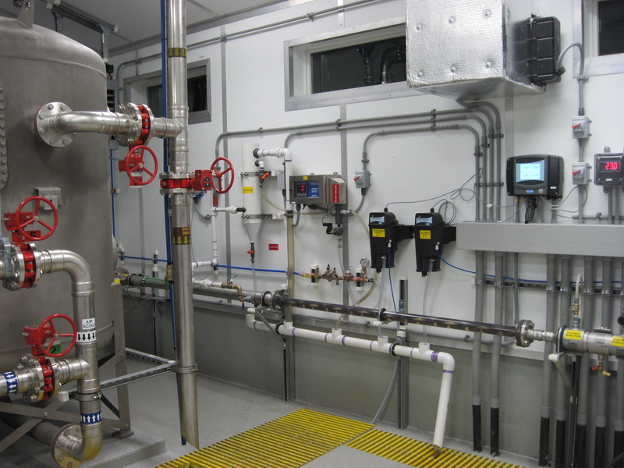
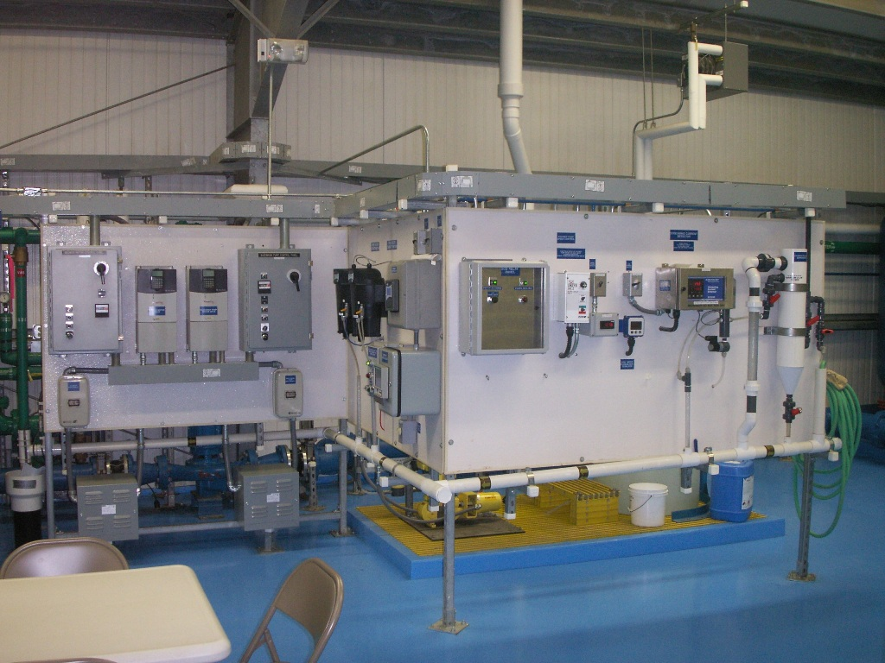
Water Treatment
Streaming Current Detectors
Online Monitoring
Drives

Slide 7
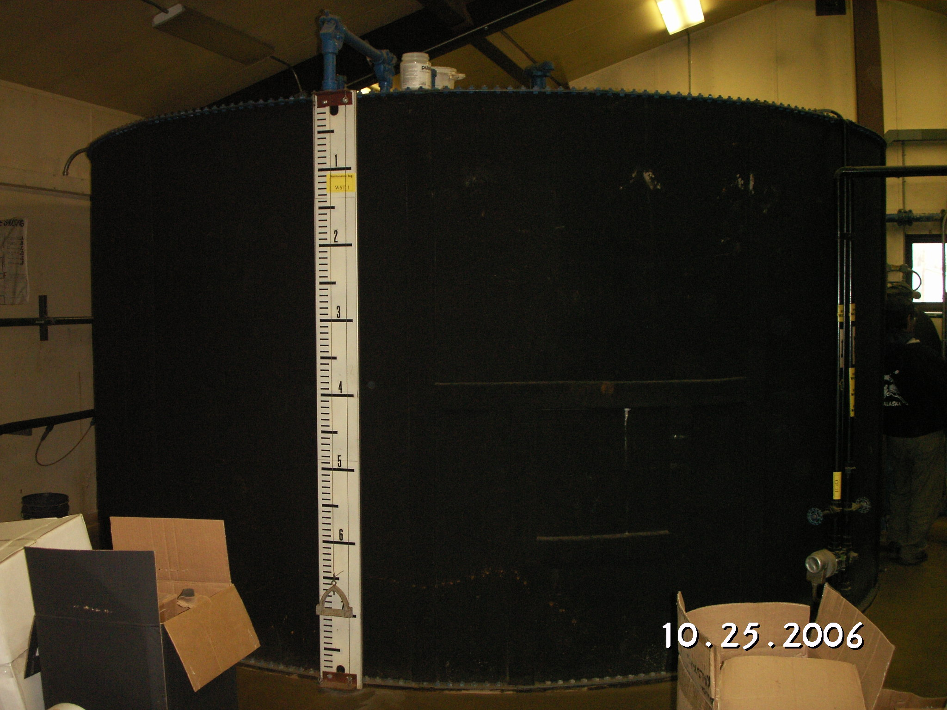
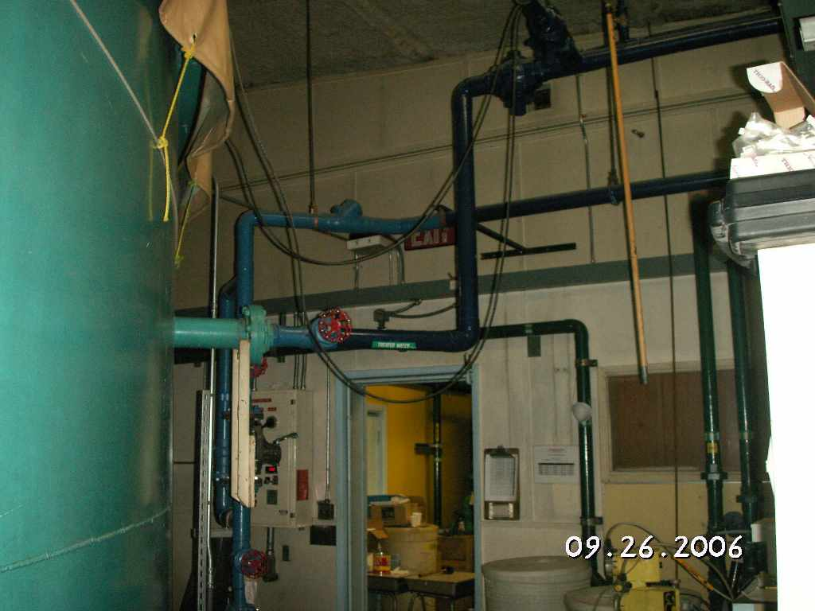
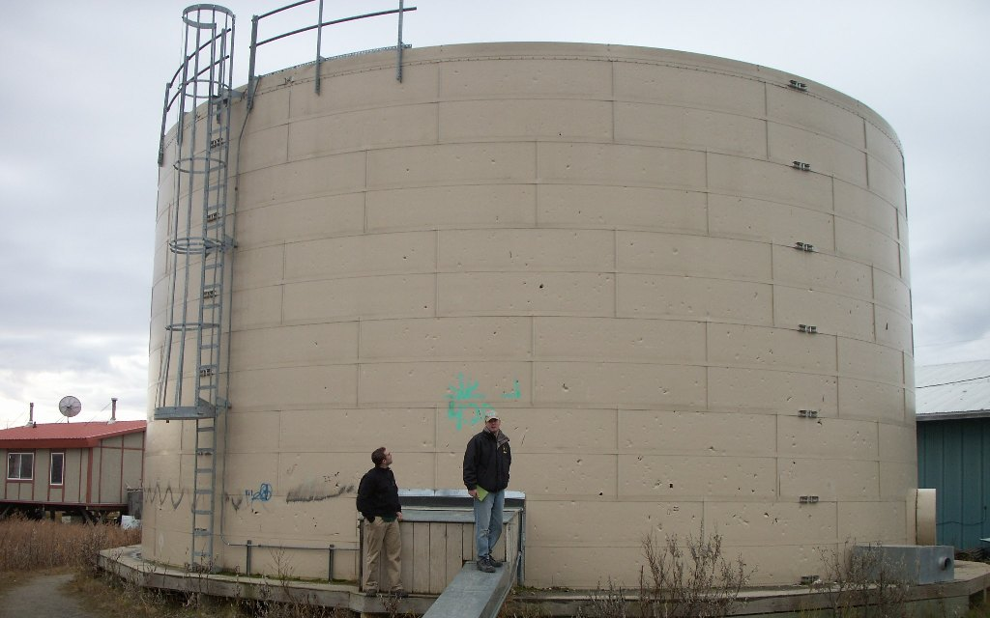
Water Storage
Exterior Insulated Tanks
Interior Tanks in Buildings

Slide 8
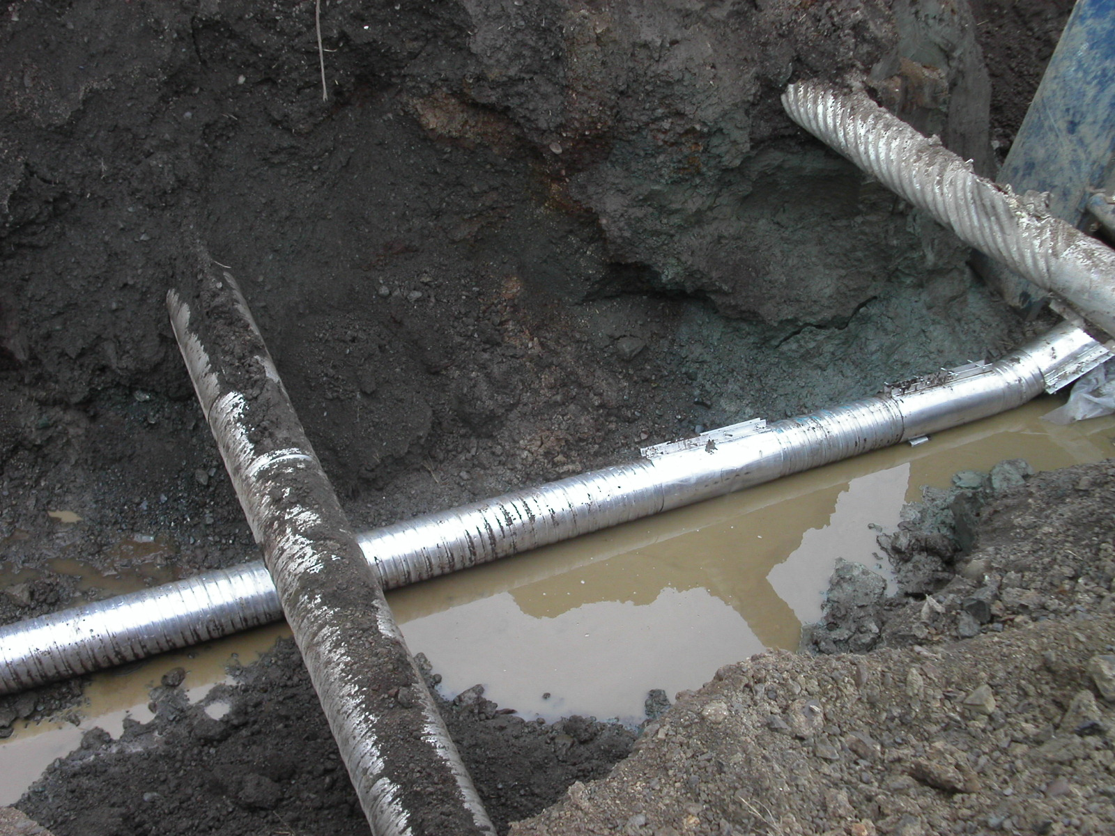
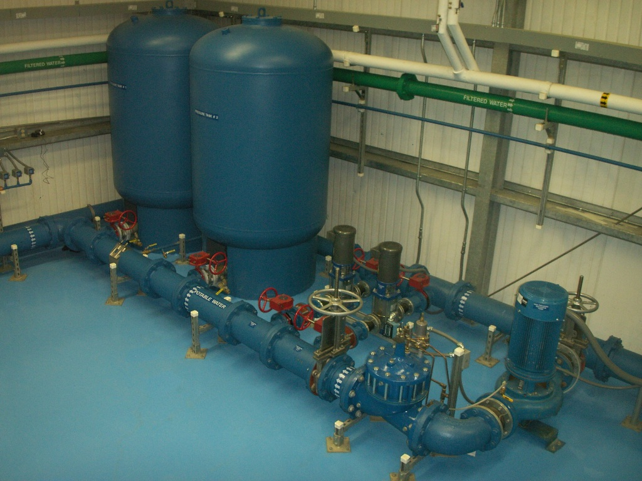
Water Distribution
Piped Distribution
Buried
Above Ground
Utilidor

Slide 9
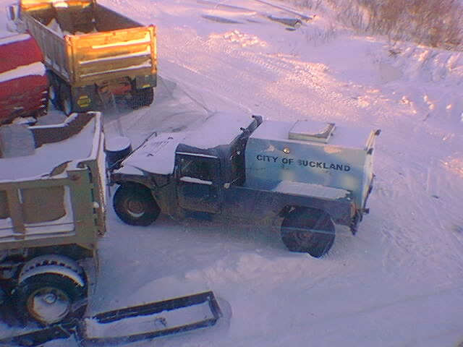
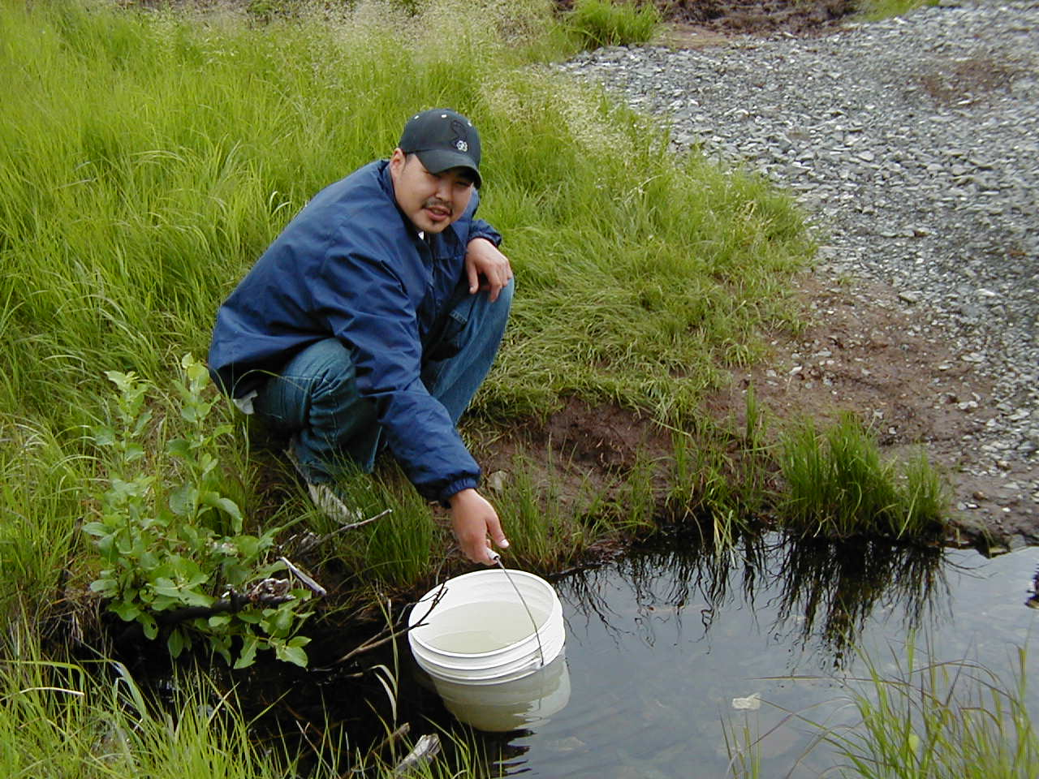
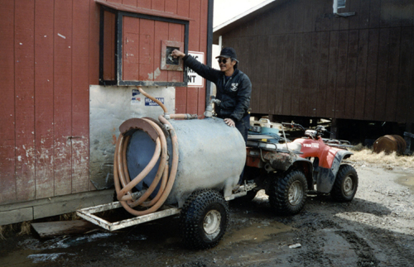
Water Distribution
Haul
Community
Individual

Slide 10
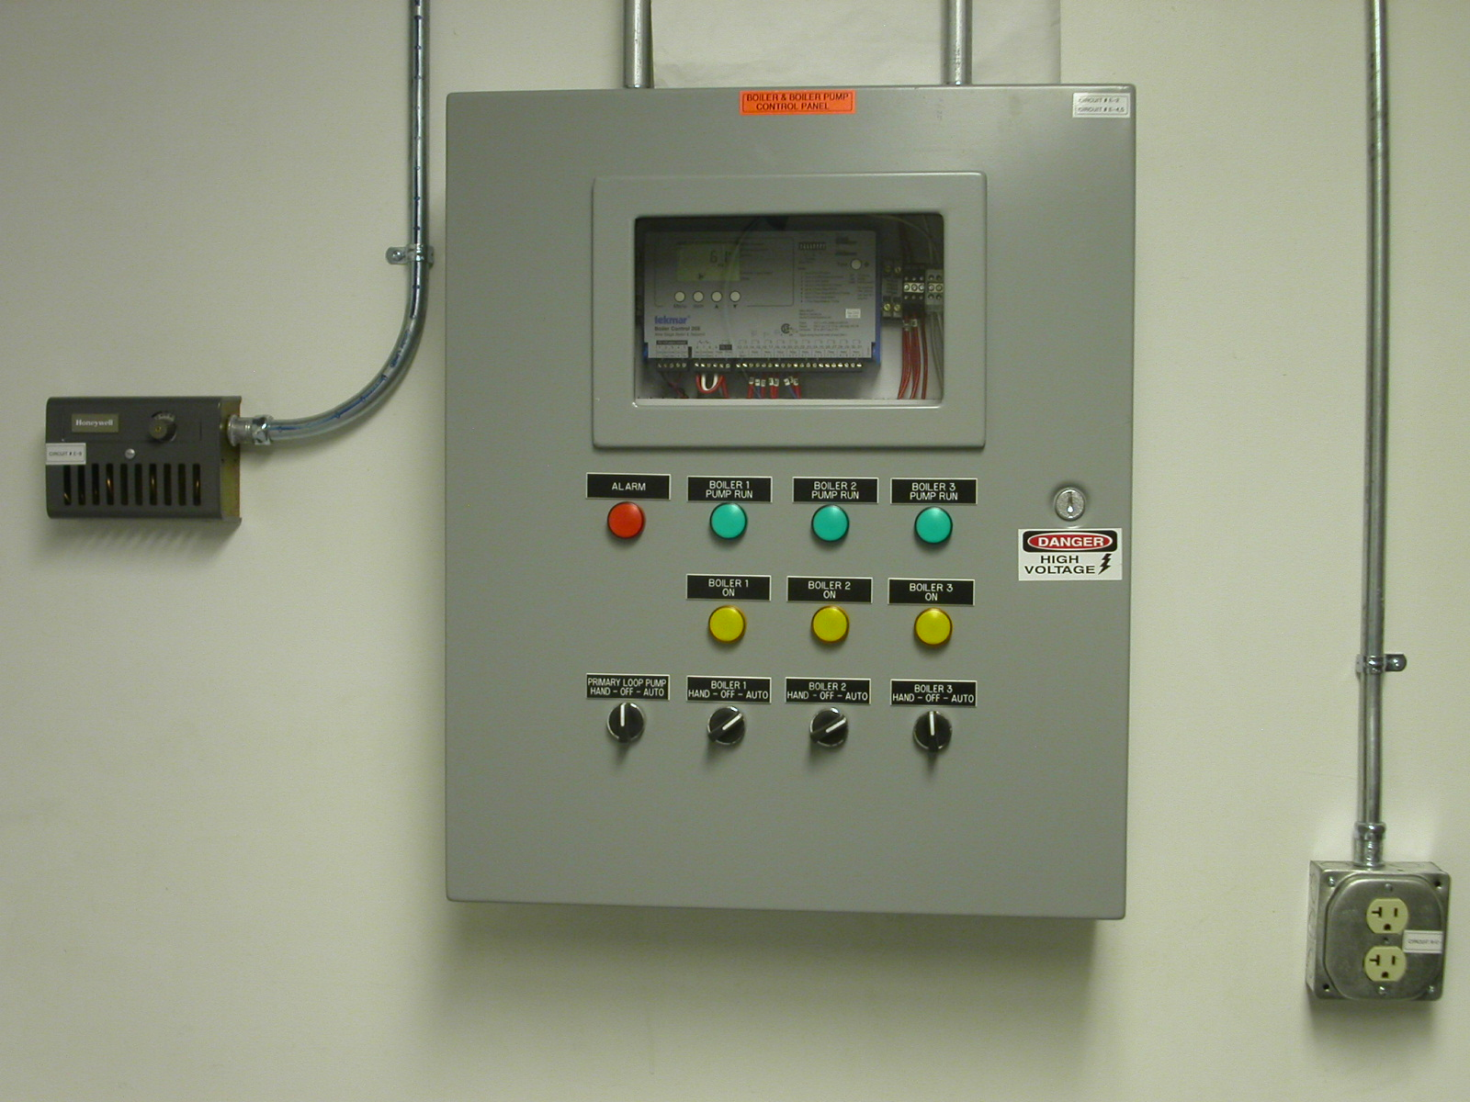
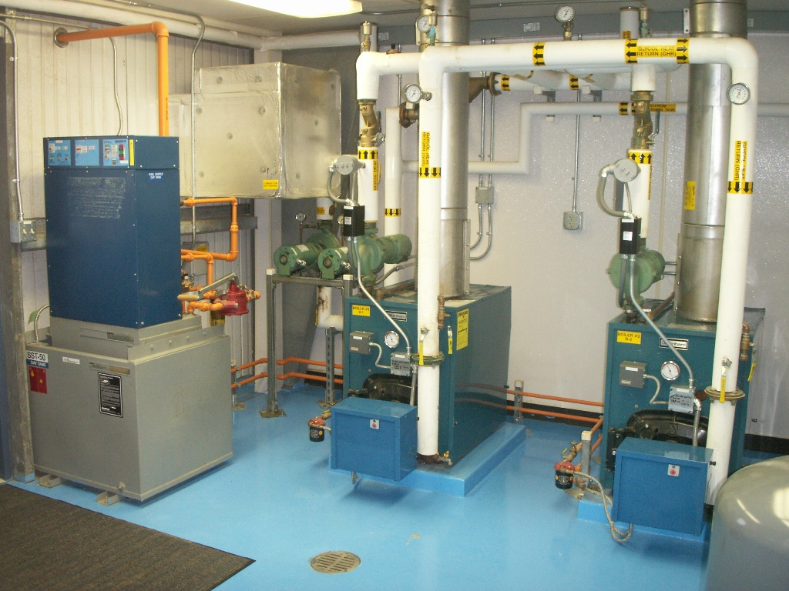
Water Distribution
High Efficiency Heating Systems
Boiler Controls
Drives (motor controls)
Integrating Online Monitoring

Slide 11
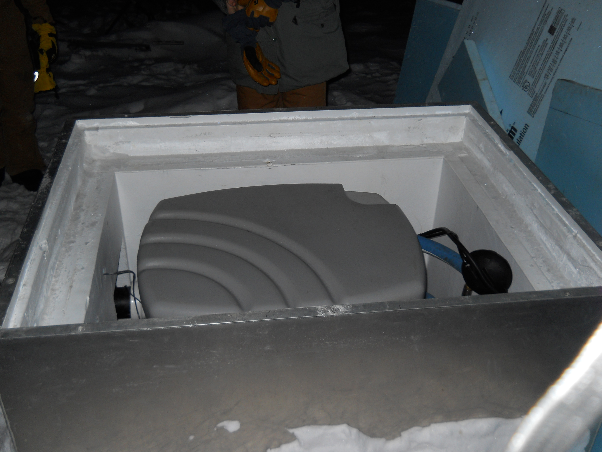
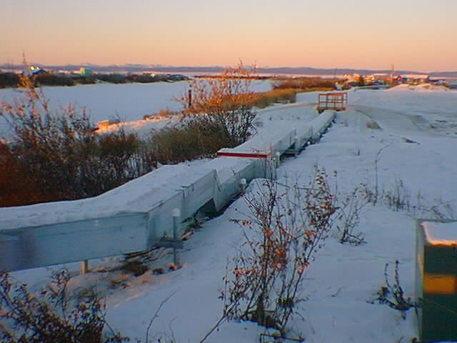
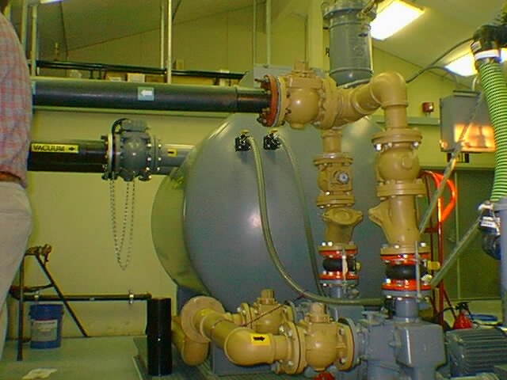
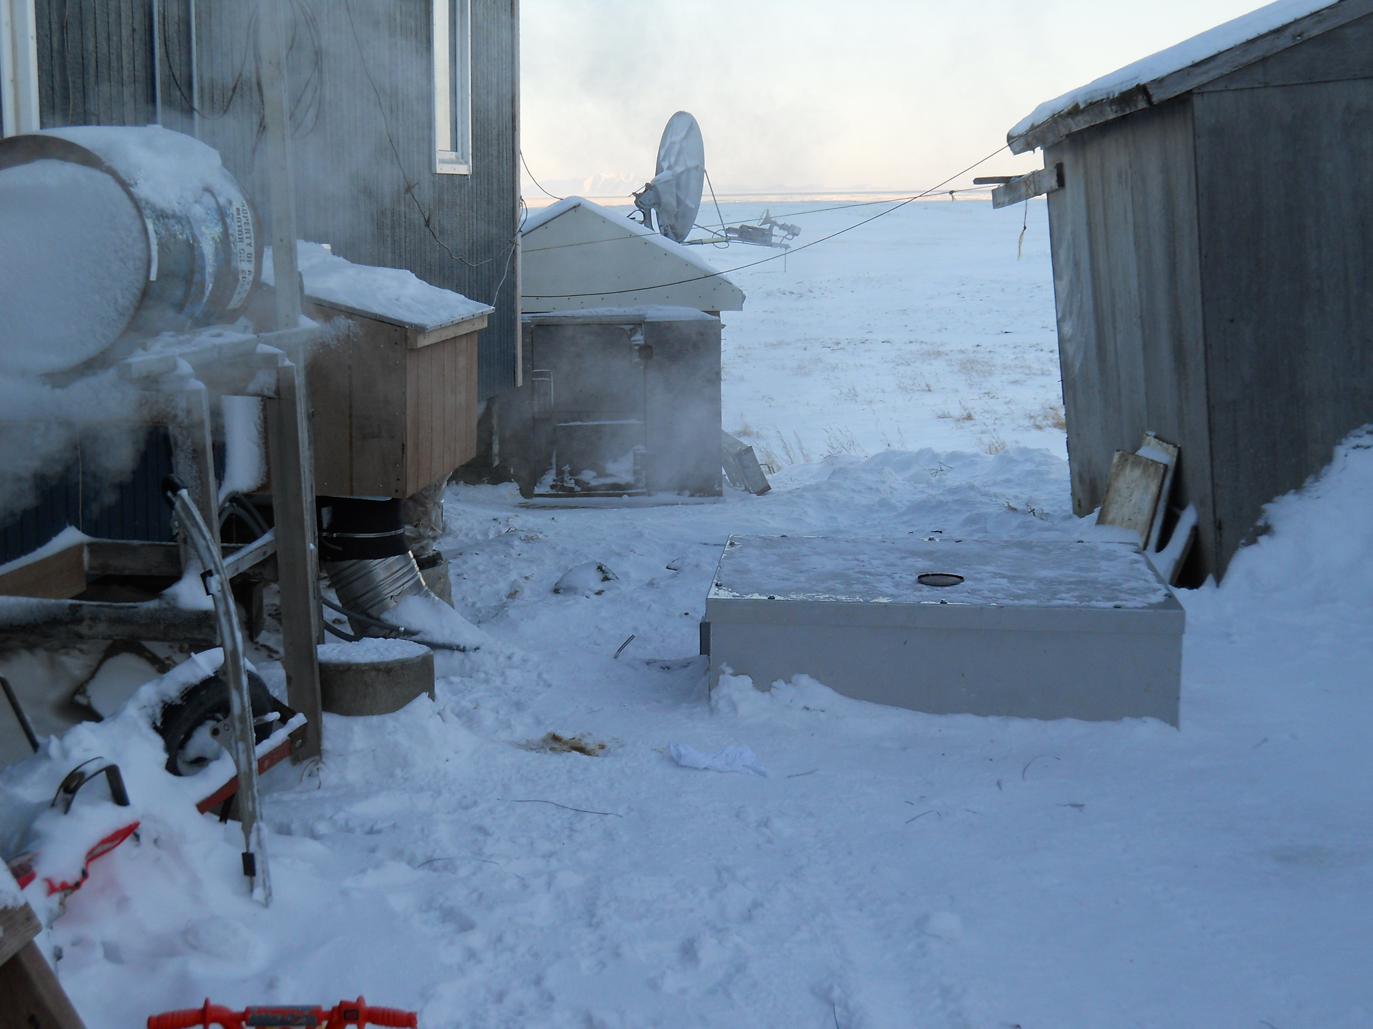
Wastewater Collection
Piped Collection
Gravity
Vacuum
Low Pressure

Slide 12
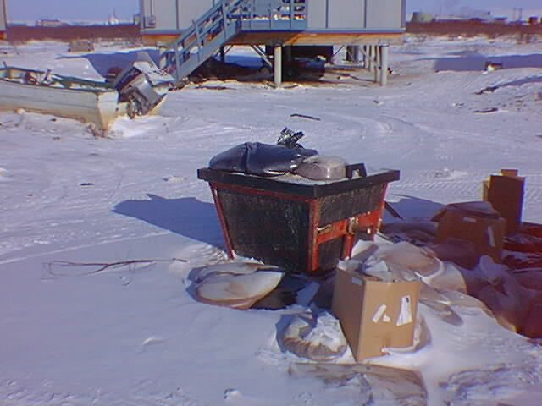
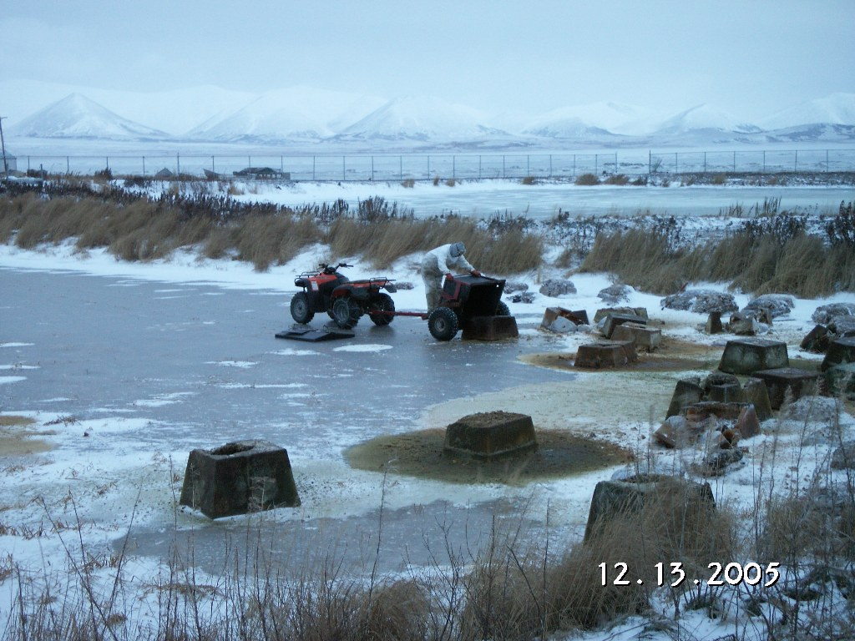
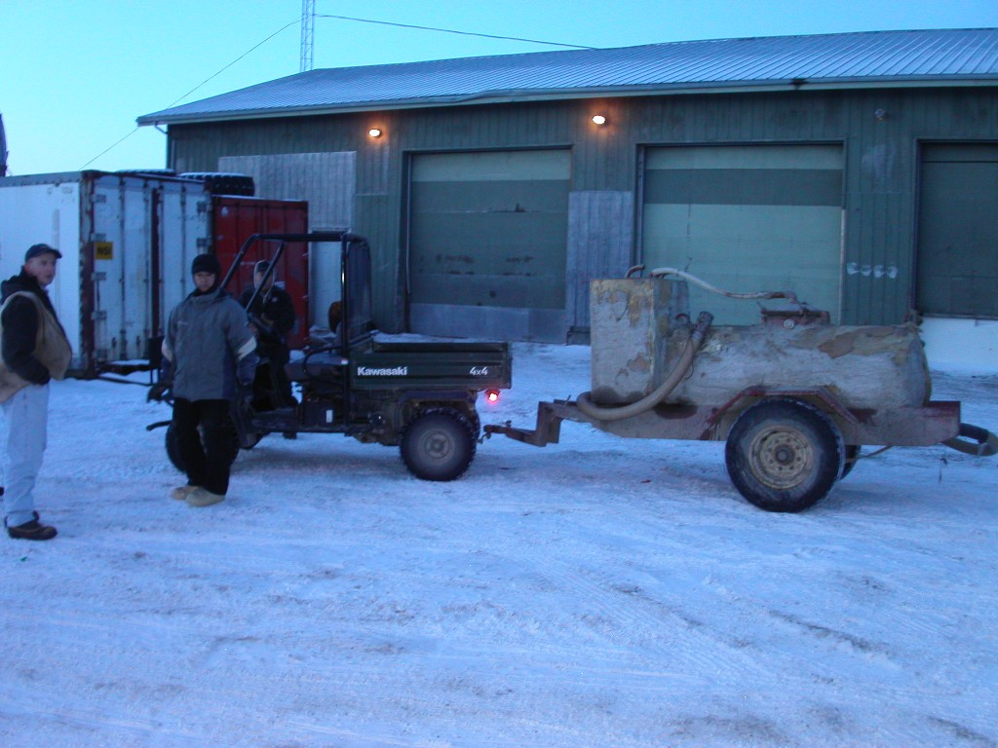
Wastewater Collection
Haul
Individual
Community

Slide 13
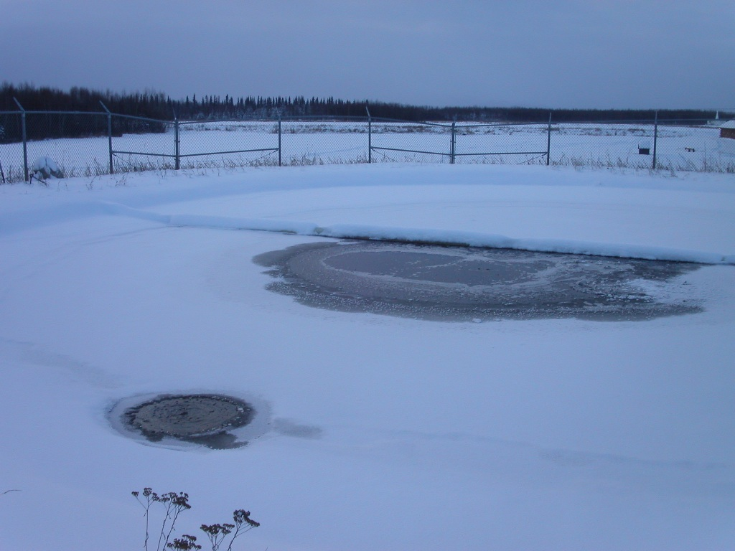
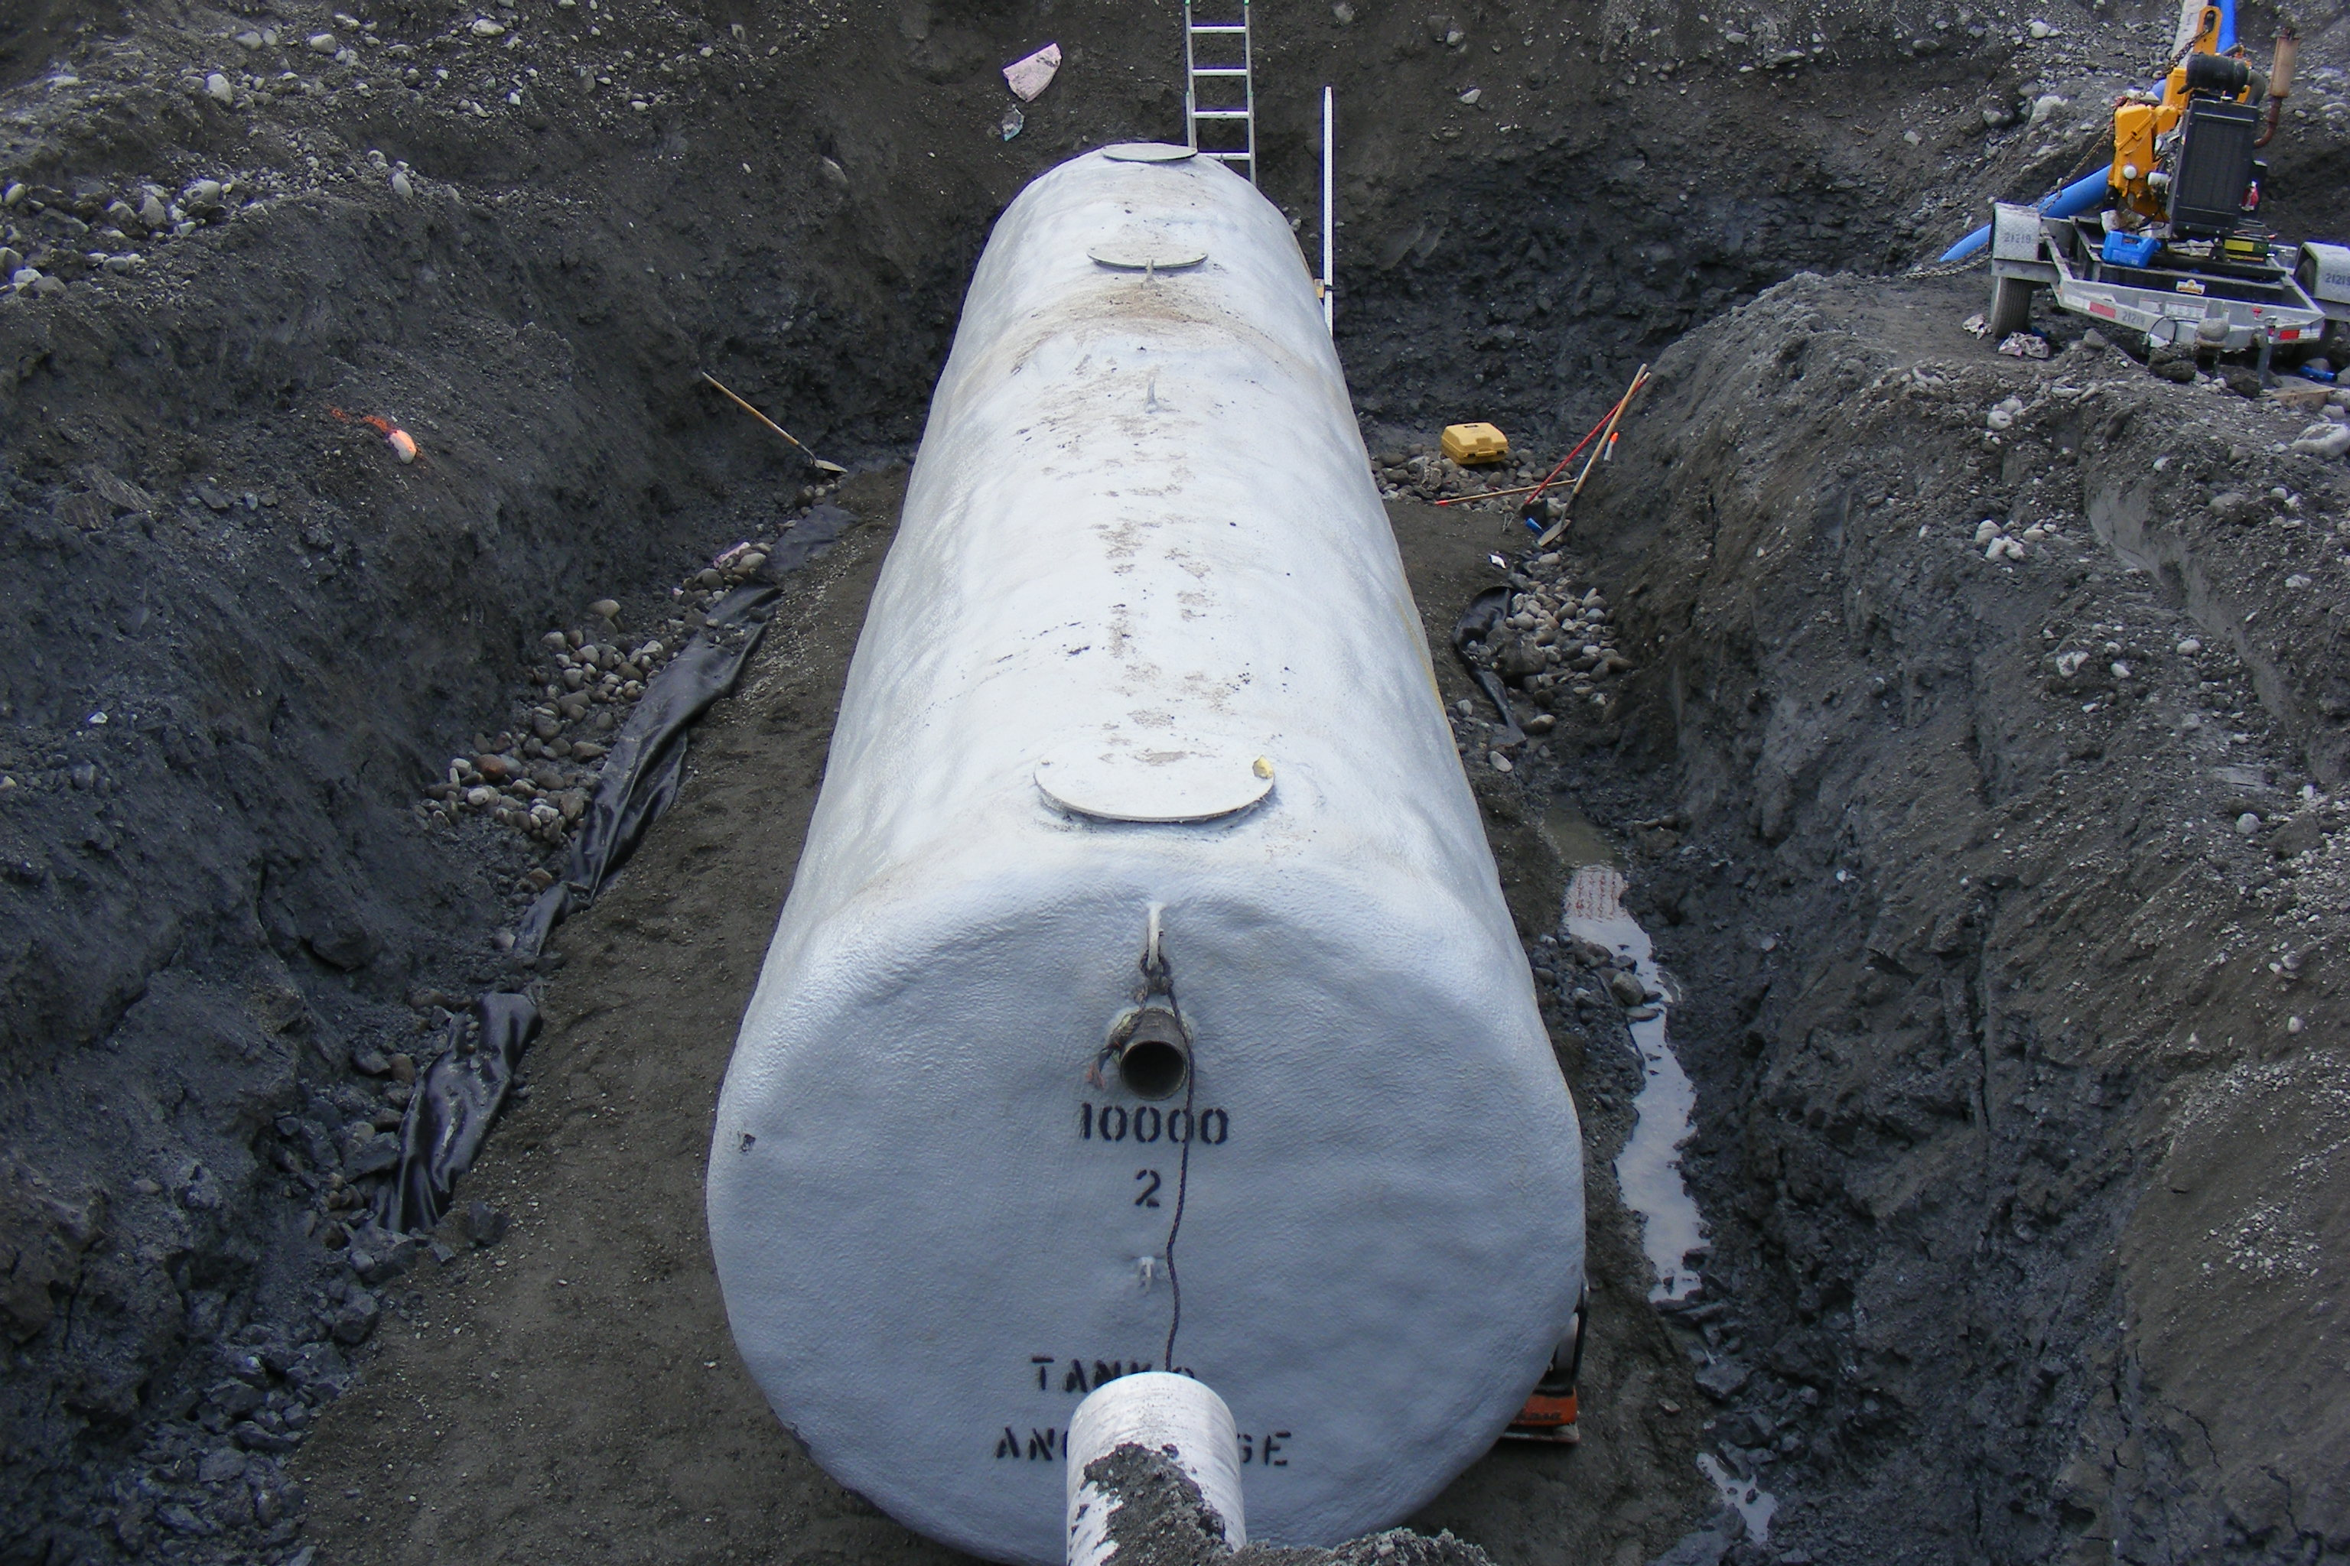
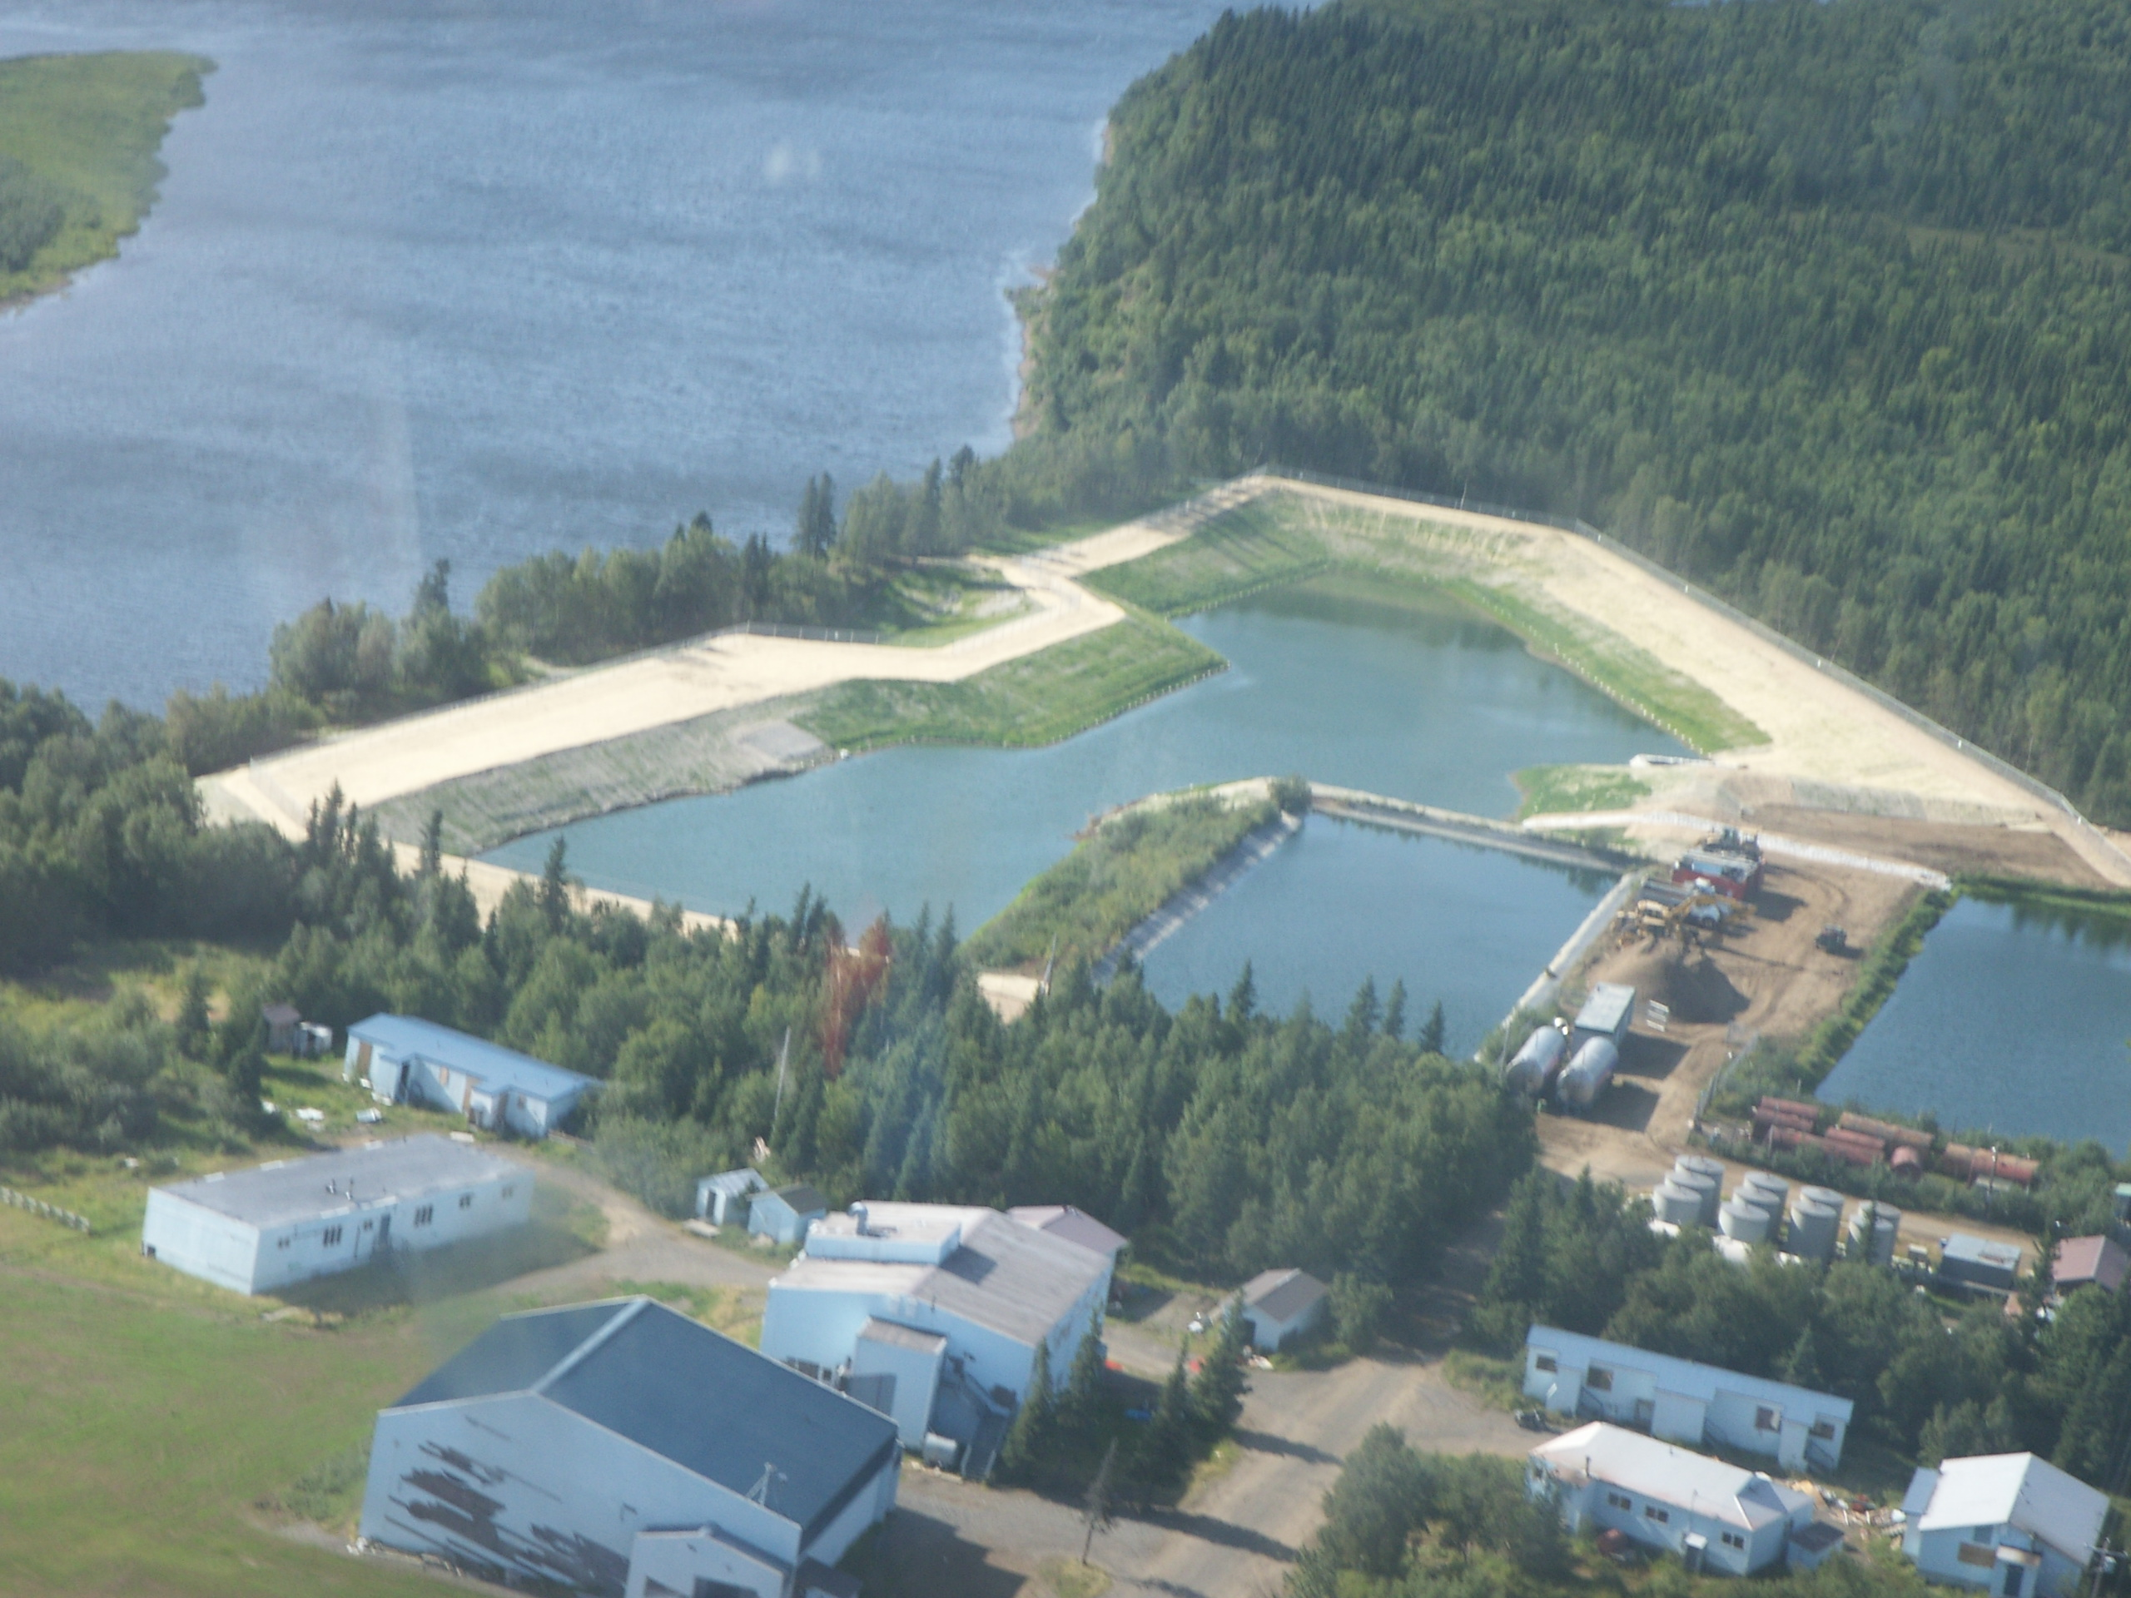
Wastewater Treatment
Natural Systems
Facultative Lagoons
Septic Tanks
Advanced Treatment
Aerated Ponds
Suspended or Attached Growth
Regulatory Requirements

Slide 14
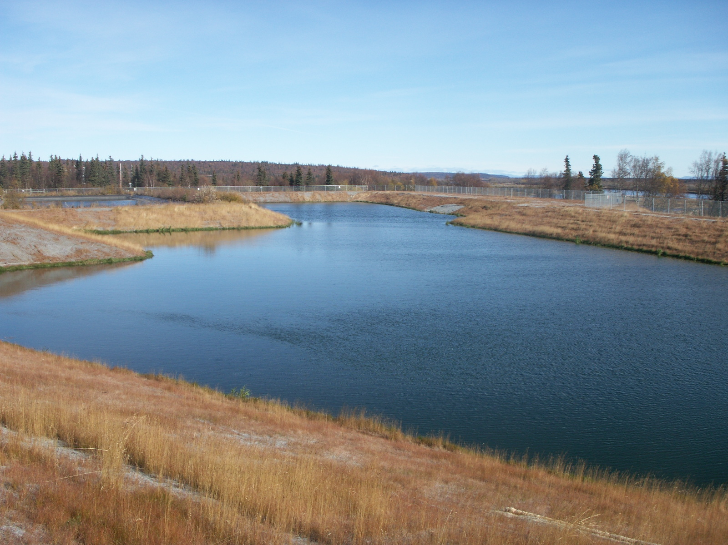
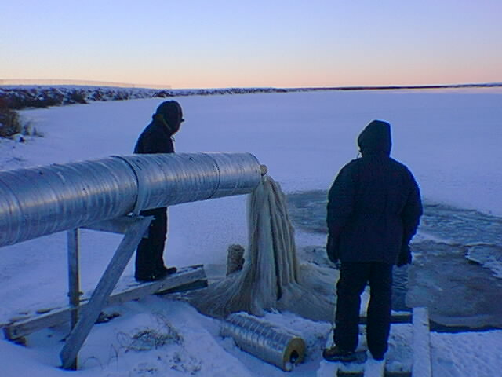
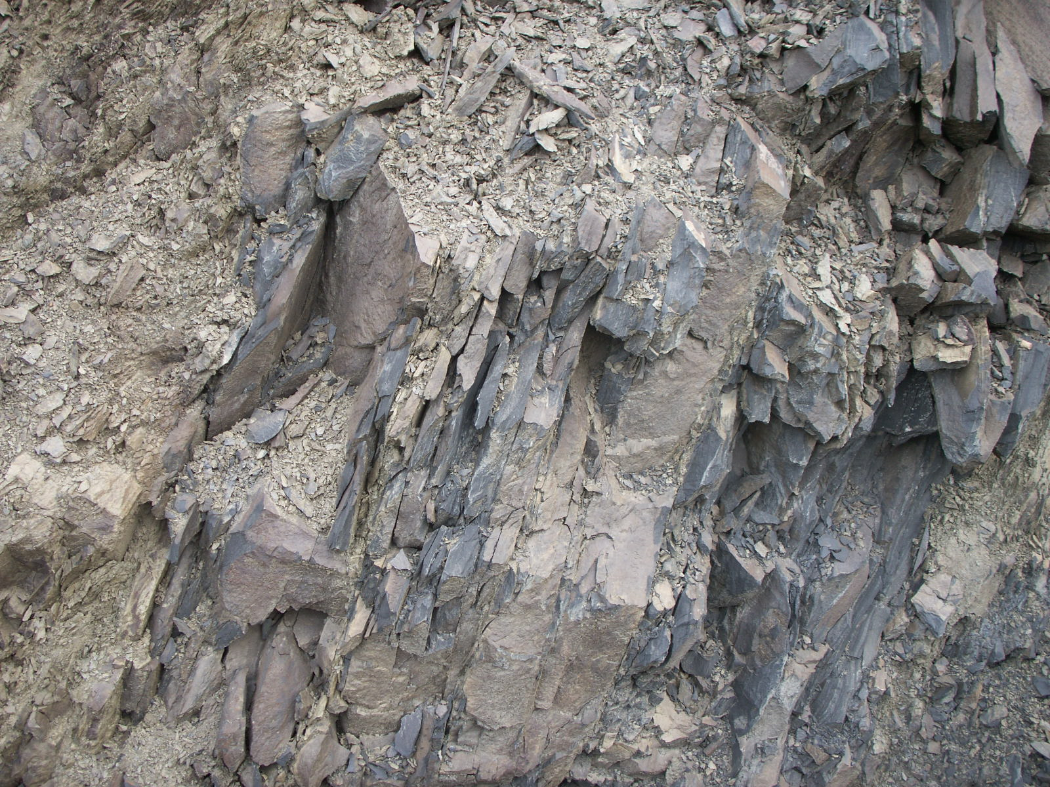
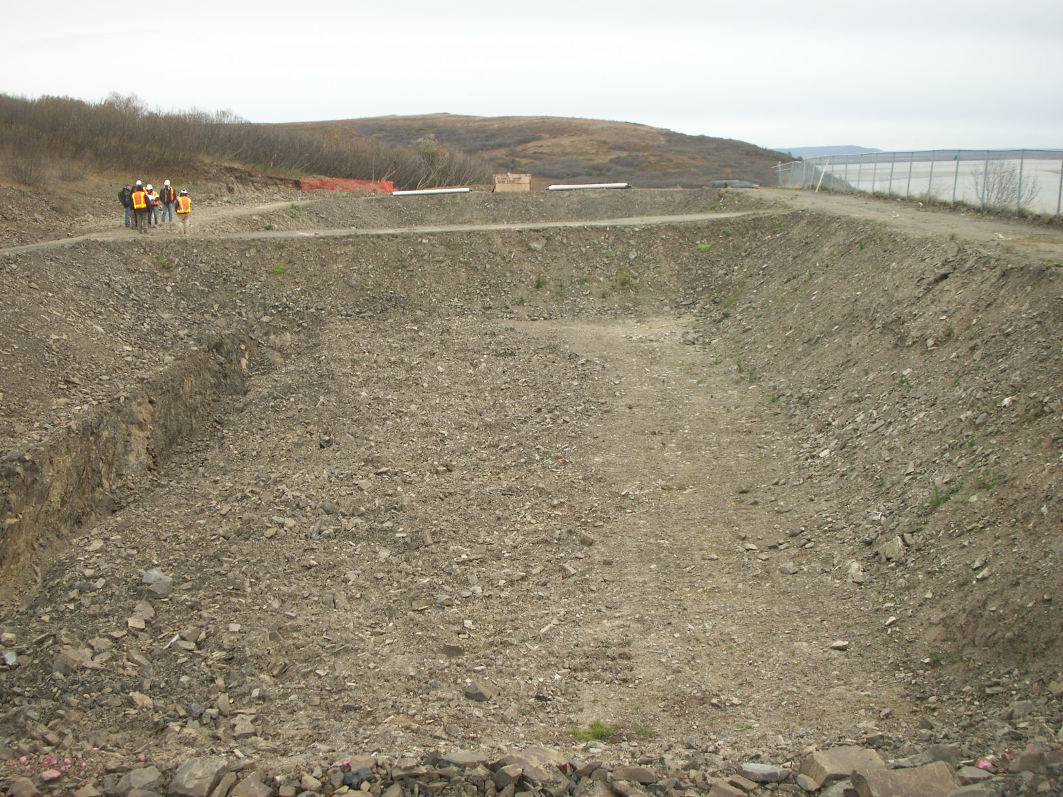
Wastewater Disposal
Liquids
Percolation
Surface Discharge
Solids
Landfill

Slide 15
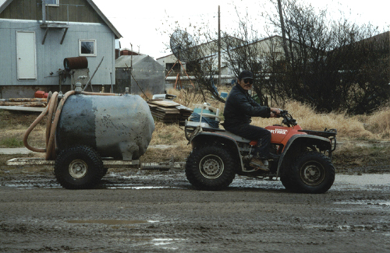
Opportunities
Piped Systems
Well Refined
Expensive to Construct
Lower Operational Cost
Benefit from Economy of Scale
Haul Systems
Not Well Refined
Inexpensive to Construct
Higher Operational Cost

Slide 16
QUESTIONS?

