Slide 1
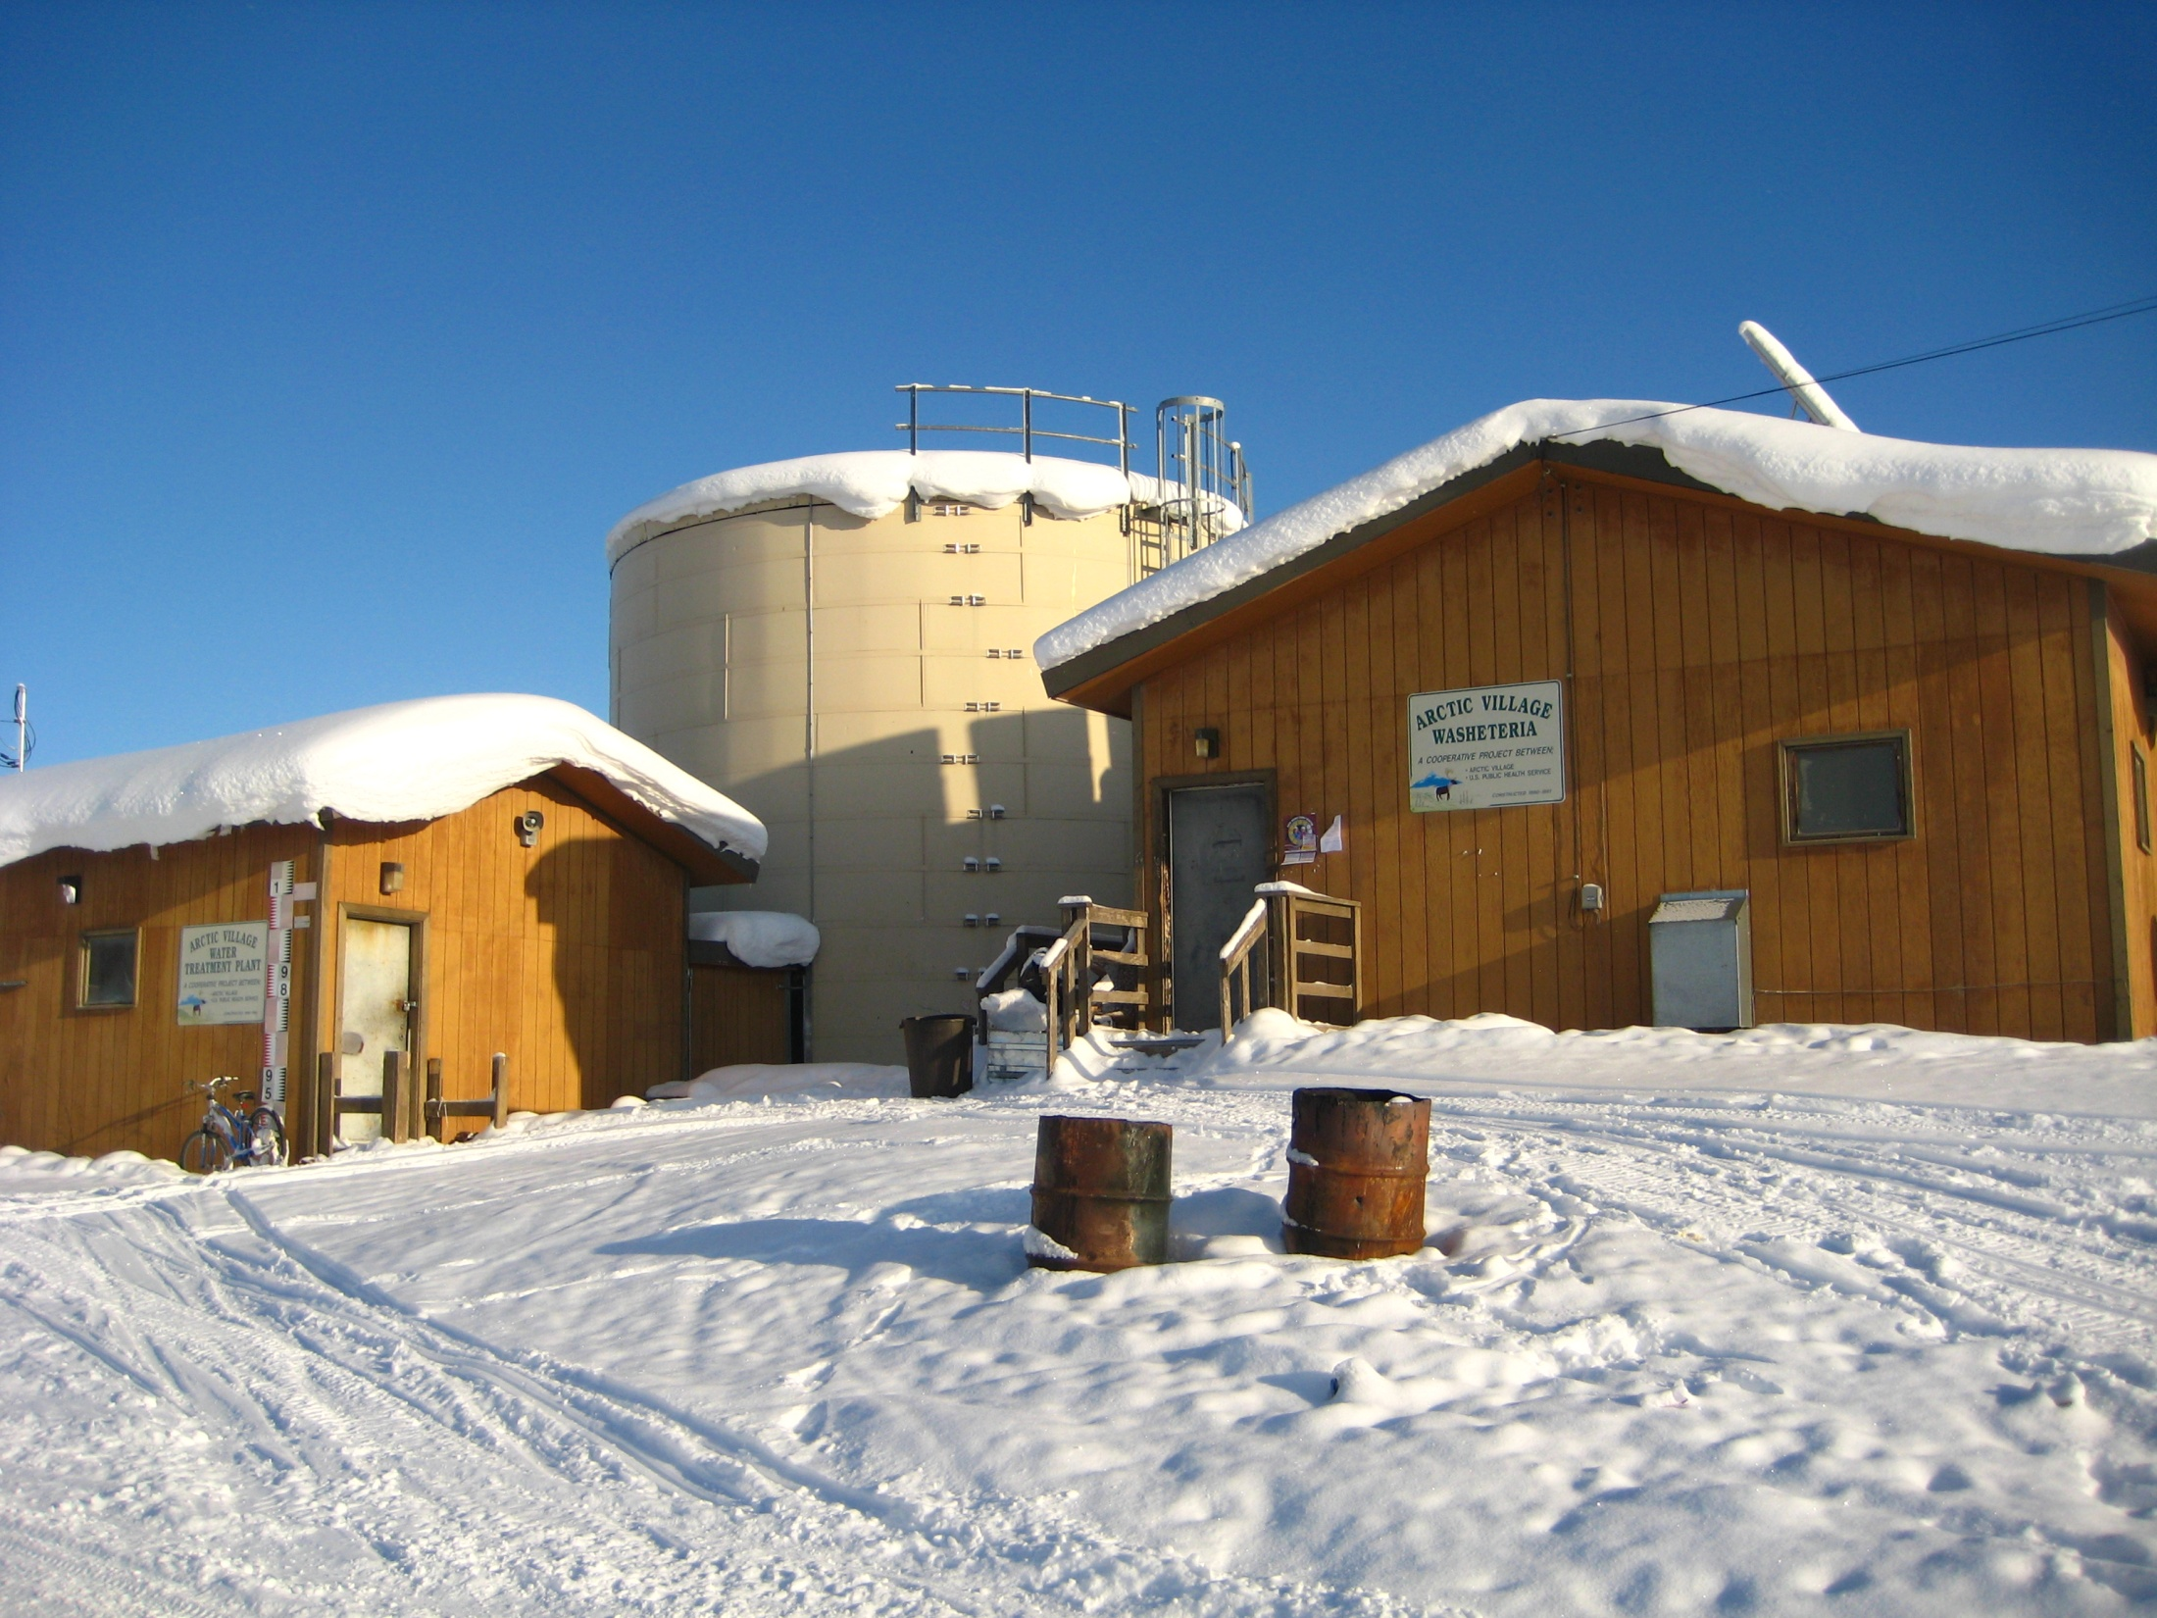
Overview of Funding and Needs for Rural Alaska Water and Sewer Improvements
Bill Griffith
Alaska Department of Environmental Conservation

Slide 2
Progress in Alaska Village Sanitation
For half a century, we’ve focused on “putting the honey bucket in the museum” (and keeping it there!)
Much progress has been made:
30 years ago, fewer than 25% of rural Alaska households had running water and flush toilets.
In 1996, 55% of rural homes had piped or covered haul service.
Today, approximately 75% of rural homes have indoor plumbing (over 90% if regional hubs are included in the calculation).

Slide 3
“Centralized” Approach Since 1970:
100% water treatment to full regulatory compliance (regardless of ultimate use)
Storage of large quantities of water, usually requiring heat addition
Distribution of treated water to individual homes via pipes or haul vehicle, usually requiring heat addition
Collection of all household sewage for lagoon disposal, usually requiring heat addition

Slide 4
Categories of Project Needs January 2012
Upgrades or replacements to address substantial health threats: $410,015,442

Slide 5
Distribution of Unserved Homes in Served -vs- Unserved Communities
Served Homes (29,513 or 83%)
An unserved home is one which is not connected to an onsite or community piped or closed haul system.
An unserved community is one in which less that 55% of residences are connected to an onsite or community piped or closed haul system.

Slide 6
Categories of Unserved Homes
An unserviceable home is one that is located in an area where septic tanks and wells are not feasible and is too far away from the
“core” area of a community making extending piped service or providing vehicle access for flush/haul vehicles unreasonably expensive.

Slide 7
Past and Projected Project Funding Needs

Slide 9
Project Funding from All Sources 2004 - 2013

Slide 10
The Growing Gap Between Critical Needs and Available Funding

Slide 11
Relationship of Needs, Multi-Year Projects and Funding
*Note: Tribal funding through EPA and IHS for Alaska projects is not dedicated to Alaska’s Multi-Year Projects.

Slide 12
How long would it take to provide service to all remaining Alaskan homes without running water and sewer?
Assumptions:
Current cost estimate to serve homes is very low – probably by a
factor of 2 or 3.
Projecting actual recent construction costs and current house count
information: The cost to provide first time service to all unserved homes
is between $600 million and $900 million. Use $750 million for this exercise.
Assume that total funding remains constant at $65 million per year.
Assume continued funding split between first-time service and upgrades
remains at 60/40 ($39 million for first-service projects and $26 million for
upgrades)

Slide 13
Projection:
It would require 19 years to provide service to all remaining homes.
Year 2031.

Slide 14
EPA Recommended Sustainability Threshold
- - - - - - - - Lower 48 Average

Slide 15
Bottom Line:
Centralized solutions used for the past 50 years are increasingly unaffordable to build, upgrade, replace and maintain.
Available funding is not adequate to serve remaining homes and make needed improvements.
Innovative approaches are needed now in order to address health problems associated with water and sewer system deficiencies.

Slide 16
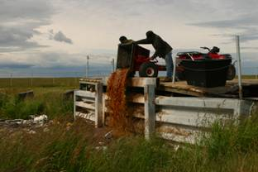
The need for innovative approaches exists at every service level:
Thousands of people will continue to handle honey buckets for years to come

Slide 17
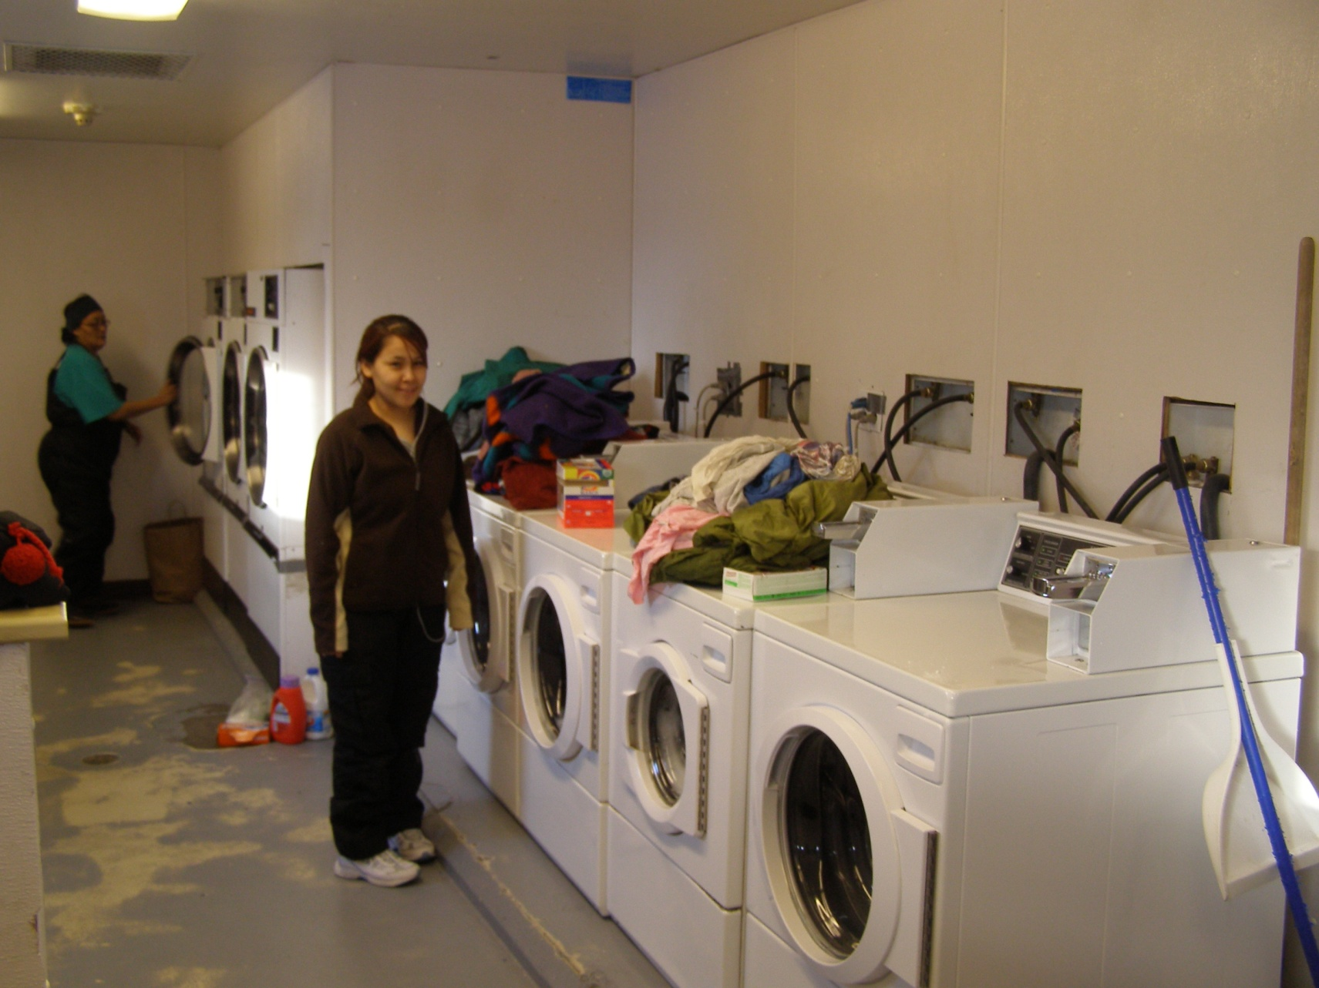
Washeterias will remain the most sustainable level of service for many villages

Slide 18
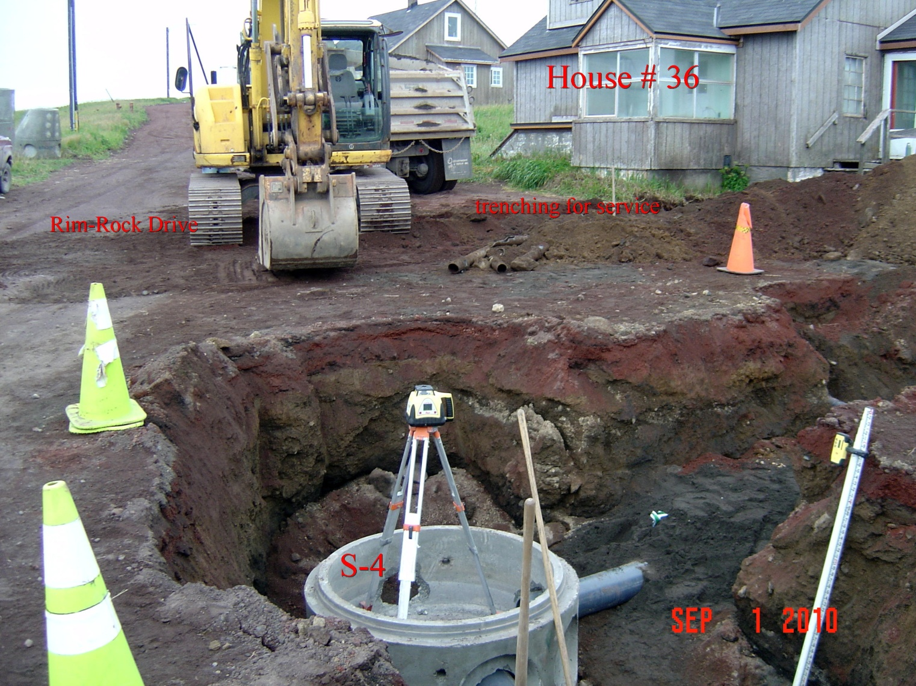
Many existing piped systems are at the end of their useful life or require major upgrades

Slide 19
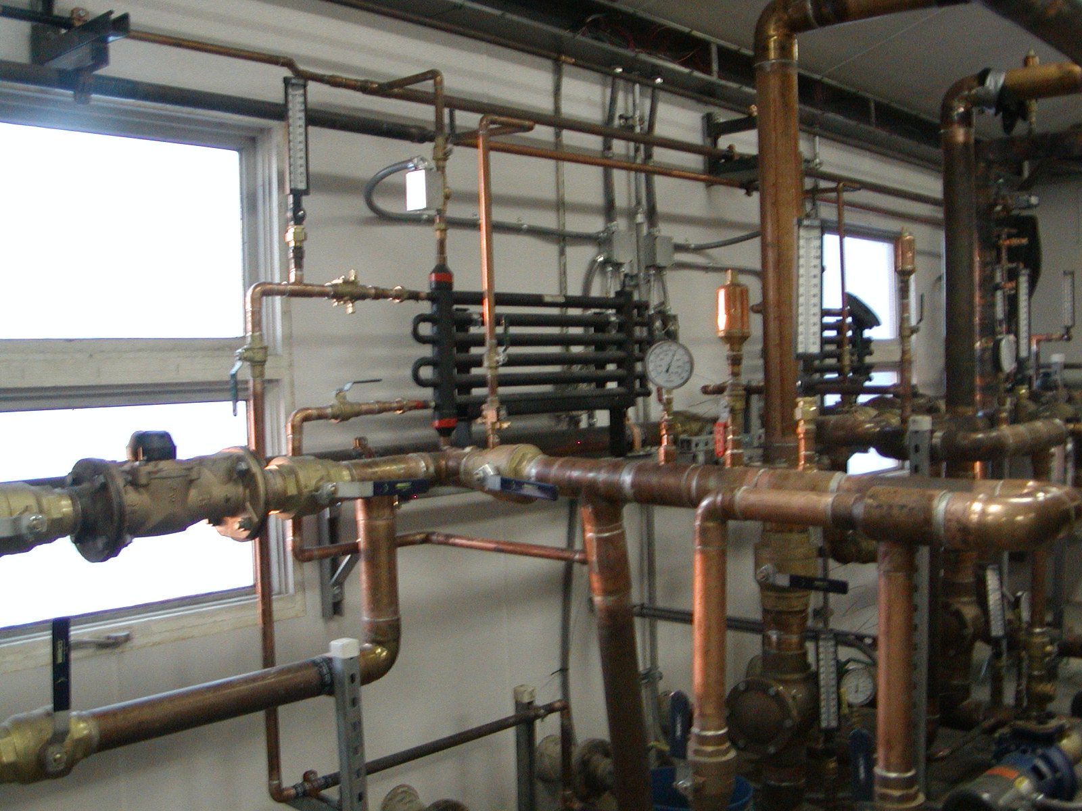
Upgrades to water plants and other buildings are needed to meet current regulations and improve energy efficiency

Slide 20
“Discovery consists of seeing what everybody has seen and thinking what nobody has thought.” Albert Szent-Gyorgyi Hungarian physiologist who won the Nobel Prize in Medicine in 1937,credited with discovering vitamin C.

