Slide 1
Water & Health in Alaska considerations for water quantity
Troy Ritter, REHS, MPH, DAAS
Applied Sciences Manager
ANTHC-DEHE
Notes:
Brundin, I. and Hennessey. T. 2011. A Review of water quality standards for optimal health.

Slide 2
Documented health benefits of improved water service in Alaska
Acute respiratory infections
Skin infections
Invasive pneumococcal disease

Slide 3
Bradley Classifications
Waterborne diseases: where the pathogen is in the water and causes illness when ingested
Water-washed diseases: where transmission of the pathogen is interrupted by washing with water

Slide 4
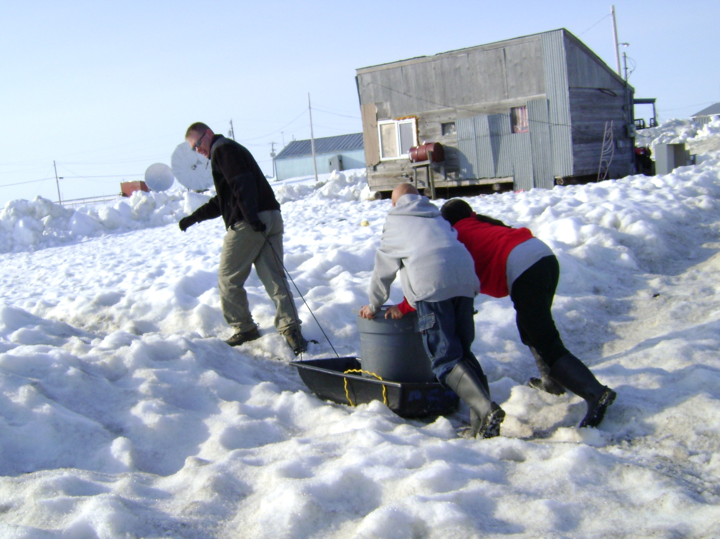

Slide 5
How much water is needed for optimal health?

Slide 6
Water Quantity Guidelines
With internal fixtures
The World Health Organization⁴: 26.4
Cold Regions Utilities Monograph⁵: 15.9
No internal fixtures
Gleick³: 13.2
The World Health Organization⁸: 13.2
The Sphere Project⁶: 4
The UN Refugee Agency⁷: 4-5
*All units are gallons/person/day
Notes:
*all recommendations originally given in L
Self-haul
Gleick (1996): 50 Lpcd (13.21 G)
The Sphere Project Handbook (2011): 15 Lpcd (3.96 G)
Minimum standards for Humanitarian Response
UNHCR–The UN Refugee Agency (1994): 15-20 Lpcd (3.96-5.28 G)
The World Health Organization (2010): 50 Lpcd
Low level of health concern
Truck Haul
Cold Regions Utilities Monograph (1996): 90 Lpcd (23.78 G)
“This quantity of water is assumed to provide a level of service and benefits (particularly health benefits) equivalent to that of a piped system” (p. 2-25)
Piped
The World Health Organization: 100 L (26.42 G)
Very low level of health concern
Cold Regions Utilities Monograph (1996): 60 Lpcd (15.85 G)
“The minimum amount of water considered adequate for drinking, cooking, bathing and laundry…even this may be difficult to achieve where piped delivery is not possible or practical” (p. 1-3; 5-16)
“there was no statistical decrease in health conditions where water use was over 65 Lpcd” (p. 2-3)

Slide 7
How much water is needed for optimal health (in Alaska)?

Slide 8
Impact of piped water on rates of infections
Start with 4 villages with only self haul water
Collected data on water use and health
Most households were proved piped services
Collect data on water use and health after pipes

Slide 9
Opportunities for Observation
Water use in self-haul households
Water use in piped households
Water use in transition from self-haul to piped

Slide 10
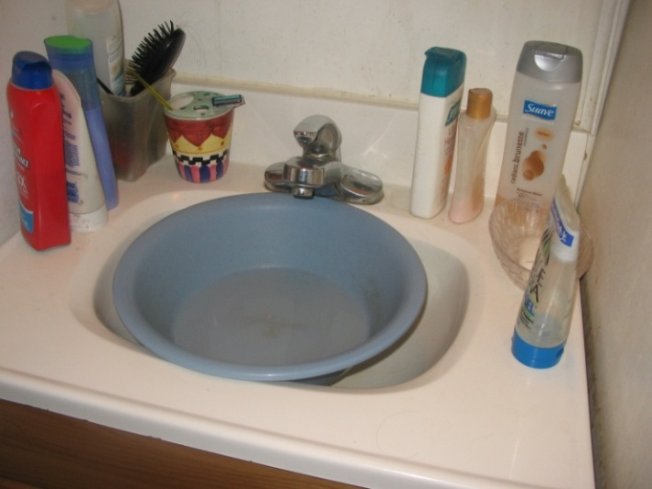
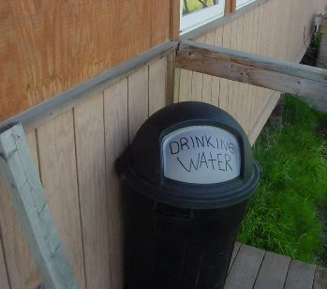
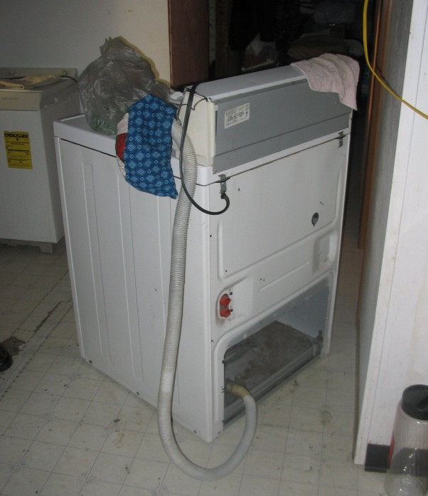
Water use in self-haul households
Residential water use < 2 gpcpd

Slide 11
Change in Household Water Use (volume)
Mean Water Use
Predicted Water Use
Self-haul Water Use
Self-haul Water Use
Notes:
The average water use along with the predicted level from the linear regression are shown in Figure 3 for the village of Akiak, the village with the longest monitoring of water meters. On average, at the start of the project, as predicted from the regression model, households used 19.1 gallons (95% CI: 15.3, 23.0) of water pppd. By the end of the promotion project, households were using an average of 27.8 gallons (95% CI: 24.2, 31.4) pppd.
The village of Akiak was the only village with households with enough readings to do individual regressions at the household level. There were 45 households in Akiak with ≥ 10 periods of water use. Of these 45 households, 16 (36%) demonstrated a statistically significant increase in their water usage, 3 (7%) had a decrease in water use, and 26 (58%) showed no trend in their water use.

Slide 12
Change in Soap Use (volume)
Self-haul use
Notes:
There was a statistically significant trend in household soap use throughout the course of the project. A quadratic term for the time variable was added to the model (p = 0.005), as the trend was not strictly linear. At the start, households used a predicted average of 3.2 grams pppd (95% CI: 1.7, 4.8) and in the last month of follow-up households used a predicted average of 13.7 grams pppd (95% CI: 9.8, 17.6). Water use and soap use are plotted for the village of Akiak in Figure 5. Although water and soap use both increased throughout the course of the water promotion project, high water use months did not predict high soap use months (p > 0.05).

Slide 13
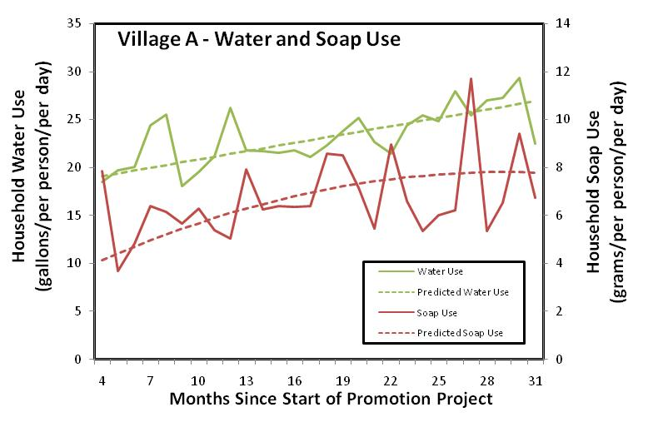
Change in Water & Soap Use (volume)

Slide 14
Comments about water use…
"When our kids come in dirty we just put them in the bath. It's really easy we don't have to heat water for the bath.“
“You can take shower anytime.“
"With the potable water, you can wash your hands more frequently."
"We don't have to wash hands in the same water.“
"Cleaner kids. Cleaner house. Our family doesn't get sick that often.“
"People have readily available water to wash hands and dishes."
“You can wash your hands. You have water all the time. Dishes are done whenever they need to be.
"Has been nice to be able to wash everyday"

Slide 15
Change in (piped) Water Use by Village
Village A
Village B
Village C
Village D
Self-haul Water Use
Notes:
Prior to water installation, homes in the 4 villages used an average of 1 gallon/per person/per day (pppd) of water. Within all 4 villages, 12% of households used ≥ 2 gallons/pppd of water and 4% of households used ≥ 3 gallons/pppd of water. The maximum water use observed prior to water installation was 8.2 gallons pppd. In village A, 17% of households used ≥ 2 gallons/pppd of water compared to all other villages where 12% used ≥ 2 gallons/pppd.
Trends in water use during the water promotion project are shown in Figures 1 and 2. The peaks observed in the village of Akiak (and all four villages trend) during the early period (June, July and November 2008) are primarily due to 1-2 households with very high consumption for those particular months. The peaks in Akiachuk later on during the period were due to months with low participation. During months of low participation in water meter readings, those households that did participate tended to have the high water consumption.

Slide 16
What about small vehicle haul systems?

Slide 17
Water use in small-haul households
Self-haul vs. Small haul
Water use in self-haul households
Residential water use < 2 gpcpd
Residential water use < 2 gpcpd

Slide 18
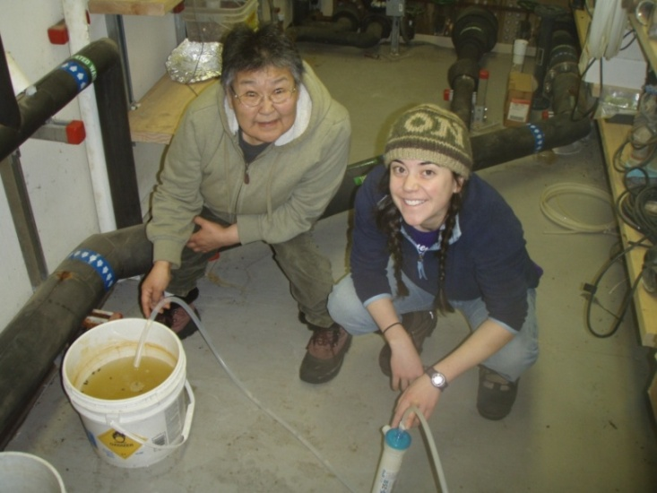
Promoting healthy water use through education

Slide 19
“You can teach a dog to swim but you can’t teach a dog to snorkel”
- Calie Ritter, age 6

Slide 20
Recommendations for optimal health
There’s no “magic number”. Water use needs are specific to the system and population.
Optimal health is achieved through an integrated approach that includes provision of infrastructure, proper O&M and education to encourage healthy water use behaviors.
Water service must be affordable in order to provide a health benefit. User fees should be independent of water use.

Slide 21
References
Brundin, I., & Hennessey, T. (2011). Literature review of water quantity standard for optimal health in arctic regions.
Eichelberger, L. P. (2010). Living in utility scarcity: energy and water insecurity in northwest Alaska. Am Journal of Public Health, 100(6):1010-18. 3. 4. 5.
Gleick, P. (1996). Basic water requirements for human activities: Meeting basic needs. Water International, 21:83-92.
Howard, G. & Bartram, J. (2003). Domestic Water Quantity, Service Level and Health, World Health Organization. Retrieved January 20, 2012 from http://www.who.int/water_sanitation_health/diseases/WSH03.02.pdf
Smith, D.W. (Ed.). (1996). Cold Regions Utilities Monograph, (3ed Ed.). New York, NY: American Society of Civil Engineers.
The Sphere Project. (2011). Minimum standards in water supply, sanitation and hygiene promotion. In The Sphere Project Handbook, (pp 79-137). Rugby, UK: Practical Action Publishing. Retrieved January 18, 2012 from http://www.your-brochure-online.co.uk/sphere_handbook_english_2011/html/
UNHCR. (1992). Water Manual for Refugee Situations. Retrieved January 18, 2011 from http://www.unhcr.org/3ae6bd100.html
World Health Organization. (2010). Minimum water quantity needed for domestic use in emergencies. Retrieved January 18, 2012 http://www.who.int/water_sanitation_health/hygiene/envsan/minimumquantity.pdf

Slide 22
Hierarchy of Water Requirements
(after Maslow’s hierarchy of needs)
Drinking
Cooking
Increasing
Quantity
“Zone of Water-Washed Infection”
Personal Washing
Washing Clothes
Cleaning Home
Waste Disposal
Non-Residential

