Slide 1


Water, hygiene and skin infections: Northern Saskatchewan Experience
Water and Sanitation Innovations for the Arctic
February 5, 2013
Dr. James Irvine
Medical Health Officer, Population Health Unit
And Professor, Academic Family Medicine, University of Saskatchewan
La Ronge, SK Canada
James.irvine@mcrrha.sk.ca

Slide 2
Waterborne diseases: where the pathogen is in the water and causes illness when ingested
Water-washed diseases: where transmission of the pathogen is interrupted by washing with water

Slide 3
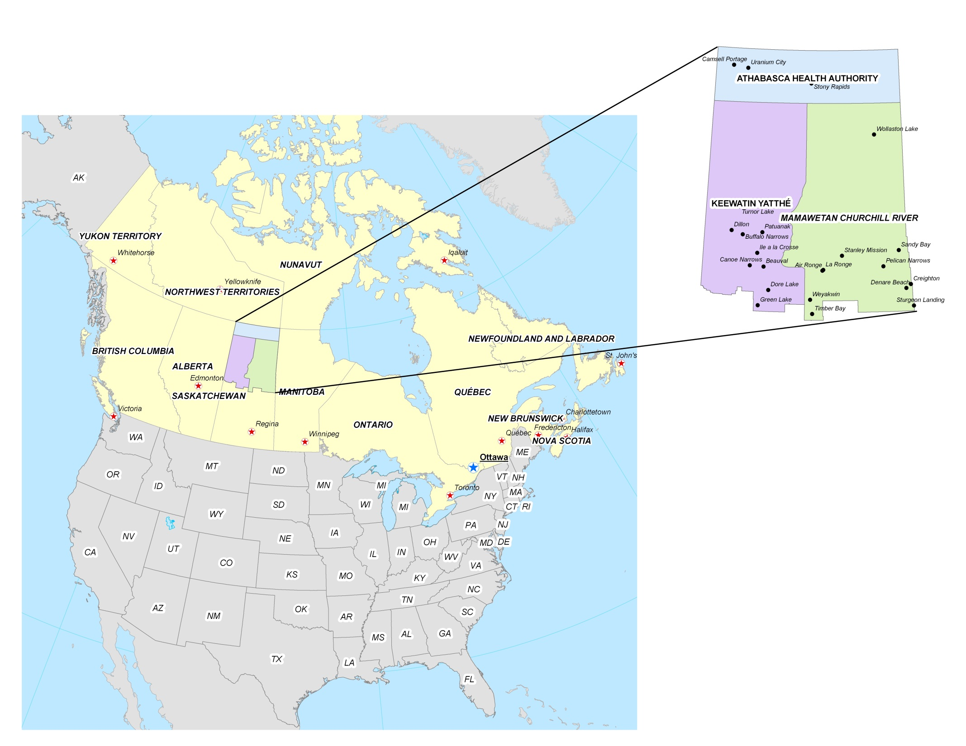
Northern Saskatchewan
2011 population = 39,000
0.3 people / sq mile
226,480 square miles

Slide 4
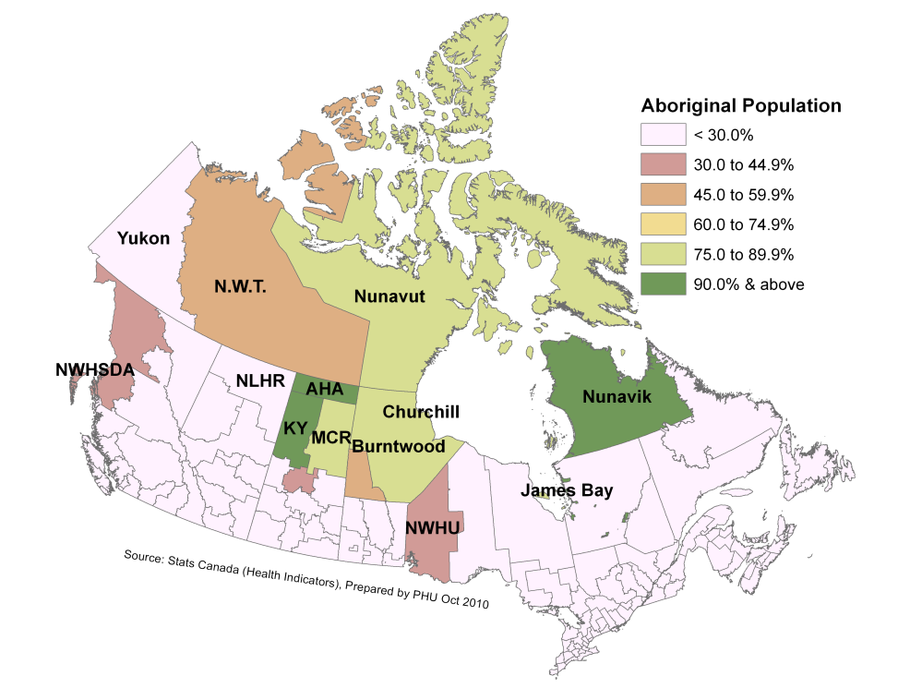
Population declaring Aboriginal identity, by Health Authority, 2006

Slide 5
Water Systems for First Nations homes on reserve in Saskatchewan
74% of the homes (10,523) are piped
21% of the homes (3,028) are on truck delivery
5% of the homes (652) are serviced by individual wells
<1% of the homes (45) were reported to have no water service.
Source: DINAC, National Assessment of FN Water and Wastewater Systems – April 2011

Slide 6
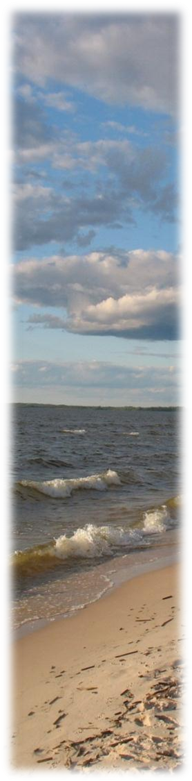
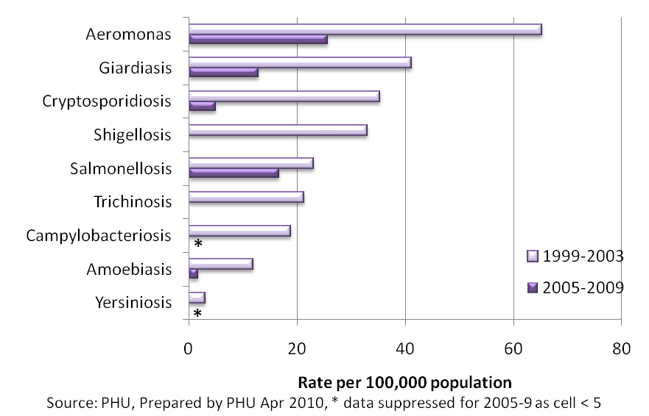
Selected infectious diseases reported, 5 year average estimated crude rates, Northern Saskatchewan 1999-2003 to 2005-2009

Slide 7
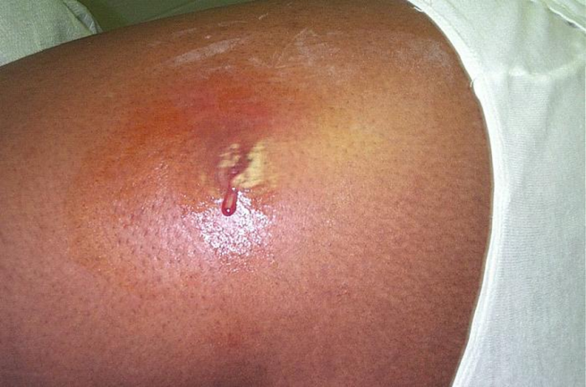


Community Associated MRSA
Photo: CDC PHIL
Victoria and
Vancouver
(USA300)
CMRSA10
Calgary
(USA 300)
CMRSA10
Toronto
(USA 300)
CMRSA10
USA 400
CMRSA7
Wylie and Nowicki. JCM. 2005, 43:2830-6.; Mulvey et al. EID 2005, 11:844-850;
Gilbert et al. CMAJ. 2006, 175:149-154.

Slide 8
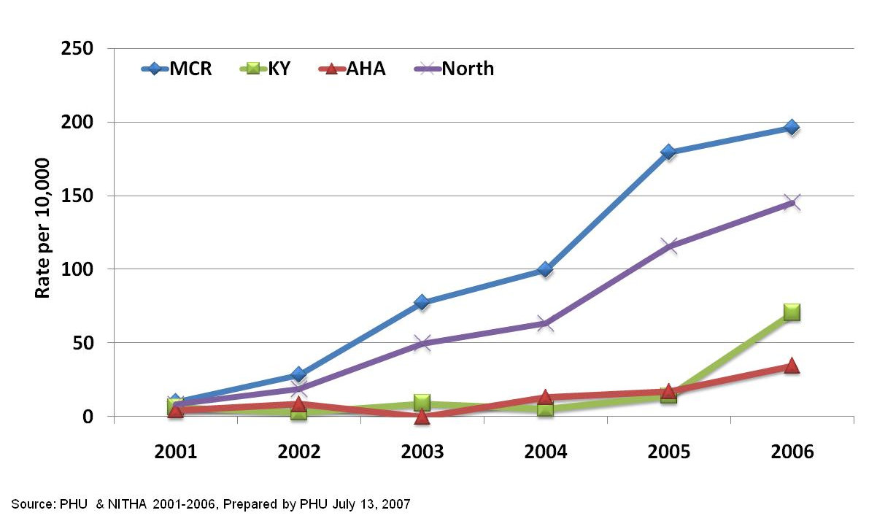
MRSA crude rate per 10,000 population in Northern Saskatchewan by Health Authority 2000-2006.

Slide 9
Annual age-specific rate of individuals with new CA-MRSA by health region
(three – year average 2004-2006)
Notes:
I’ve not included AHA in this age-specific rate, because with the small numbers it goes up and down.

Slide 10
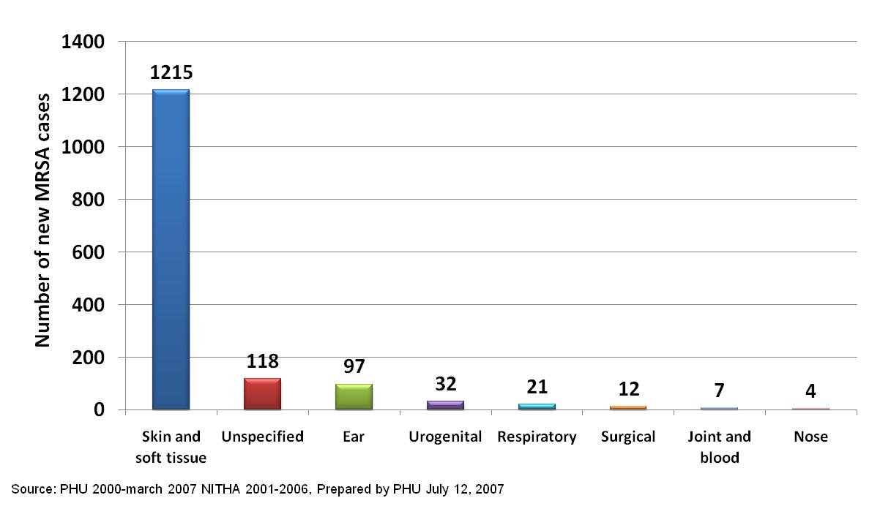
Number of New MRSA cases in Northern Saskatchewan by Clinical Picture

Slide 11
MRSA types by Health Region
(July 2006 – June 2007)
CCCA-
Community Associated types
CMRSA 7 (USA 400)
CMRSA 10 (USA 300)
Heath-care Associated types
CMRSA 2, 4, 6, & 8
Source: Saskatchewan Disease Control Lab

Slide 12
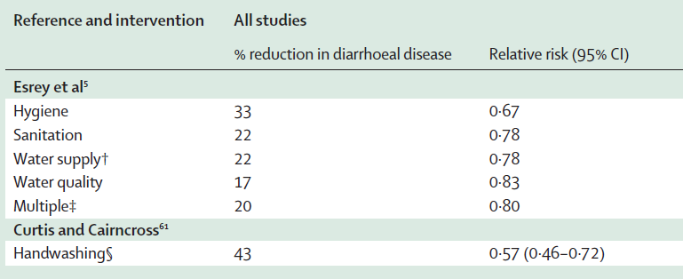
Reported reduction in diarrheal disease morbidity from various mitigations
Fewtrell et al. http://infection.thelancet.com Vol 5 January 2005

Slide 13
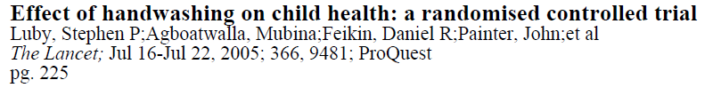
RCT in Karachi, Pakistan
Home delivery of plain soap and education:
  50% reduction in pneumonia
  53% reduction in diarrhea
  34% reduction in impetigo

Slide 14
Home water services and hospitalizations - Alaska
Hennessy, AJPH, 2008
  Hospitalizations for lower respiratory tract infections, pneumonia, RSV, Staphylococcus infections and MRSA associated with percentage of homes with water service

Slide 15
Water Outages and Health
Water outages (average length of 15.7 hours) led to higher rates of outpatients visits during and 10 days following for:
  Gastroenteritis RR - 1.31 (1.26-1.37)
  Skin diseases RR - 1.36 (1.30-1.42)
  Eye diseases RR - 1.34 (1.26-1.44)
  Source: Huang L-Y et al. BMC Public Health 2011

Slide 16
Promotion of handwashing:
associated with a 12-34% reduction in respiratory-tract infections and colds in child-care centres in the USA [Masters 1997], Canada [Carabin 1999], and Australia [Roberts 2000]; and
a 21% decrease in absences due to respiratory illness in the school setting [Masters 1997].
Ahanchian H. BMC Pediatr. 2012; 12: 147
Notes:
BMC Pediatr. 2012; 12: 147.
Published online 2012 September 13. doi: 10.1186/1471-2431-12-147
PMCID: PMC3471019
Respiratory viral infections in children with asthma: do they matter and can we prevent them?
Hamid Ahanchian,^{1,2} Carmen M Jones,¹ Yueh-sheng Chen,¹ and Peter D Sly¹

Slide 17
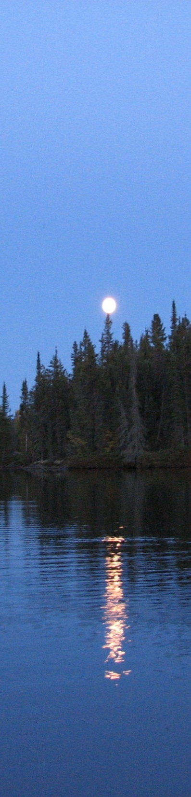
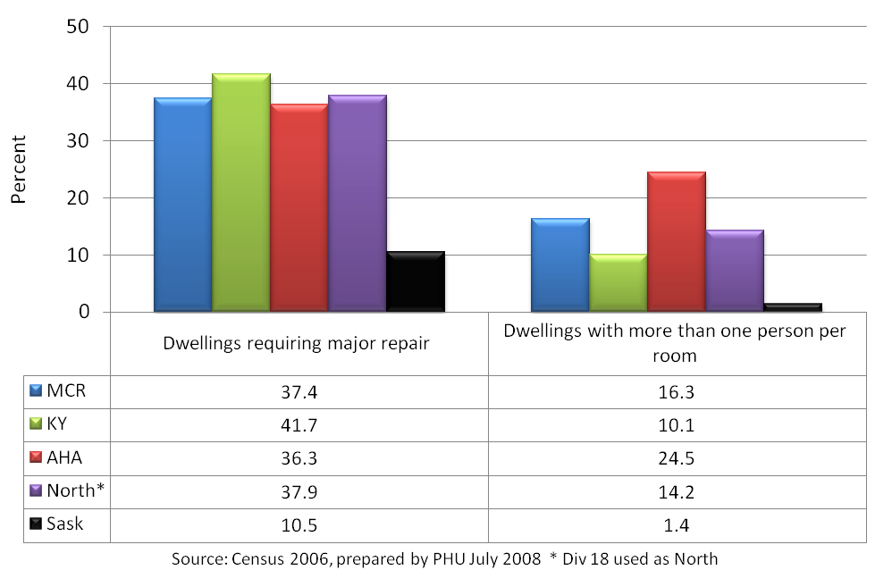
Housing
2006
Crowding in the north is 10 times that of the south
Notes:
Alaska 8.6% One of the data sources for housing characteristics is the Census from Statistics Canada. The Census asks people to classify their home as needing regular maintenance, minor repairs or major repairs. Regular maintenance refers to regular up-keep such as painting and furnace cleaning. Minor repairs include missing or loose floor tiles, bricks or shingles; defective steps, railing or siding. Major repairs include defective plumbing, electrical wiring, structural repairs, floors or ceilings.
The Census also collects information on crowding by examining the proportion of homes with more than one person per room. A 'room' is defined as an enclosed area within a dwelling suitable for year-round living, not counting bathrooms, halls, entrances and rooms used solely for business purposes.
In 2006, northern Saskatchewan had almost four times the proportion of dwellings requiring major repair as did Saskatchewan. Northern Saskatchewan also had 10 times the rate of crowding, with more than one person per room, compared to the province.

Slide 18
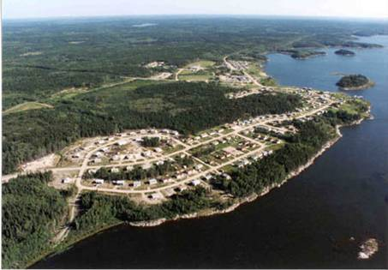

Slide 19
Challenges
Infectious diseases common
MRSA common
High antibiotic useage
Issues of household crowding
Challenges of handwashing, sharing of clothes, bedding, towels

Slide 20










The Partnership
Public Health Agency of Canada
National Laboratory of Microbiology
Saskatchewan Disease Control Laboratory
University of Manitoba
University of Saskatchewan
Population Health Unit, Northern Health Authorities
Kelsey Trail Health Region
Mamawetan Churchill River Health Region
Keewatin Yatthé Health Region
Northern Intertribal Health Authority
Prince Albert Grand Council
Red Earth First Nation
Shoal Lake First Nation
Cumberland House First Nation

Slide 21
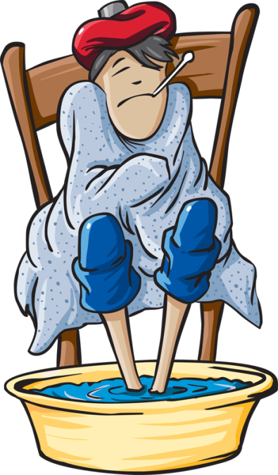
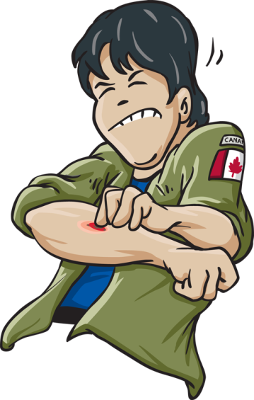
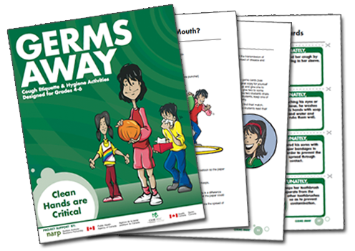

NARP Education Approaches
Educational Tools to Reduce the Spread of Communicable Disease
NARP Team
(Northern Antibiotic
Resistance Partnership)
Michael Mulvey, George Golding, James Irvine, Greg Horsman, Paul Levett, Brian Szklarzuk, Steve Silcox, Mandiangu Nsungu, Shirley Woods, Mohammed Khan, Kirsten Bergstrom, Barb Brooke, Shirley Paton, Donna Stockdale,
and the Northern Antibiotic Resistance Partnership

Slide 22
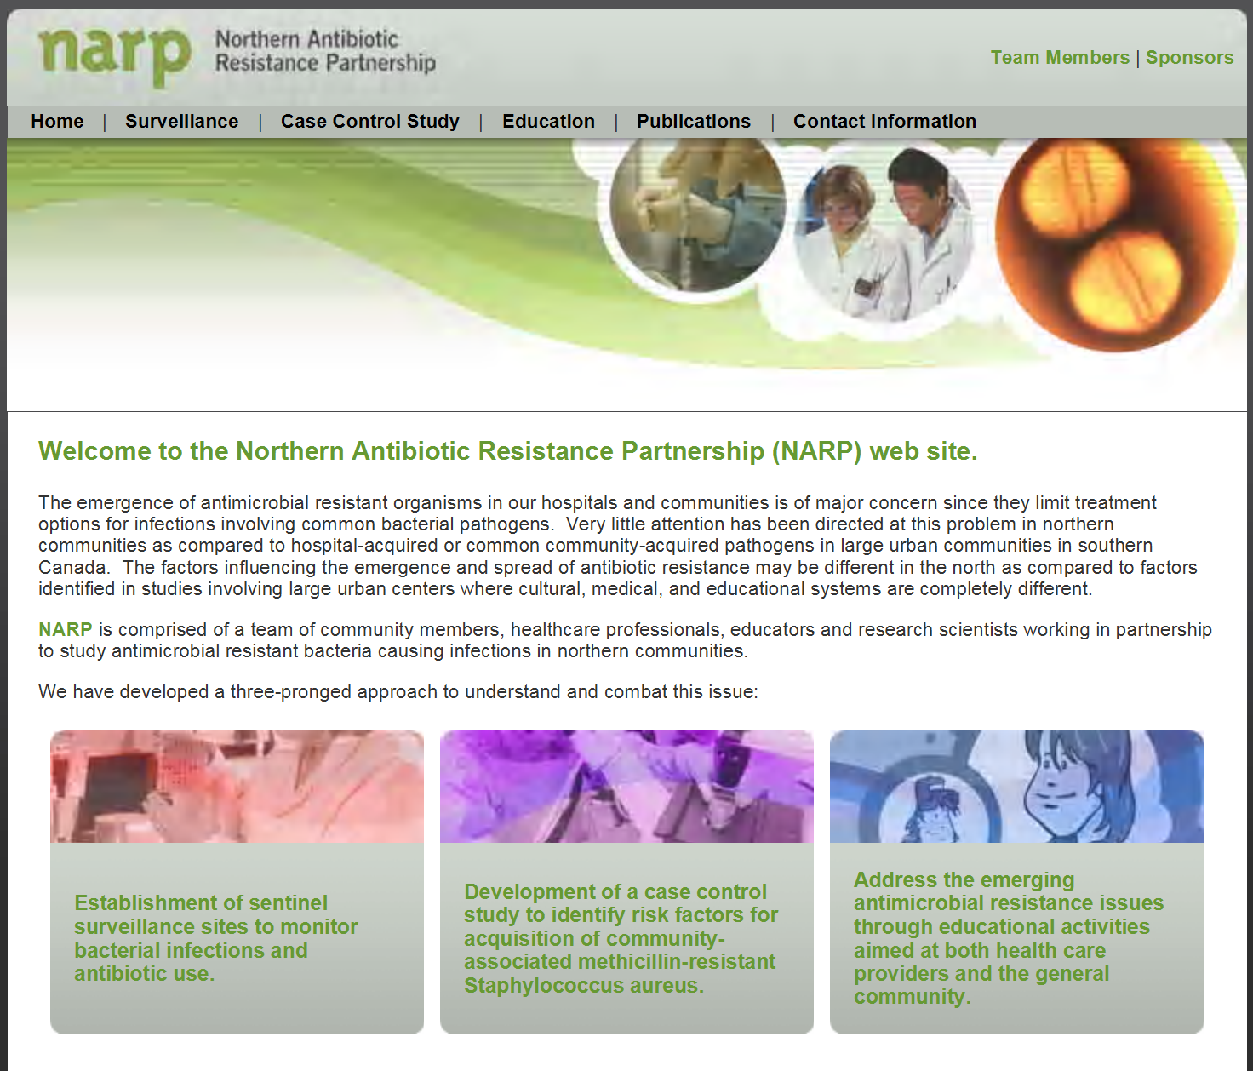
www.narp.ca

Slide 23
Education for Patient and Healthcare Providers
Prevalence and local antimicrobial susceptibilities provided through surveillance.
www.narp.ca

Slide 24
Community-Based Education
www.narp.ca

Slide 25
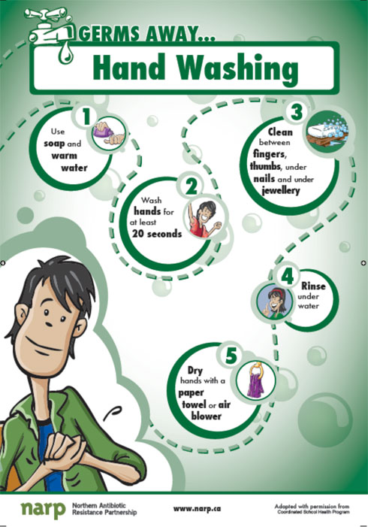
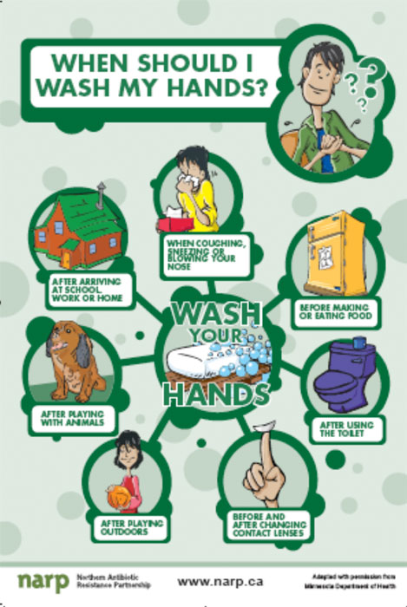
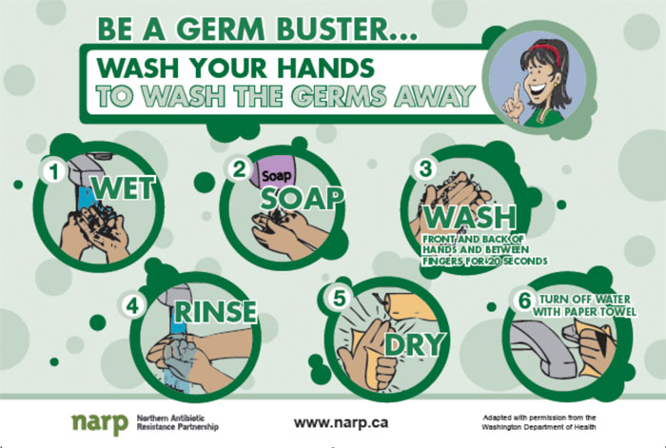
Posters
3 different posters to raise
awareness and keep
interest

Slide 26

http://www.dobugsneeddrugs.org
Train the trainer for schools, daycares, Kids First / Head Start for “Do Bugs Need Drugs”®
Notes:
http://www.germwise.com/glogermcompany.html

Slide 27
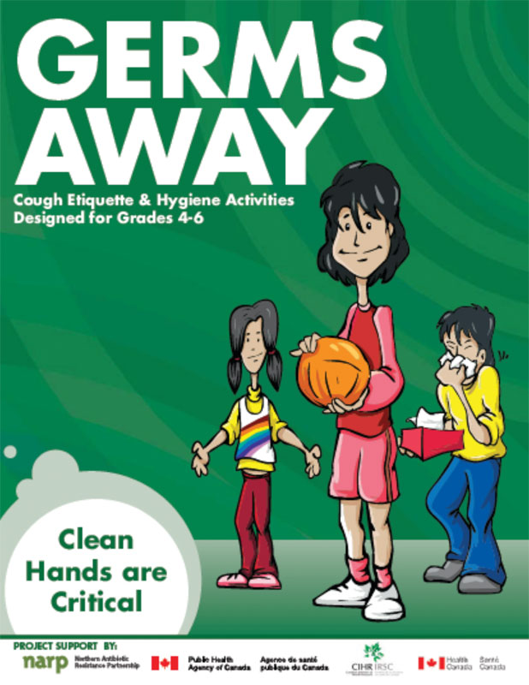
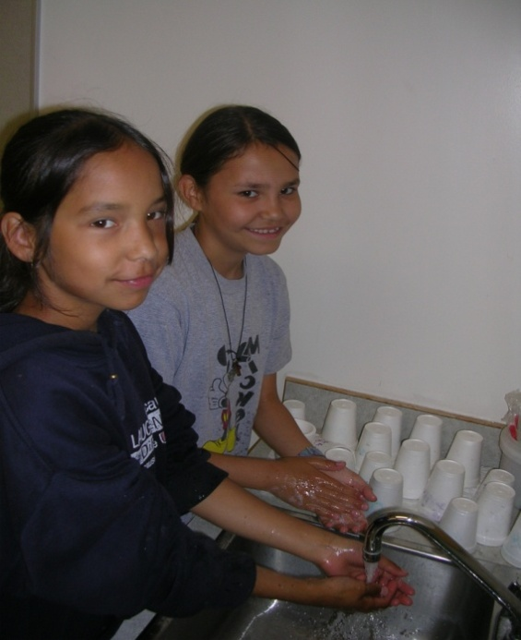
School Aged Education
Germs Away was designed for Grade 4- 6 educators and students.
Introduces basic concepts related to the spread of infectious diseases through contact.
www.narp.ca

Slide 28
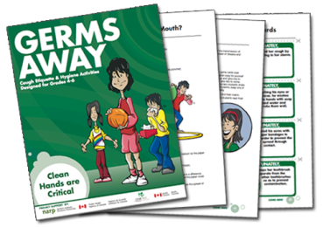

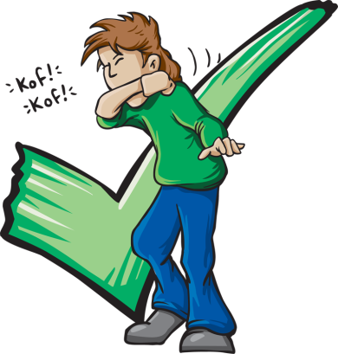
Germs Away Objectives
  1. Students will be able to identify
  specific daily activities that
  spread germs;
  2. Students will know that epidemics occur by the spreading of germs from person to person;
  3. Students will be aware of the importance of proper hand washing for the prevention and spread of disease;
  4. Students will be aware of specific disease prevention techniques; and
  5. Students will know possible transmission routes for germs.

Slide 29
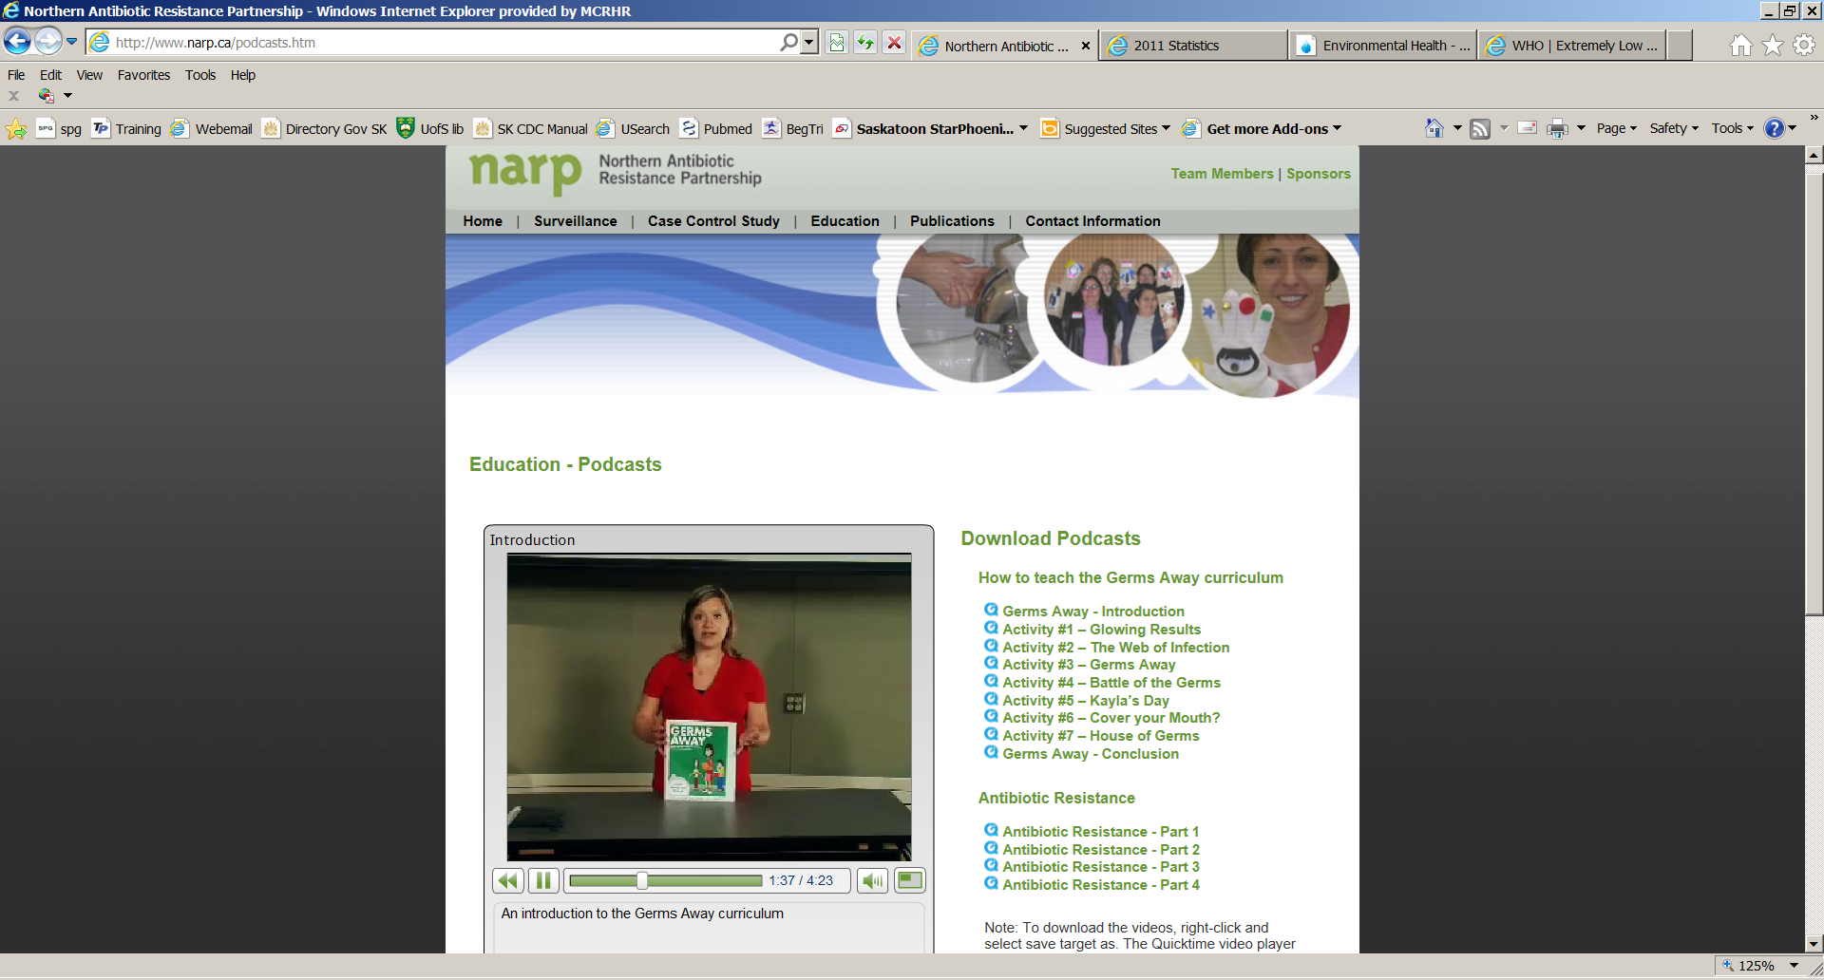

Slide 30
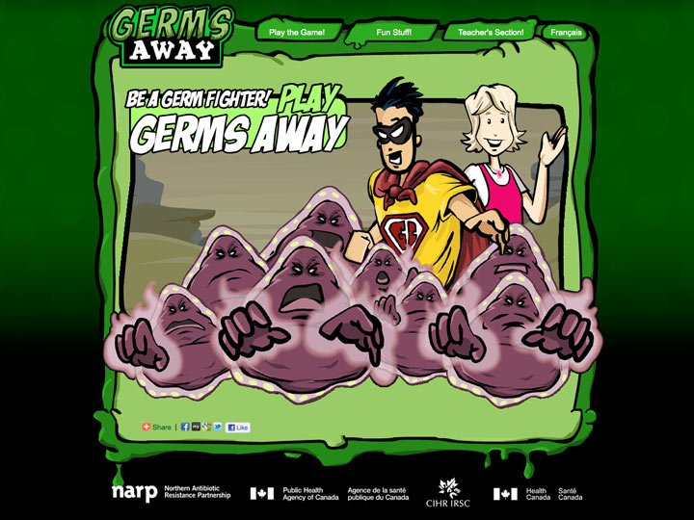

Slide 31
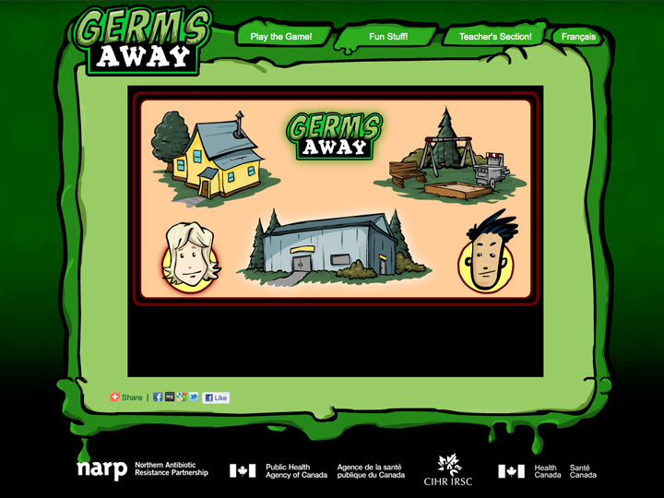

Slide 32
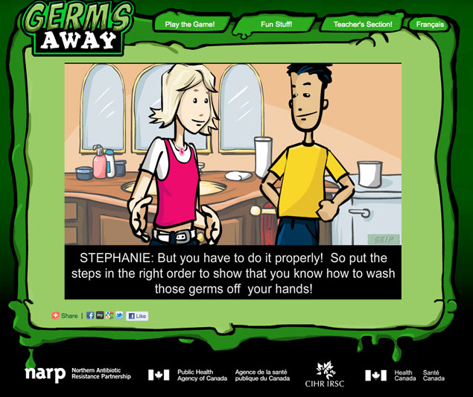
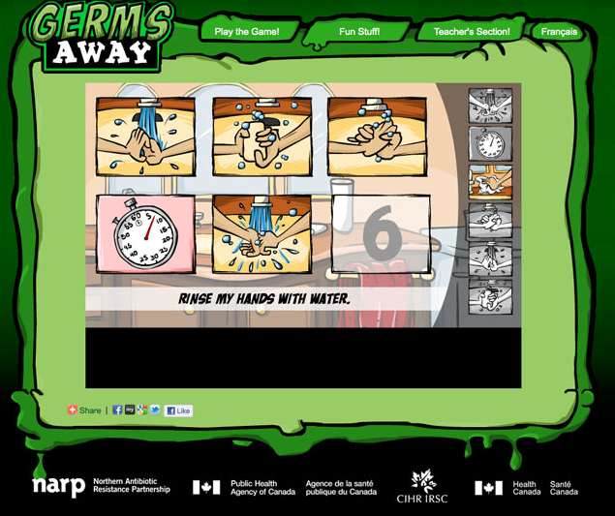
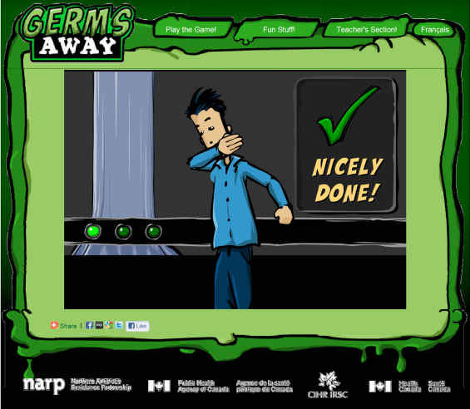
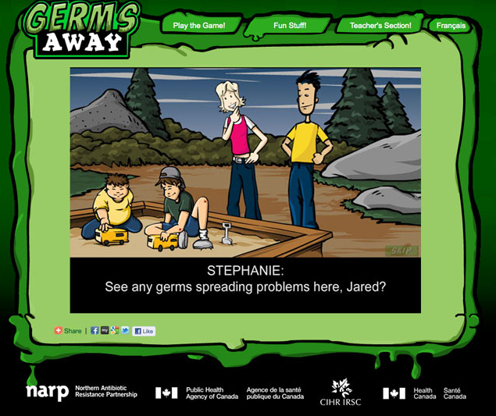
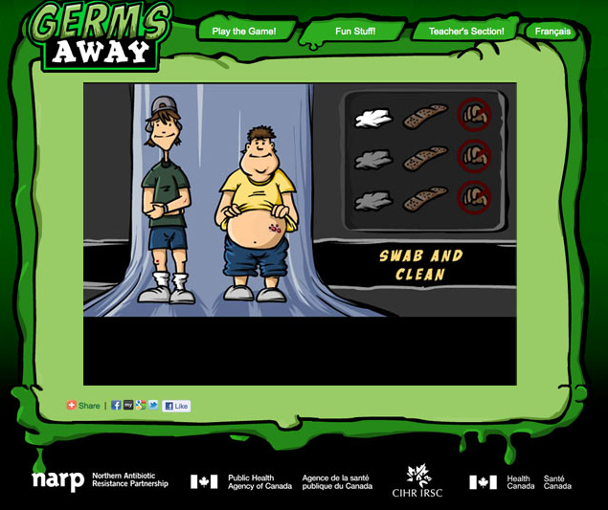

Slide 33
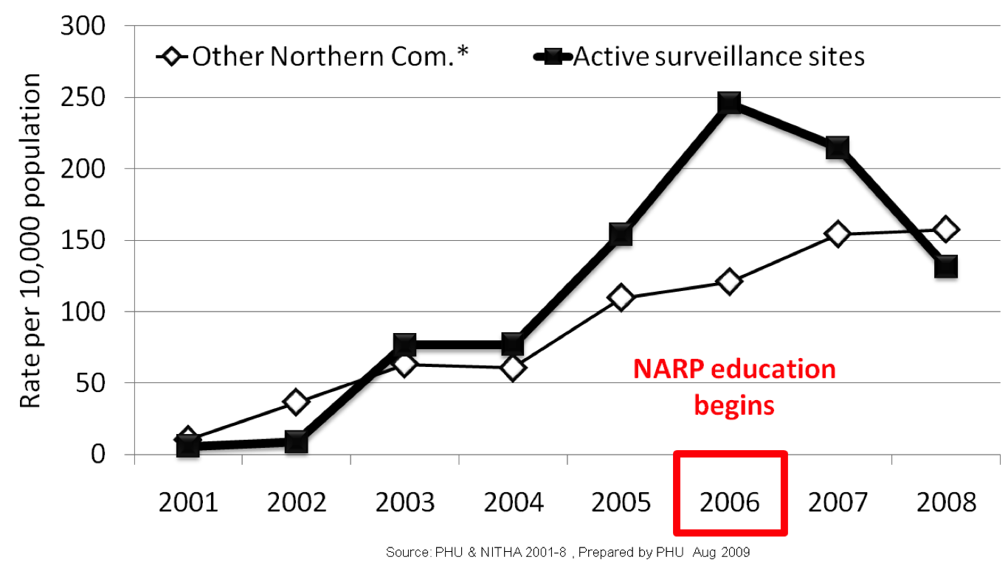
Using Surveillance to Monitor
Possible Effectiveness:
Rates of MRSA Infections

Slide 34
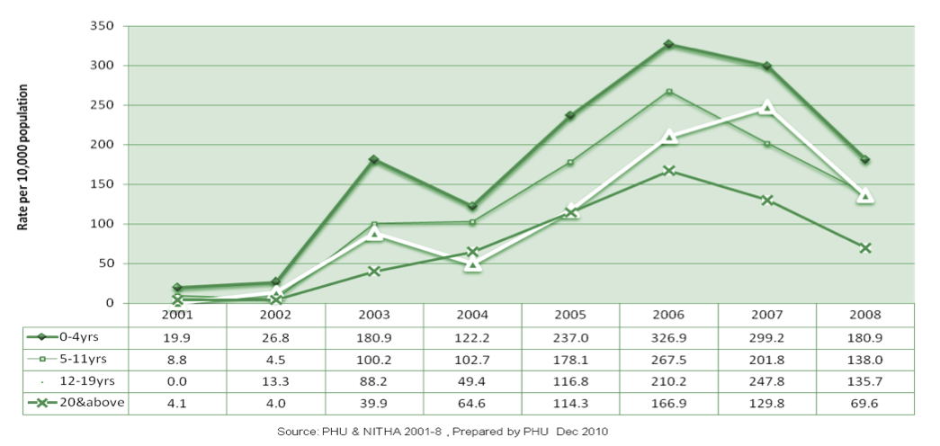
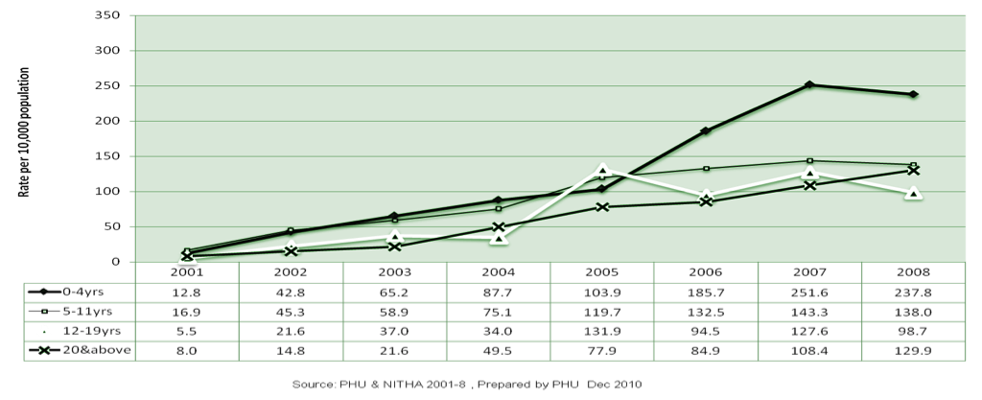
Age Distribution of MRSA Infections
Intervention
communities
Other* northern communities
*Had some spill
over intervention
including Germs
Away in 2008

Slide 35

Team
Dr. M. Mulvey
Dr. G. Horsman
Dr. J. Irvine
Ryan McDonald
Dr. P. Levett
Dr. M. Khan
Dr. M. Nsungu
Sharon Kimbley
Shirley Paton
Dr. J. Embil
Ruth Bear
Zachary Whitecap
Brian Quinn
Rose Dussion
Matilda McKay
Donna Stockdale
Shirley Woods
Dr. B. Cholin
Pat Malmgren
Jill Johnson
Brenda Beckman
Amanda Graessli
Barb Brooke
Kirsten Leach
Georgina Quinney
Brian Szklarczuk
Annel Bear
Evelyn Nagle
Christine Schachtel
Christina Schwickrath
Arlene Obarianyk
Toni Hansen
George Golding
Christine Siemens
Steve Silcox
And many more…

Slide 36
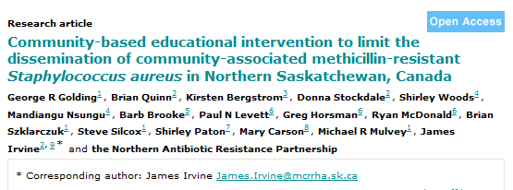
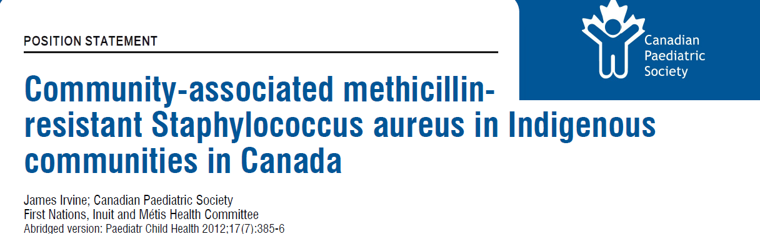
References
BMC Public Health 2012, 12:15
http://www.cps.ca/en/documents/position/community-associated-MRSA-in-Indigenous-communities

