Slide 1


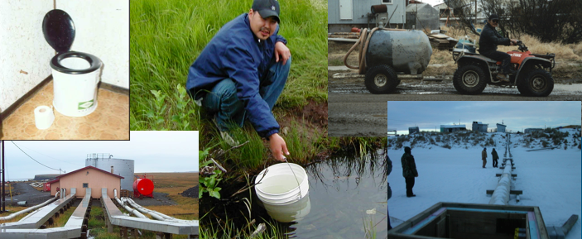

Alaskan Rural Water and Sanitation Working Group Update
Cheryl Rosa, DVM, PhD
Deputy Director, United States Arctic Research Commission
3RD Annual Water and Sanitation Workshop
February 5, 2013
Photo credit: A. Parkinson

Slide 2
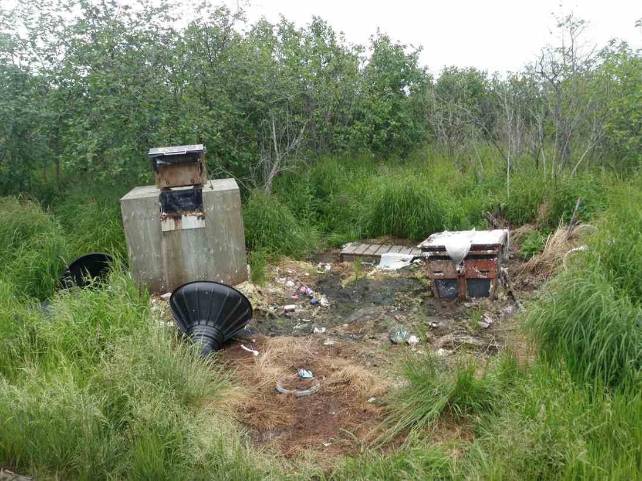
Water and Sanitation Working Group background
Update on Water and Sanitation Retrospective
Photo: B. Lefferts

Slide 3
Alaska is last in US for in-home water services
Status quo increasingly unaffordable
Sufficient amounts of clean in–home water improves health, especially in infants
Current funding inadequate to bring remaining unserved homes up to standard
New technologies and strategies are needed

Slide 4
Who is the AK Rural Water & Sanitation Working Group?
        Alaska Department of Conservation
        Alaska Native Tribal Health Consortium
        Alaska Pacific University
        Alaska Public Health Association
        Centers for Disease Control and Prevention
        Denali Commission
        Environmental Protection Agency
        Indian Health Service
        US Arctic Research Commission
        University of Alaska Anchorage
        University of Alaska Fairbanks
        Village Safe Water (AK DEC)
        Yukon-Kuskokwim Health Corporation

Slide 5
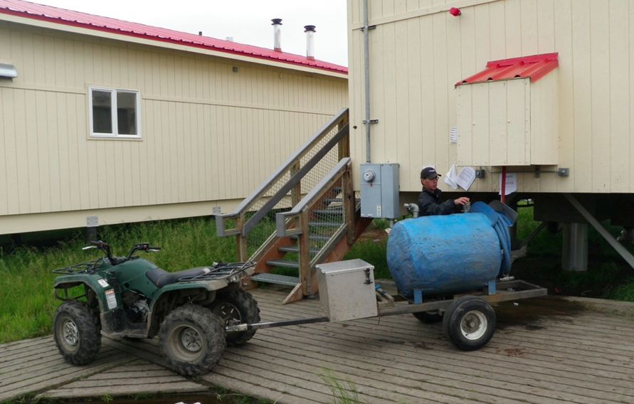
Why were we created?
Because there was a need…
A group like this did not exist prior to 2011.

Slide 7
Rural Alaska Water and Sanitation Retrospective
Purpose:
  To compile a historical account of rural Alaskan water and sanitation research and development efforts in decentralized settings that will serve to inform future efforts in this field. These efforts have often consisted of pilot testing new alternatives in select homes in a specific community.
Scope:
  The investigation will focus on technologies applied from 1990 through the present, with material from pre-1990 included at the author’s discretion.

Slide 8
Four parts to the document:
A compilation of descriptions of water and sanitation technologies that have been applied
    -a summary of each technology’s intended use and applications
    -information on its attributes/deficiencies.
A collection of case studies that examine historical technology applications
A final chapter on the future of water and sanitation R&D.
A separate USARC white paper that will summarize our findings.

Slide 9
  26 Rural Water and Sanitation Experts interviewed
  Standard format interview (example questions):

Slide 10
Name pilot program(s) that you have been involved in.
Provide an overview of the individual project.
Benefits conferred by the system (check all that apply):
  In-home efficient water/wastewater management
  In-home water treatment
  In-home hygiene
  In-home laundry facilities
  Reduced contact with human waste
  Other
Deficiencies and limitations identified during pilot testing (check all that apply):
  Could not be left in an unheated house and then resume operations
  Operational requirements exceeded local knowledge
  Operational costs were prohibitive
  Other
Were community needs considered in the inception of this project?
Did you receive community feedback on the effectiveness of the project?
Was energy efficiency considered in the inception of this project?
Was the project successful?
  Yes. Why?
  No. Why did it fail?

Slide 11
  Preliminary Results:
  Multi-faceted problem
  Health Standard has evolved (improved)
  No real silver bullet
  ** Almost all interviewees pointed to O&M issues

Slide 12
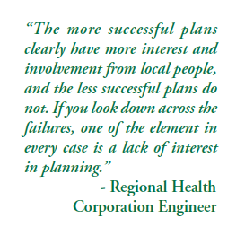

Slide 13
