Slide 1


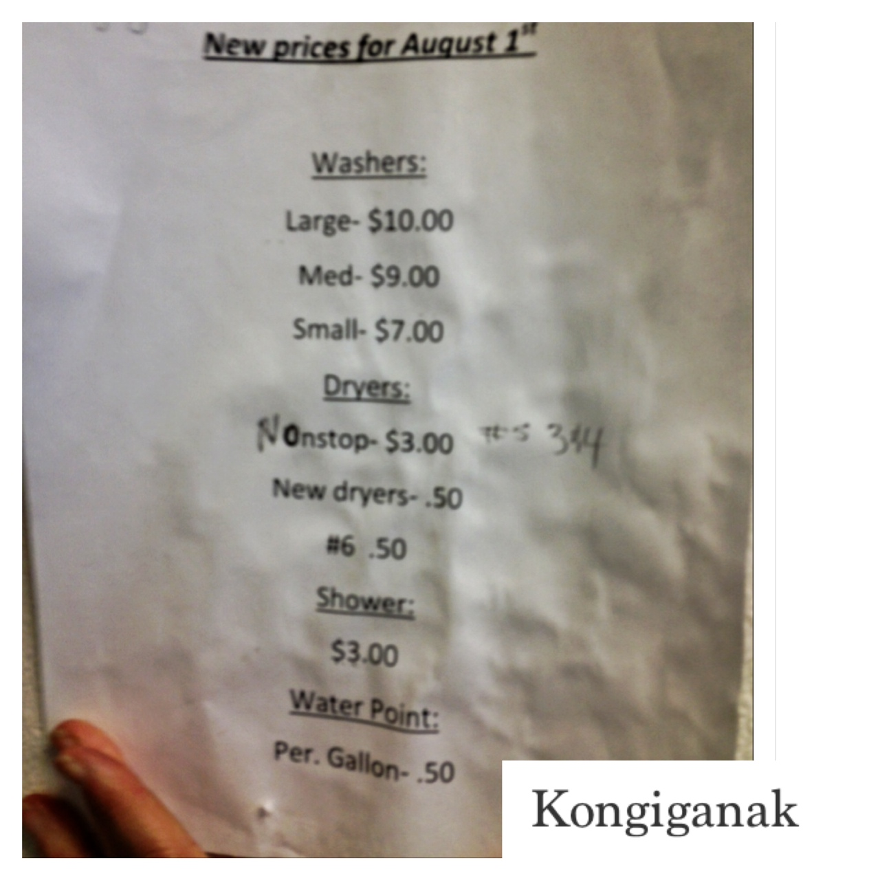

Maximizing Sanitation and Hygiene in Washeterias
Cheryl Rosa, DVM, PhD
Deputy Director, United States Arctic Research Commission
January, 30, 2014
Photo credit: A. Parkinson

Slide 3
Outline
Brief intro on MRSA
MRSA and bacterial hotspots
Sanitation: toilets, showers
Laundry disinfection
Saunas

Slide 4
MRSA: Methicillin-resistant Staphylococcus aureus
Beta-lactam antibiotic resistance = difficult to treat
People are very commonly colonized with CA-MRSA and are completely asymptomatic – nose colonization
Simple skin infections, such as impetigo, boils, abscesses, folliculitis, and cellulitis
Rarer, but more serious necrotizing fasciitis and pyomyositis (most commonly found in the tropics), necrotizing pneumonia, infective endocarditis

Slide 5
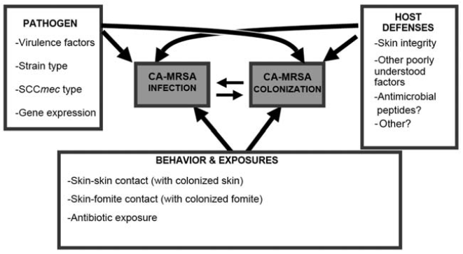
Miller and Diep 2008

Stepwise progression of exposure to MRSA, followed by colonization, followed by infection: NO
CA-MRSA acquisition may arise from a variety of forces that may result in either colonization or infection (without preceding colonization). In turn, colonization may lead to infection or infection to colonization
Notes:
Figure about: Conceptual model of the pathogenesis of community-associated (CA-) methicillin-resistant Staphylococcus aureus (MRSA). Rather than a
stepwise progression of exposure to MRSA, followed by colonization, followed by infection, CA-MRSA acquisition may arise from a variety of forces
that may result in either colonization or infection (without preceding colonization). In turn, colonization may lead to infection or infection to colonization.

Slide 6
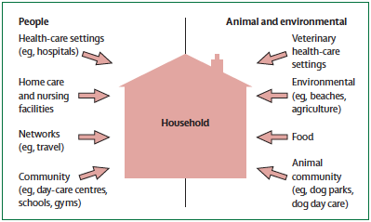
MRSA: Environmental factors
WASHETERIAS
Davis et al. 2012

Slide 7
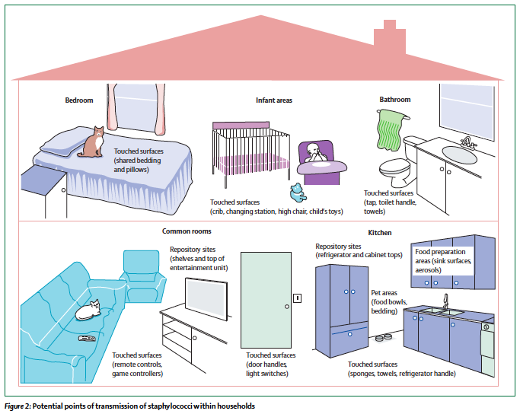
Davis et al. 2012

Slide 8
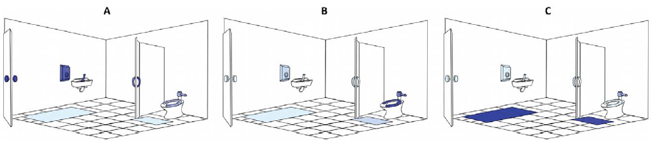
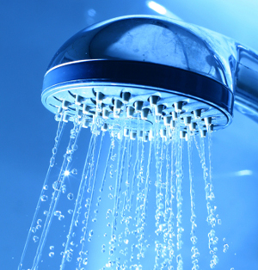
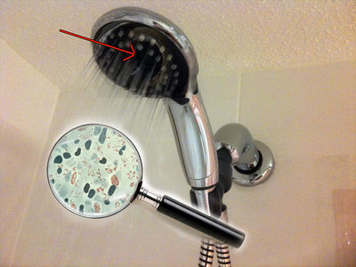
Hot spots: Bacteria (in general)
Flores et al. 2011
Light blue indicates low abundance while dark blue indicates high abundance of taxa. (A) skin-associated taxa; (B) Gut-associated taxa; and(C) soil-associated taxa.
http://www.cosmosmagazine.com/news/showers-can-be-bad-your-health/
http://microbewiki.kenyon.edu/

Slide 9
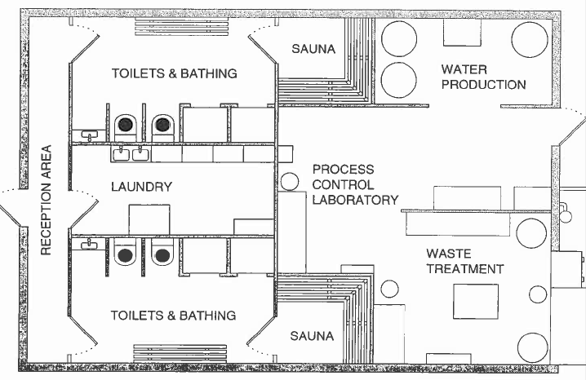

Slide 10
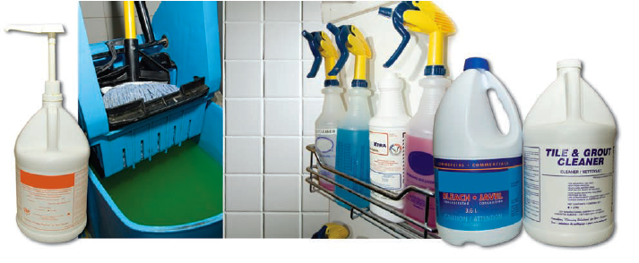
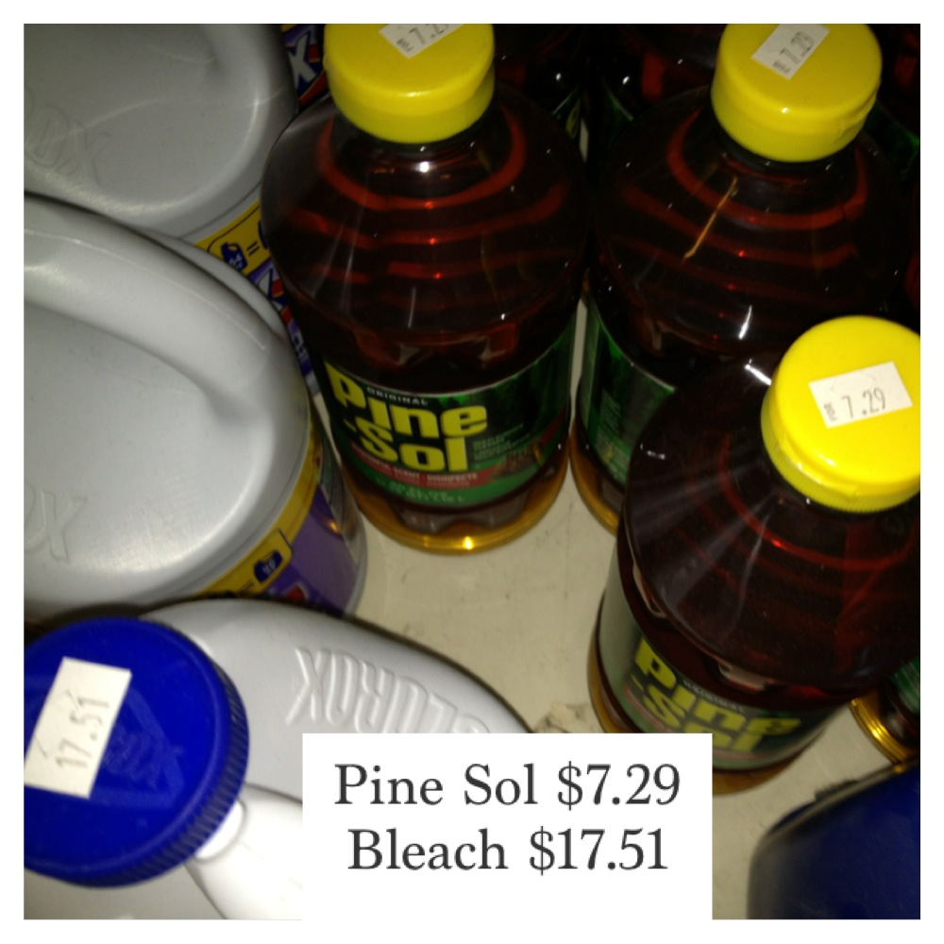
HYGIENE:
Clean first, then disinfect

Slide 11
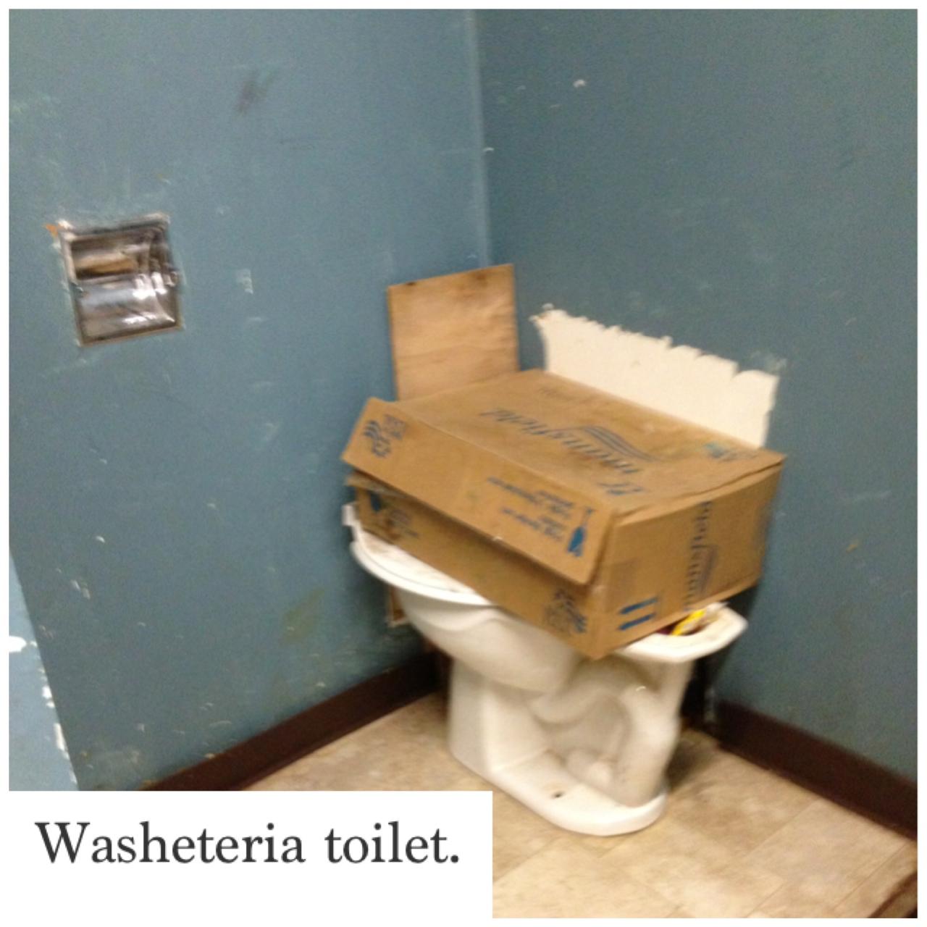
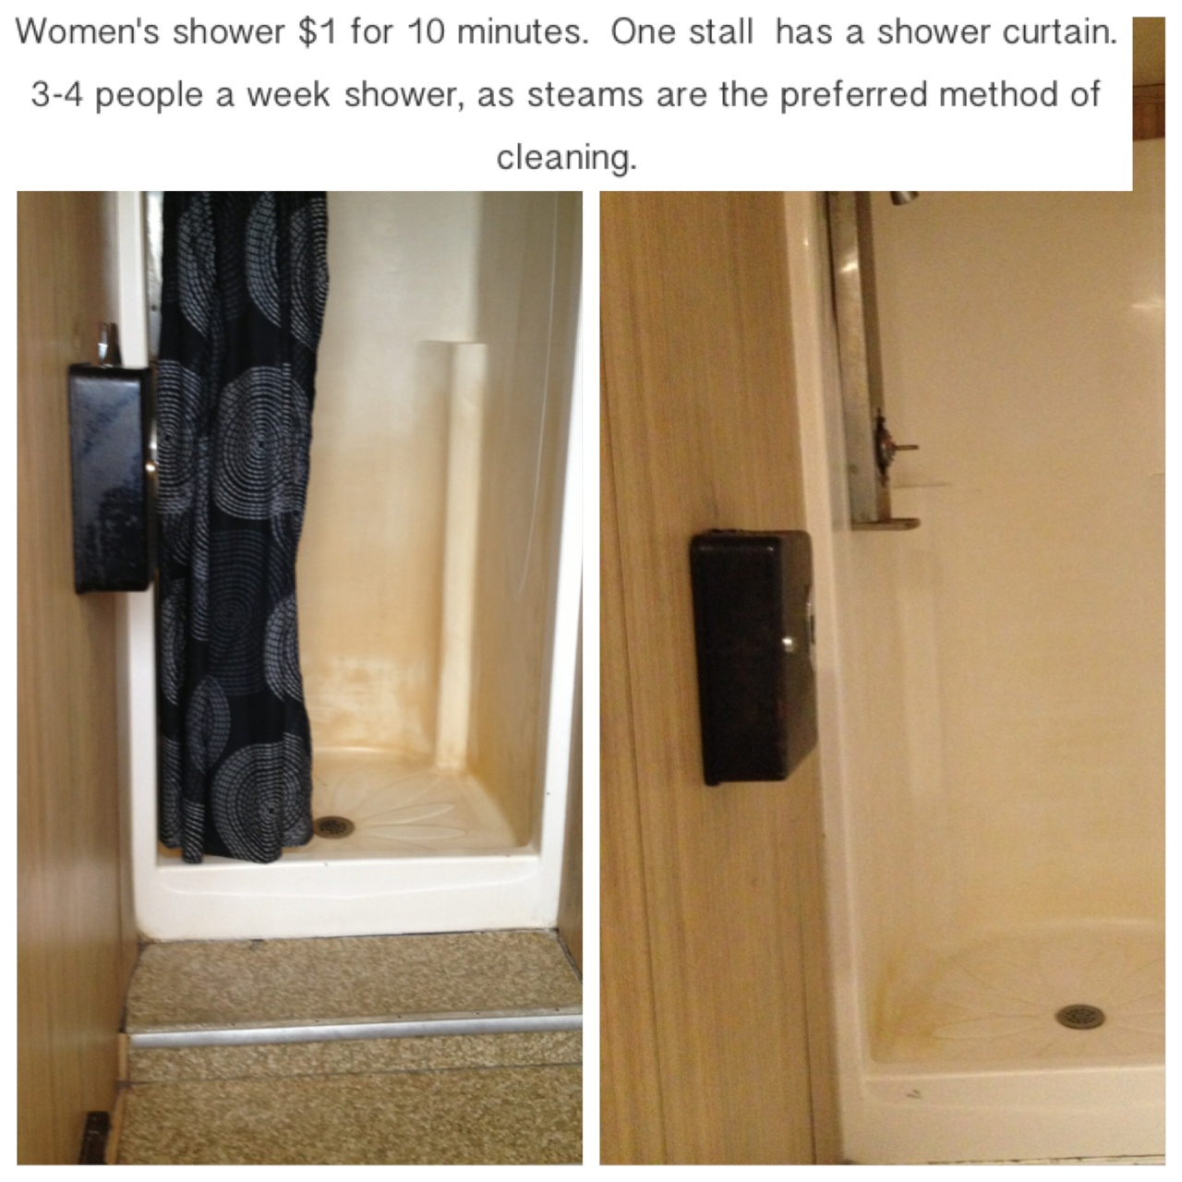
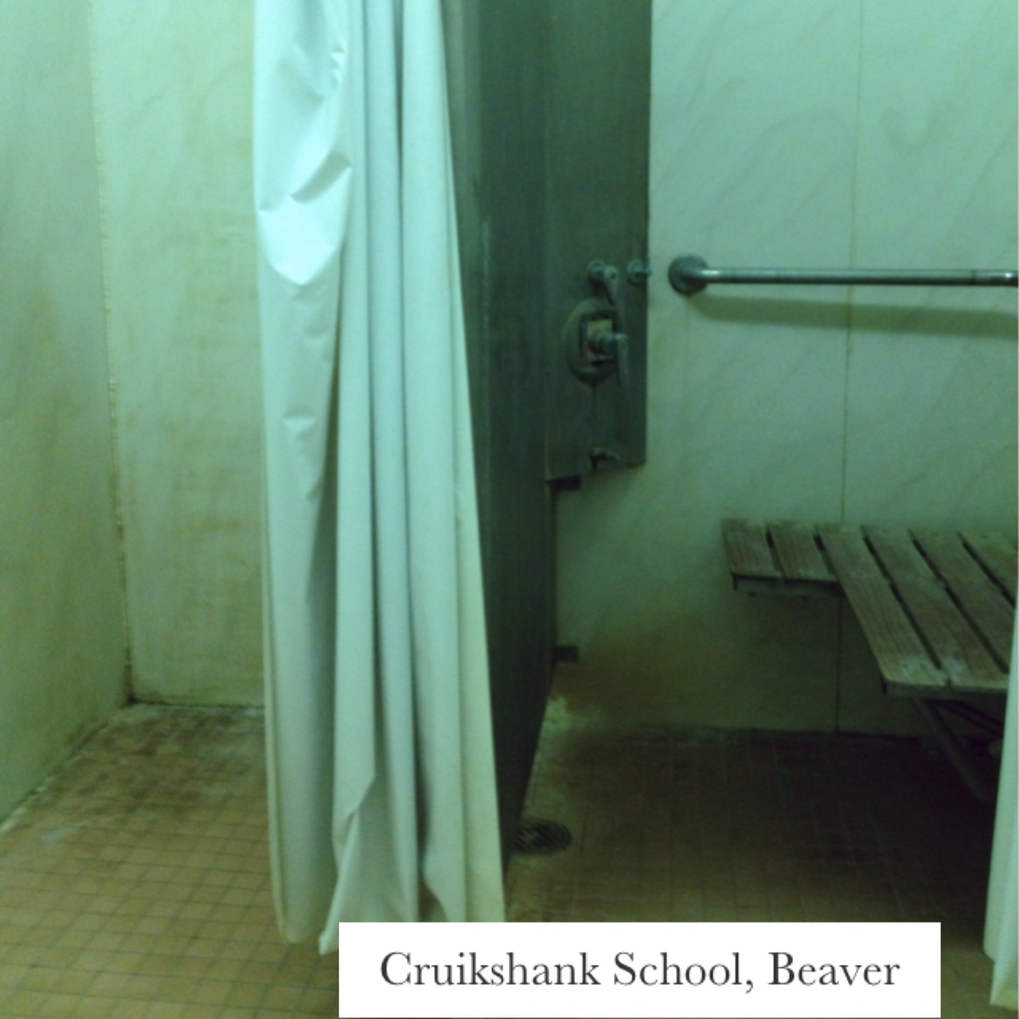
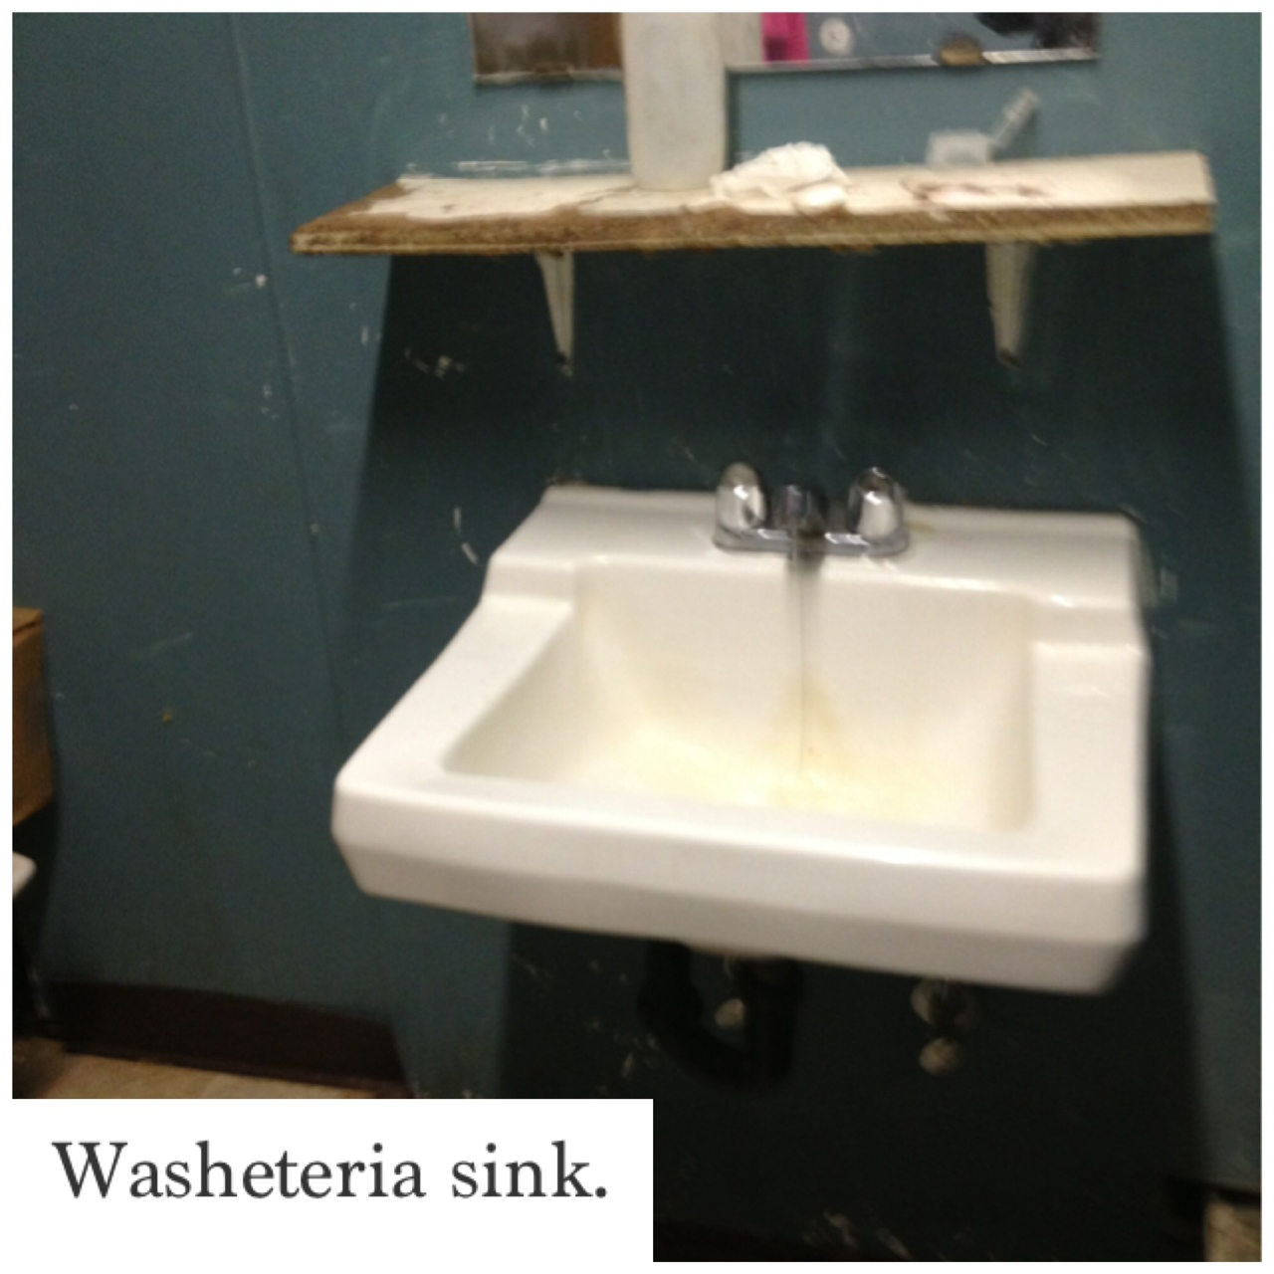

Slide 12
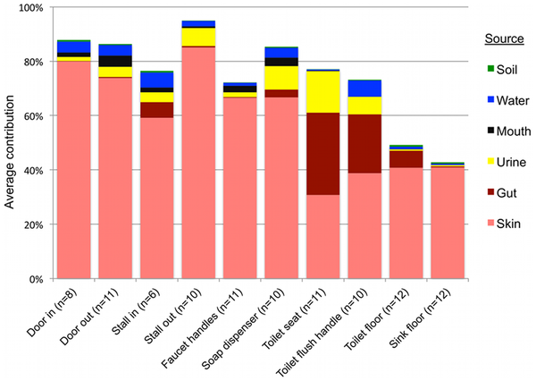
Average contributions of different sources to the surface-associated bacterial communities in twelve public restrooms.
Flores GE, Bates ST, Knights D, Lauber CL, et al. (2011) Microbial Biogeography of Public Restroom Surfaces.

Slide 13
Showerhead disinfection procedure
Clean/De-scale
Disinfect
Flush
Notes:
Sample showerhead disinfection procedure
Showers deliver water at approximately 45°C which is an ideal temperature for pathogens to
proliferate. Showerheads act as filters trapping debris and scale which can be used by bacteria
both as a nutrient and a safe habitat. When water stagnates bacteria are allowed to multiply.
Cleaning and disinfecting showerheads on a regular basis removes both the nutrients and
habitat required by bacteria, thus minimising the risk of any legionella bacteria which may be
present in the water from multiplying.
Stage 1 - Clean/De-scale
Remove and disassemble the shower heads and hoses from one another.
De-scale the shower heads and hoses using a proprietary de-scaling agent for 1 hour (or to
manufacturer's instruction).
1.
2. Dispose of the waste water safely and in accordance with environmental protection guidance.
3. Flush the showerheads and hoses through with clean water.
Stage 2 – Disinfect
Immerse the shower heads and hoses in an approved biocide solution (50mg/l hypochlorite
solution, (e.g. "Titan Sanitiser" (Johnson Diversey), "Shower Head Plus" (Water Treatment
Products), or other approved disinfectant that has an equivalent proven biocidal effect), at the
appropriate concentration and for the appropriate amount of time - following the manufacturers
instructions.
1.
2. Dispose of the waste water safely and in accordance with environmental protection guidance.
Stage 3 – Flush
Flush and wash the shower heads and hoses through with clean water and replace.
2. Dispose of the waste water safely and in accordance with environmental protection guidance.
Replace soft rubber or plastic washers or gaskets with neoprene or other approved rubber substitutes.
Under no circumstances should any acidic cleaning fluids or other acid products be added to any
solution. Such action will release toxic chlorine gas from the solution, with the potential to cause a risk
of explosion, respiratory failure and potential death.

Slide 14
NAV-CO2 systems use liquid carbon dioxide (CO2) as a propellant to dispense a 58% isopropyl alcohol solution in a heated stream of CO2 liquid. This technique allows alcohol to be used in an atomized vapor, capable of reaching nooks, crannies and crevices that would normally be beyond the reach of other disinfecting methods.
Because CO₂ is gas at room temperature, liquid alcohol evaporates off of contact surfaces within minutes after application
Surfaces do not require wiping, thus reducing the spread of pathogens on cloths
“Alcohol and CO₂ are also inexpensive and supplies are readily available” ** unlikely to be the case in rural AK
Notes:
Non-flammable Alcohol Vapor

Slide 15
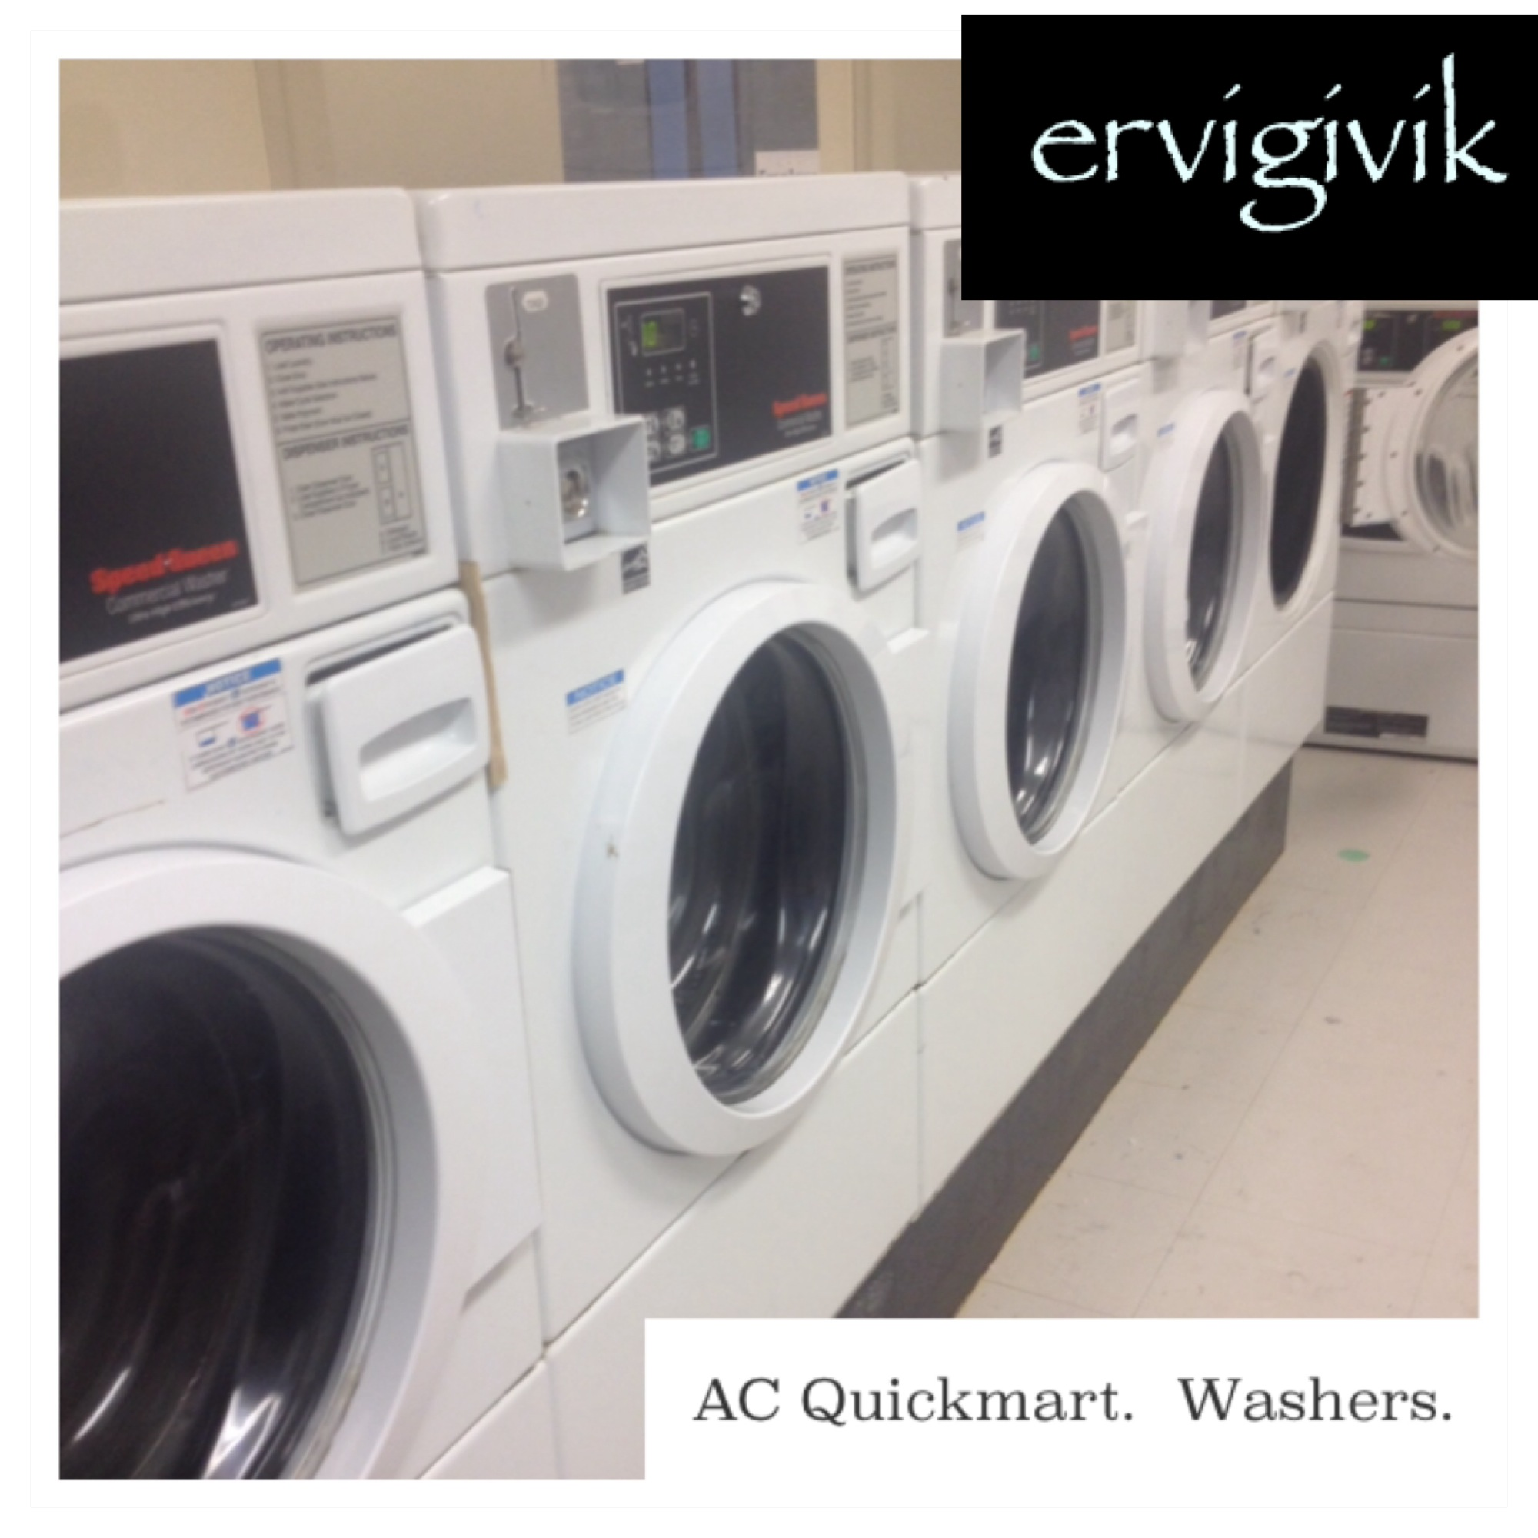
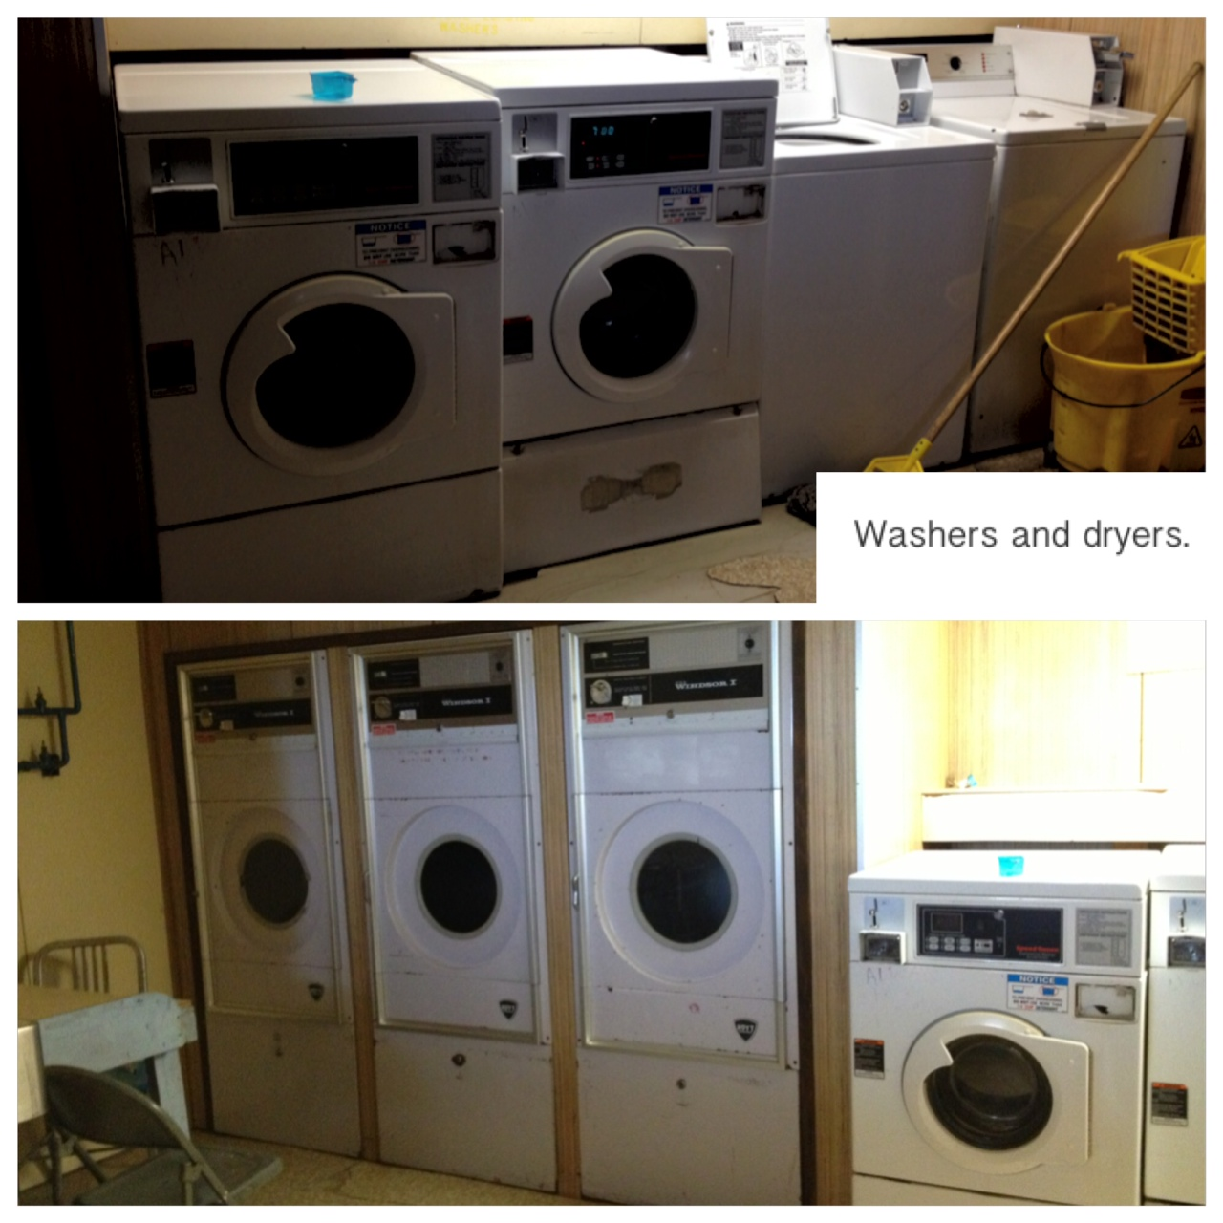
LAUNDRY

Slide 16
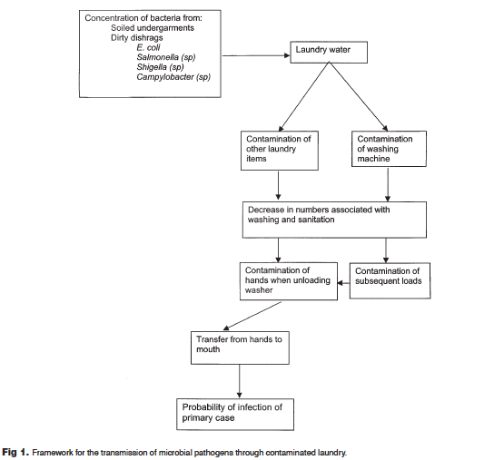
Laundry Contamination
Gibson, Rose, and Haas, 1999

Slide 17
Ozone
Reduces Energy Use—Ozone enhances the effectiveness
of the actions of chemicals, reducing the need for high temperature washing.
Reduces Water Use—Ozone wash systems normally require fewer rinse steps, thus reducing water usage by an estimated 30–45%.
Reduces Chemical Use—Ozone makes existing chemicals work better
    Ozone in water solution performs the function of chlorine bleach, without producing by-products.
Purifies and Disinfects—Ozone is very effective against bacteria, viruses and other microorganisms.
Improves Textile Life and Quality—Shorter cycle times and cooler temperature water
Improves Effluent Quality – Fewer chemicals needed, ozone oxidizes bacteria/microorganisms and some dissolved organic compounds

Slide 18
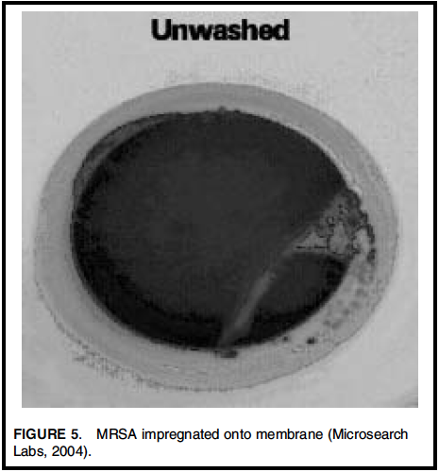
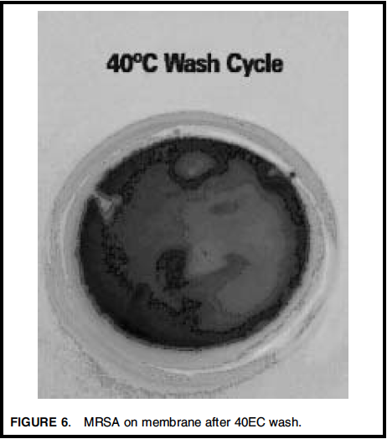
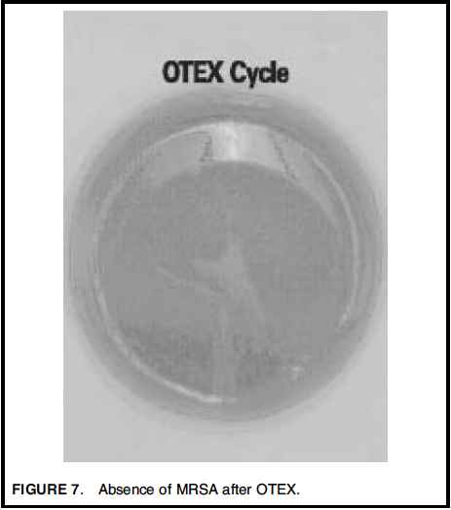
Laundry disinfection: MRSA and Ozone

Slide 19
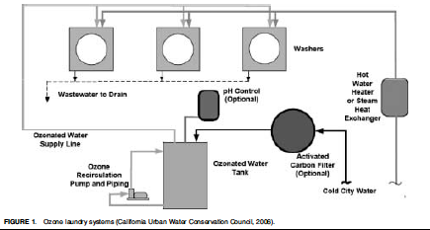
Ozone Laundry Systems
Three types:
1) Recirculation injection (RI)
(water drawn from, ozone added to the wash water)
2) Direct water-injection
(ozone added directly to water during fill)
3) Air injection
(similar to direct injection, but involving a storage tank/pressure)

Slide 20
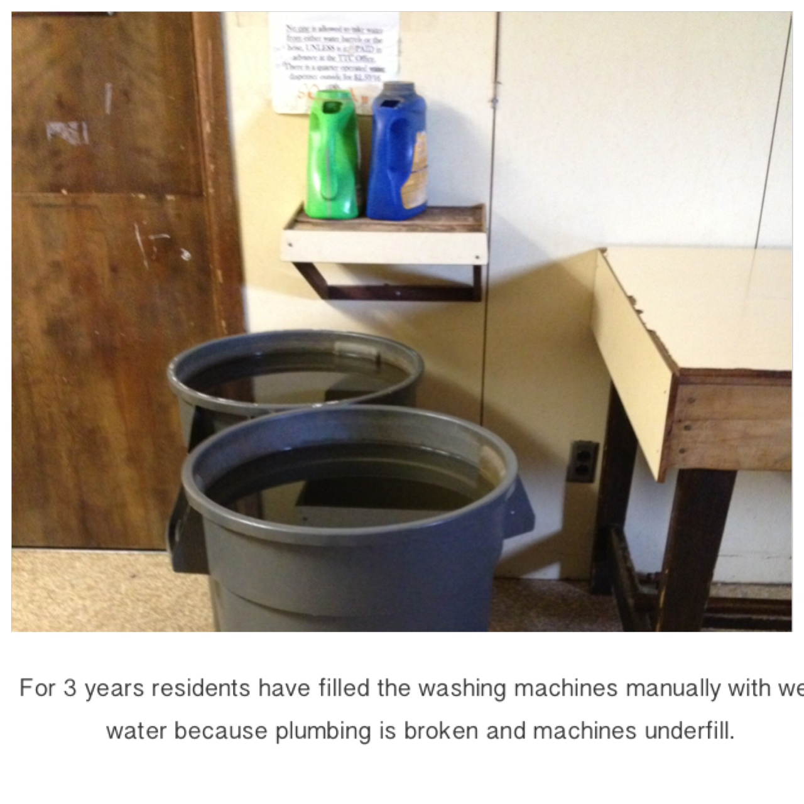
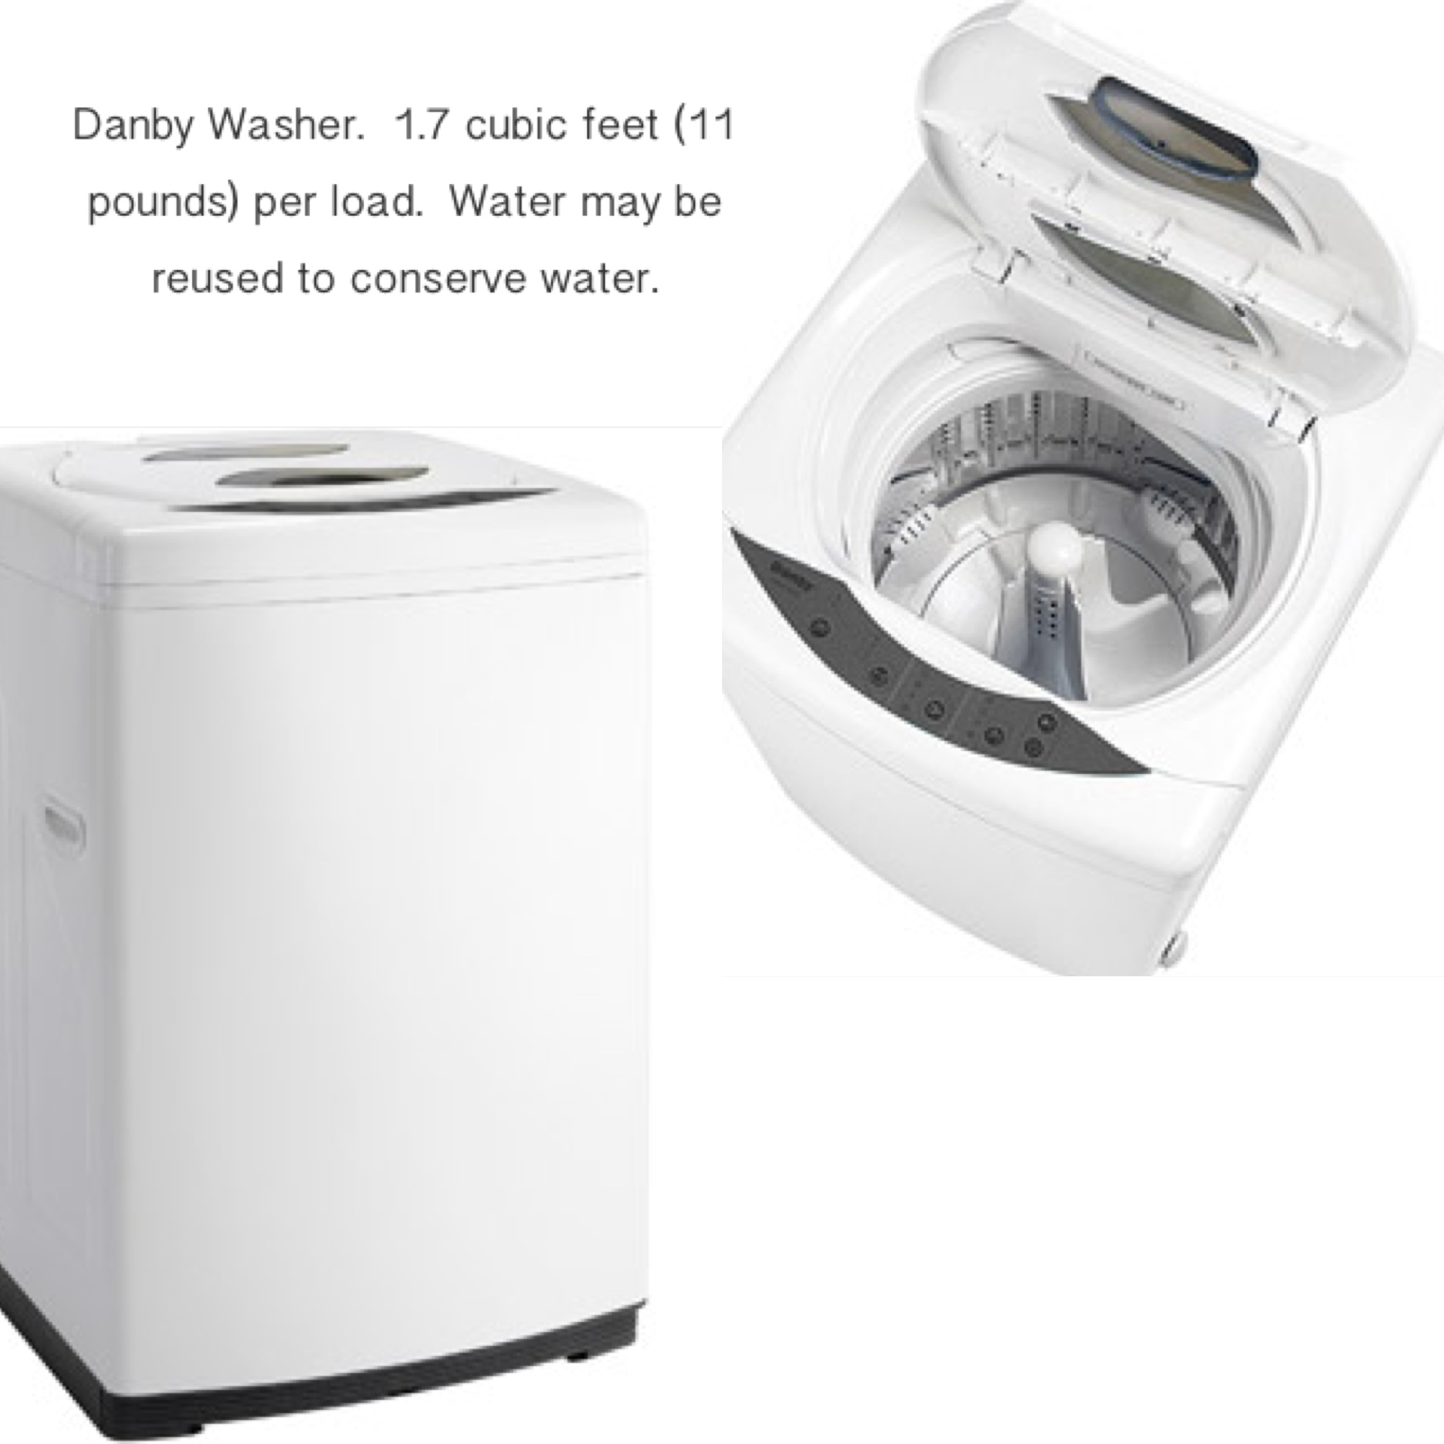
Danby washers?
Better than nothing? Can their use be made more hygienic?

Slide 21
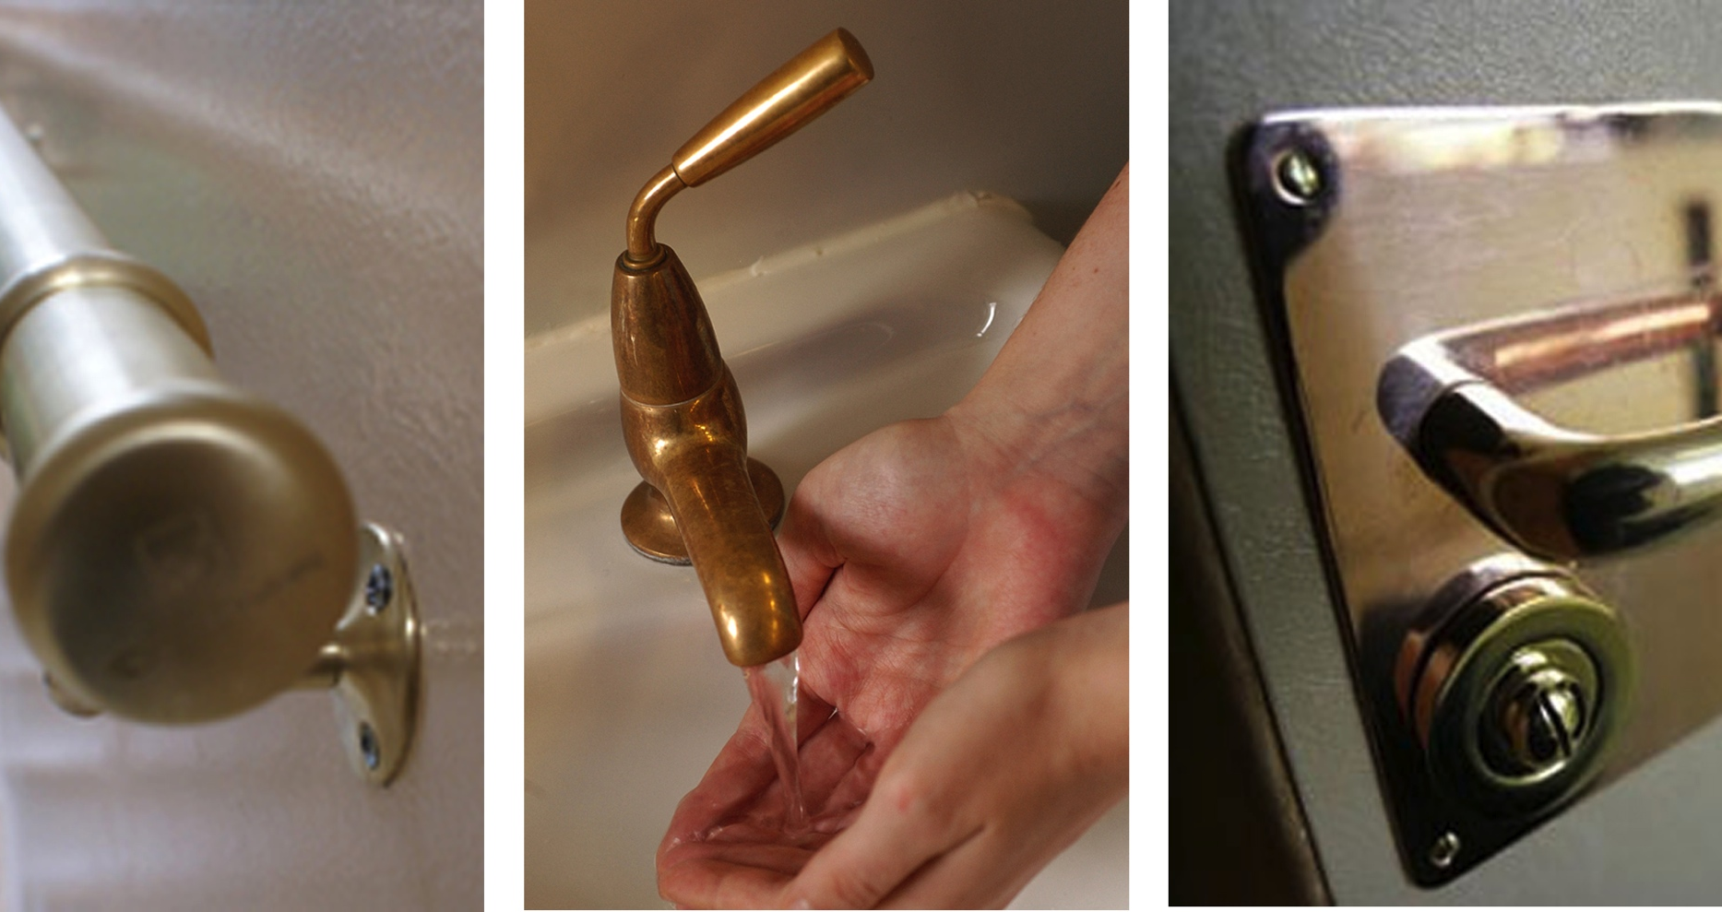
Copper: Microbicidal/germicidal/antimicrobial/antibacterial action
http://fennsheetal.wordpress.com/2012/10/12/anti-bacterial-materials/

Slide 22
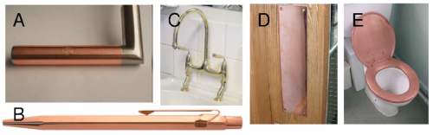
COST???
http://www.scienceonthenet.eu/content/article/copper-kills-bacteria-end-hospital-acquired-infections

Slide 23
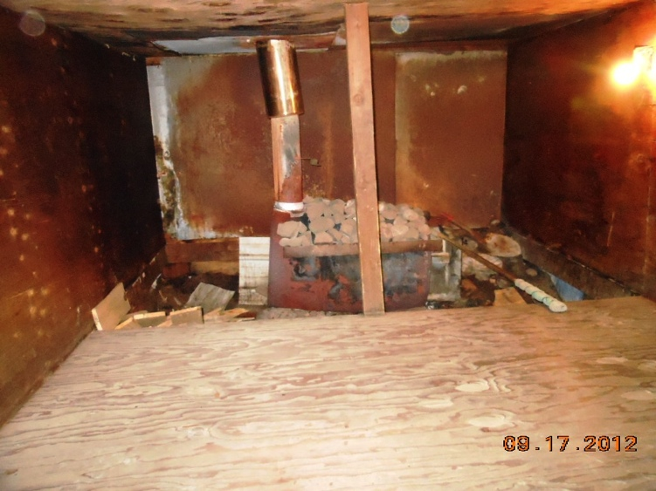
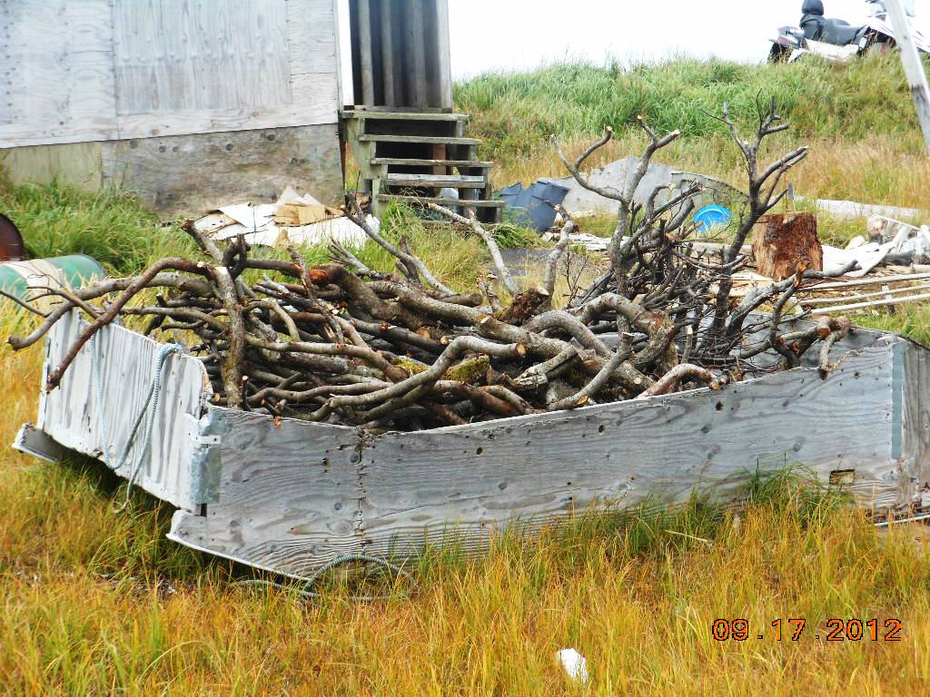
Chefornak: Inside a private steam sauna. Photo credit: Village Safe Water, ADEC
SAUNA/STEAM ROOM
Cleaning Floor, Benches, Stones, Other surfaces
Notes:
Sauna
Saunas provide dry heat in a wood-paneled room from a wood or electric stove. Generally the stove heats rocks, which radiate heat throughout the room. A sauna may have small amount of steam if water is poured over the hot rocks, however a sauna overall provides dry heat. The temperature in a sauna typically ranges from 160-200 degrees Fahrenheit with a low level of humidity (ranging from 5-30 percent). Steam rooms, on the other hand provide moist heat from a water-filled generator pumping steam into the enclosed room. The temperature in a steam room typically ranges from 110-114 degrees Fahrenheit with a humidity level of 100 percent.
Because they use mostly dry heat, saunas are largely self cleaning.
Sauna is much drier, it is harder for the bacteria to take hold. But it is not completely dry, so there can be some danger
Best protection against moisture is proper ventilation and drying after using the sauna.
The environment of a steam room makes it a primer breeding ground for mold and bacteria, necessitating thorough daily cleanings.
Tips for Design/Operation of saunas
A sauna must have a waterproof floor so that it can be easily washed and kept clean. Tile, cement, or heavy duty vinyl are recommended because they are washable and do not absorb water.
To throw water onto the sauna heater rocks, you can only use water that is suitable for household use. Do not use water that contains chlorine like that from a swimming pool or hot tub because it will cause corrosion of your heater
Wood-burning heaters require additional maintenance including the regular removal of ashes. Hire a professional chimney cleaner to clean creosote in the exhaust pipe of a wood sauna to reduce fire dangers.
Do not apply paint, sealants or any preservative on the wood panels. Wood swells and shrinks and tears off paint and sealants, which are only on the surface of the wood. It is best to leave the wood bare. Do not be tempted to paint, oil, or otherwise finish the boards to remove the stains.
It is not necessary to provide a floor drain in a sauna, water should be thrown on the sauna heater rocks with the use of a ladle so that the right amount of water is applied. Once the water hits the rocks, it turns to steam. You should not pour too much water onto the heater. But if you can provide a drain, it may be more convenient for cleaning purposes.

Slide 24
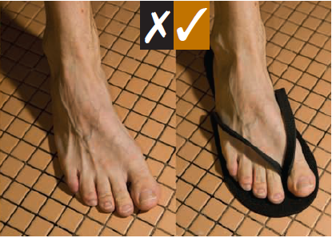
SAUNA/STEAM ROOM
Tips for Design / Operation
images: Toronto Public Health 2008
Notes:
Things sauna operators should tell patrons
insist that sauna users sit on a towel, which provides a barrier between the wood and the oils from sweaty bodies…
Insist users take a cleansing shower before entering the sauna […] to minimize the dirt and toxins taken into the sauna […] allowing clothes in the sauna will bring in extra dirt and chemicals.
Patrons should be encouraged to wear water-resistant rubber-soled sandals or slippers
[CR, NOT SURE THIS WOULD APPLY TO VILLAGES>>>]At the end of the session, take a minute to wipe down the wood and surfaces of the sauna with a clean wet cloth or brush. Lift the duck board from the floor and lean it to dry. Leave the element on and the door closed for a few minutes after everyone has left the sauna. This will allow the heat to dry everything, then leave the door open for ventilation.
The sauna is not a clothes dryer. Don’t let users hangs their wet clothes on the railing around the sauna stove to dry while they shower or do something else.
No spitting on the rocks

Slide 25
References
Feazel et al. (2009) Opportunistic pathogens enriched in showerhead biofilms. Proceedings of the National Academy of Sciences. vol. 106 no. 38
Perth & Kinross Council, UK. Sample showerhead disinfection procedure http://www.pkc.gov.uk/article/3389/Sample-showerhead-disinfe
Flores et al. (2011) Microbial Biogeography of Public Restroom Surfaces PLoS ONE 6(11): e28132
Cardis et al. 2007 Ozone in the Laundry Industry—Practical Experiences in the United Kingdom. Ozone: Science and Engineering, 29: 85–99
Toronto Public Health, June 2008. Public Health Information for Toronto Bathhouses http://www.toronto.ca/health/cdc/cdc_pub_resources/pdf/bathhouse_manual_sept2008.pdf
Gibson, Rose, and Haas (1999) Use of quantitative microbial risk assessment for evaluation of the benefits of laundry sanitation Volume 27, Number 6
Davis et al. (2012) Household transmission of meticillin-resistant Staphylococcus aureus and other staphylococci. Lancet Infect Disease, Vol 12 September 2012
Miller and Diep (2008) Colonization, Fomites, and Virulence: Rethinking the Pathogenesis of Community-Associated Methicillin-Resistant Staphylococcus aureus Infection. Clinical Infectious Diseases 46:752–60
Photo credits: Village Safe Water, Alaska Dept. of Environmental Conservation -- Unless specified otherwise.

