Slide 1
Asset Inventory for Alaska Communities
Dennis Wagner, EPA
Alaska Infrastructure Programs Manager

Slide 2
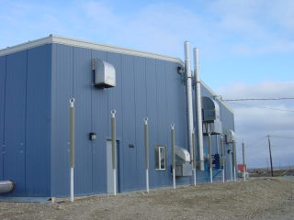
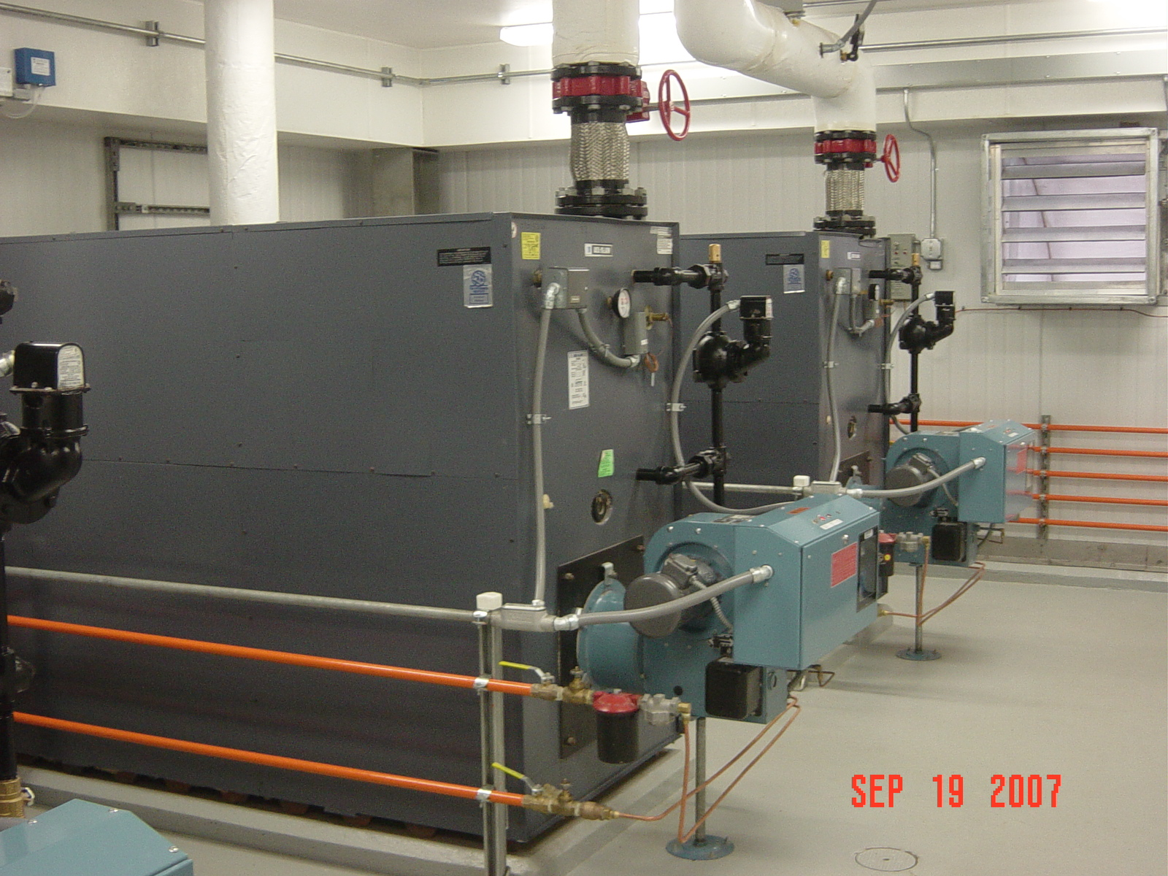
What is an Asset?

Slide 3
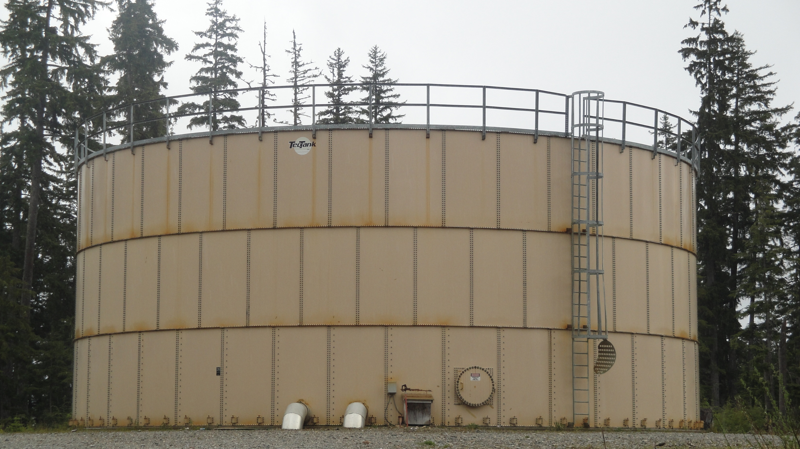
Over $2 Billion Invested in Rural Alaska Water and Wastewater Infrastructure

Slide 4
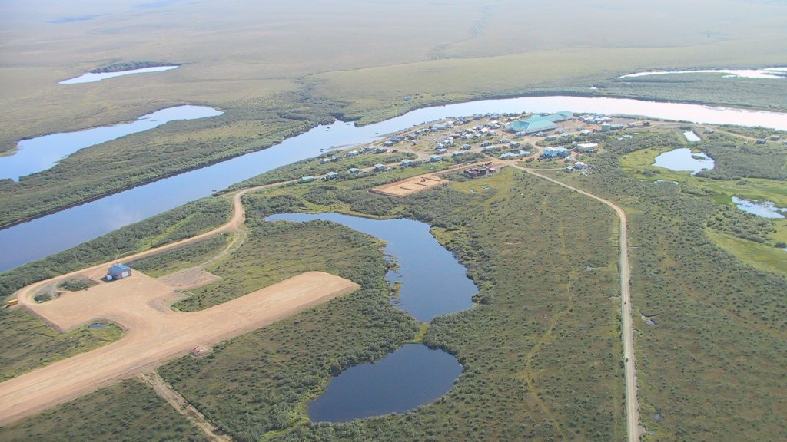
The Investments Have Been Made in Over 200 Rural Communities

Slide 5
The $2 Billion Question: What Have These Investment Provided?
Number of Communities with Piped Systems
Number of Lagoons
Number of Water Treatment Plants and Conditions
Existing Assets for 2011 Tribal Drinking Water Infrastructure Needs Survey
Asset inventory, the hardcopy version
Assets Threatened Due to Changing Environmental Conditions

Slide 6
Asset Inventory On A Community Basis

Slide 7
Answering The $2 Billion Question
Developing an asset inventory database
Asset (WST, WTP, Wells, Mains, Lagoons..)
Quantity (Feet, Gallons, Acres)
Materials
Age (Year installed)
Condition
A- No deficiencies related to the asset providing the intended service
B - Deficiencies that can be address with sufficient O&M practices
C - Deficiencies decreasing efficiencies and increasing O&M costs
D - Deficiencies effecting the quantity or quality of service and cannot be addressed by sufficient O&M practices
F - No longer capable of providing service, structurally failing, beyond repair
Verify asset information
Maintaining asset information

Slide 8
Other applications of an W&S infrastructure assets inventory:
Useful in preparation for future funding/ having “ducks in a row” regarding need/vulnerable assets. Will allow managers and funders to be less subjective in the decision making process.
Promotes community understanding of water and sanitation system value

Slide 9
Goal for Todays Workshop
Discuss the value of an asset inventory database
Discuss how to develop an asset inventory database
Discuss ideas on how to collect and verify existing assets
Discuss how to classify the condition of the assets, grades
Grades for condition
Grade for threat
Grade for impact of loss
Grade for health impacts
Discuss how to keep the asset information current
Changing conditions
New Investments in infrastructure
Comprehensive asset inventory useful from a community to a statewide basis
Weighting/prioritization approach for the at-risk infrastructure identified

Slide 10
Questions

